Slide 1

Expert elicitation - Cotopaxi
17-Jul-2024

Slide 2
Experts' weights
Expert elicitation 17-Jul-2024

Slide 3
Experts' weights
Expert elicitation 17-Jul-2024
Expert ID | Cooke
Exp1 | 19.25
Exp2 | 1.71
Exp3 | Below threshold
Exp4 | 21.96
Exp5 | 8.29
Exp6 | 9.00
Exp7 | Below threshold
Exp8 | 4.01
Exp9 | Below threshold
Exp10 | 20.00
Exp11 | 6.07
Exp12 | 4.31
Exp13 | Below threshold
Exp14 | Below threshold
Exp15 | Below threshold
Exp16 | Below threshold
Exp17 | 5.40
Equal weight = 5.88
For Cookes' method, below threshold weight does not mean zero score. It simply means that this expert's knowledge was already contributed by other experts and adding this expert would not change significantly the results.

Slide 4
Seed Answers
Expert elicitation 17-Jul-2024

Slide 5
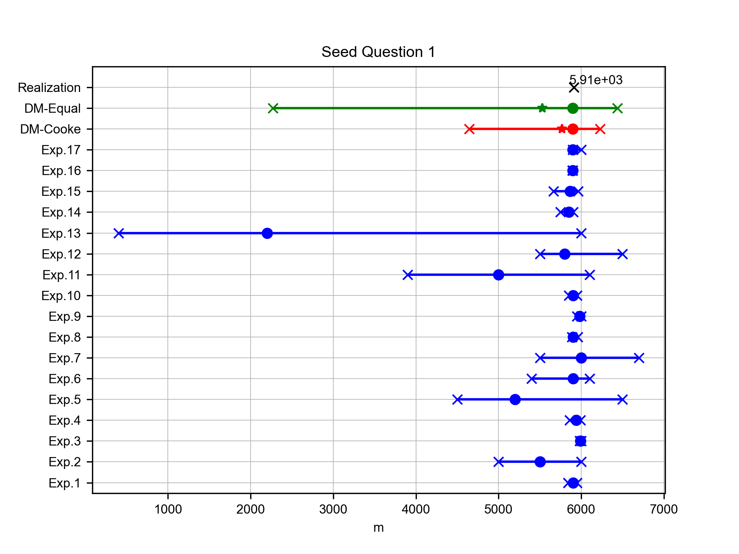
Elevation of Cotopaxi
Expert elicitation 17-Jul-2024
What is the elevation (in m a.s.l.) of the Cotopaxi volcano? (Data source: GVP database [2018])

Slide 6
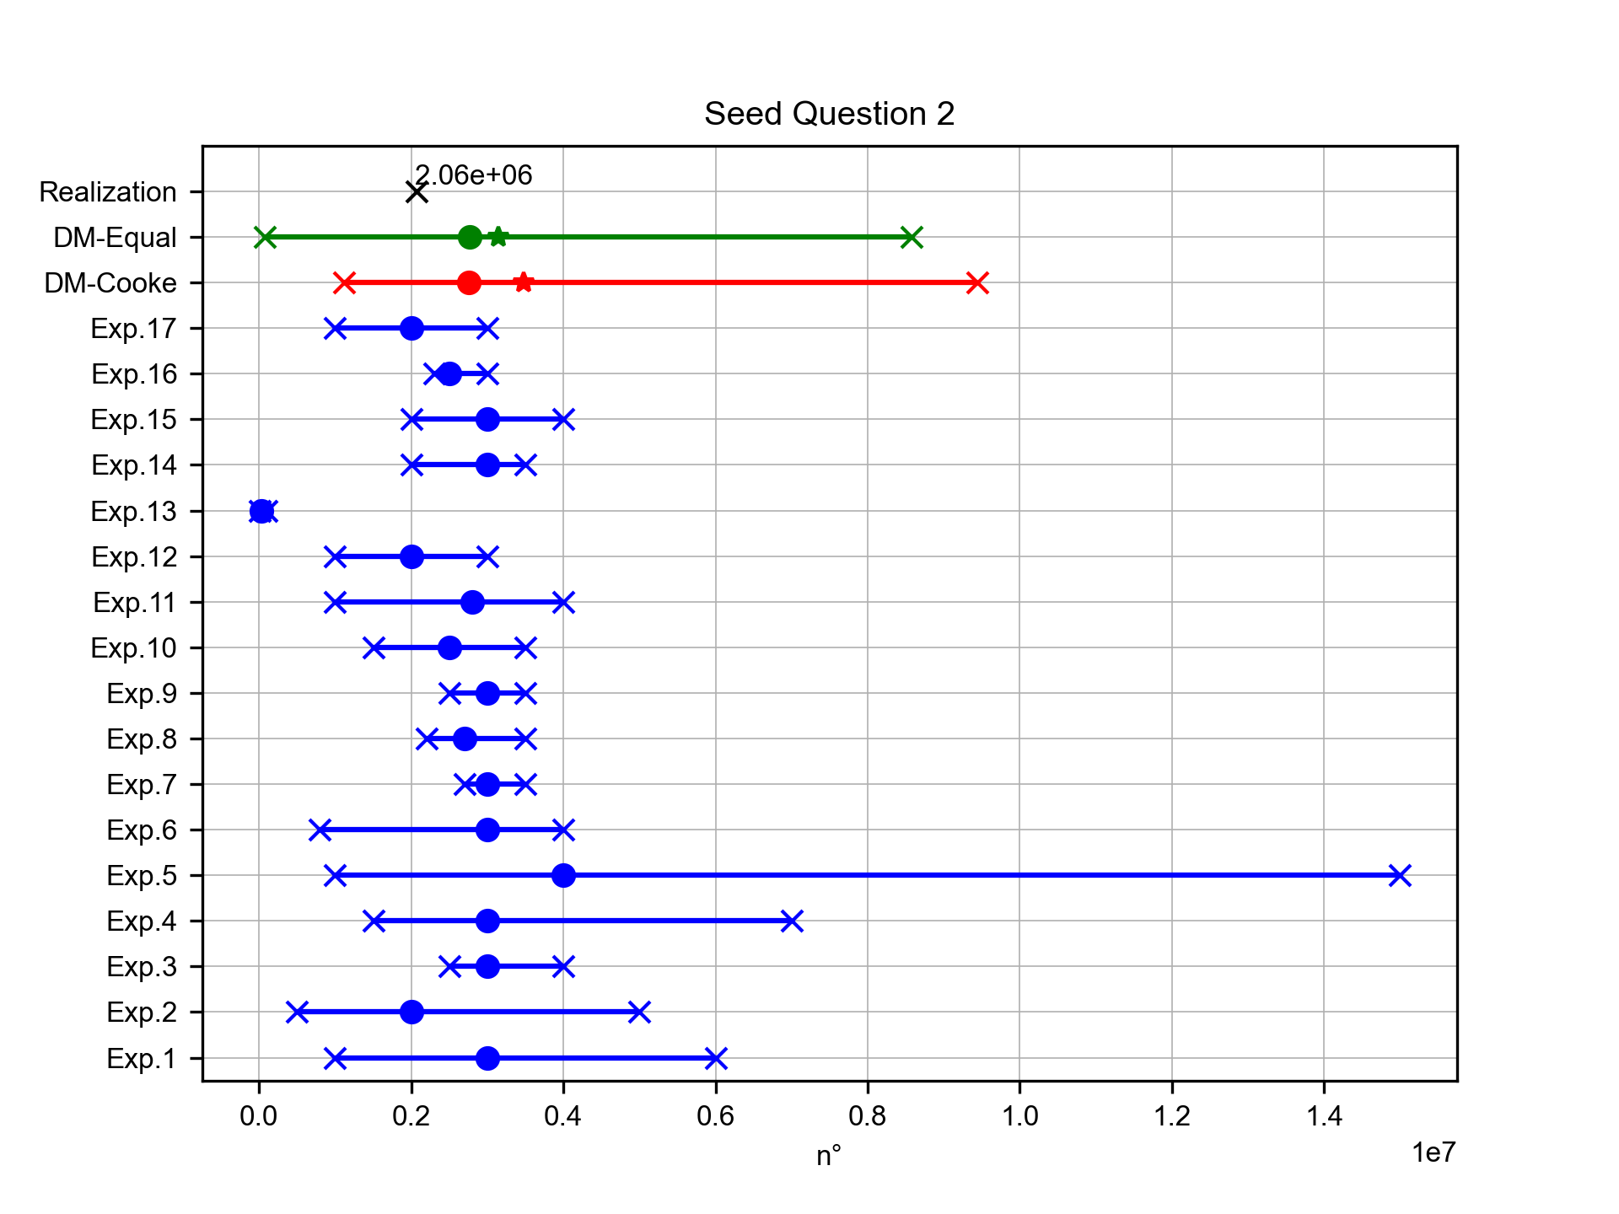
People living close to Guagua Pichincha
Expert elicitation 17-Jul-2024
According to the GVP database [2018], how many people live within a radius of 30 km from the crater of the Guagua Pichincha volcano?

Slide 7
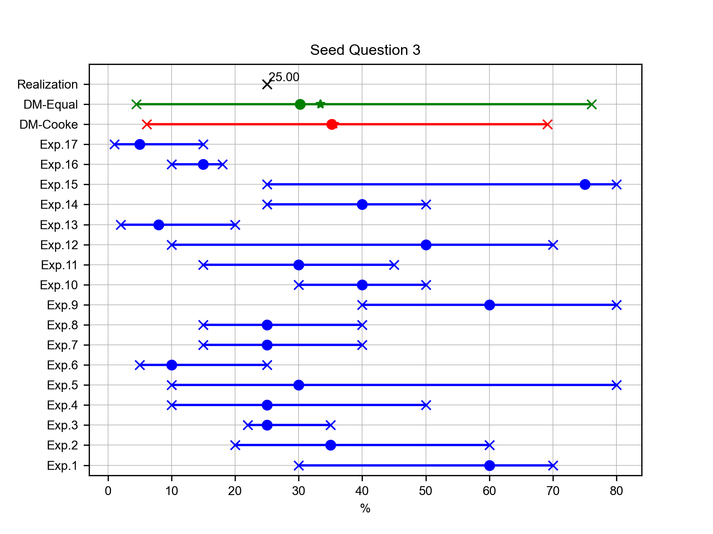
Percentage of VEI4+ eruptions at Cotopaxi
Expert elicitation 17-Jul-2024
Given your knowledge of the frequency of activity over the past ~4 ka at Cotopaxi volcano and based on the total number of eruptions (76) for which a VEI index has been estimated, what percentage were VEI 4 or higher eruptions? (Data source: GVP database [2018])

Slide 8
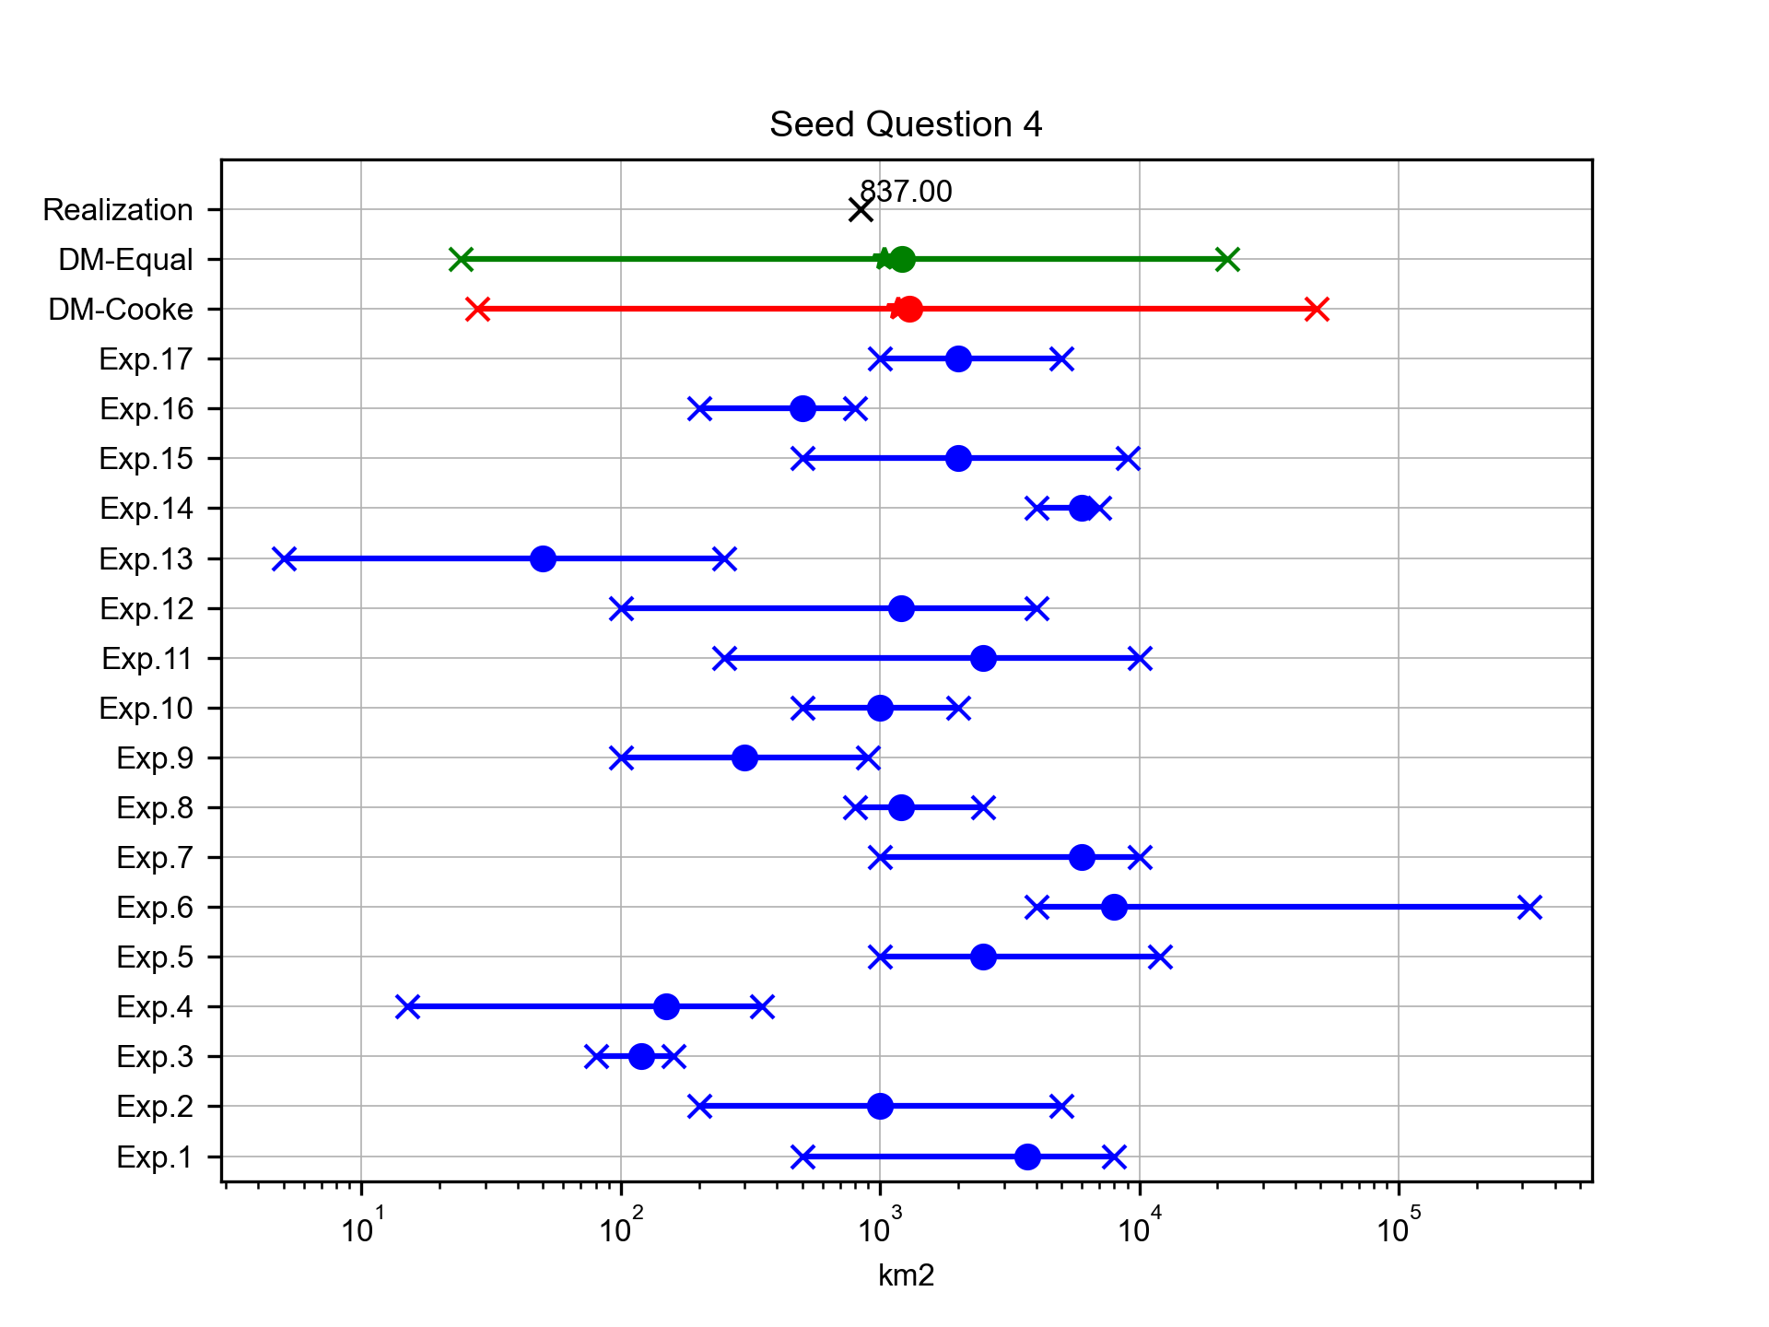
Mean area of 10 cm isopach for Plinian eruptions at Cotopaxi
Expert elicitation 17-Jul-2024
Robin et al. [2008] derived from field data the isopach maps of the fallout deposits from the three Plinian eruptions (1660 AD, 970 AD and 70 AD) at Guagua Pichincha volcano. What is the mean surface area (in km2) enclosed by the 10 cm isopach lines of the fallout deposits? (e.g., the three surface areas of the corresponding 10 cm isopach for the three eruptions are, respectively, 2000, 300 and 10000 km2, the mean value is therefore 4100 km2)

Slide 9
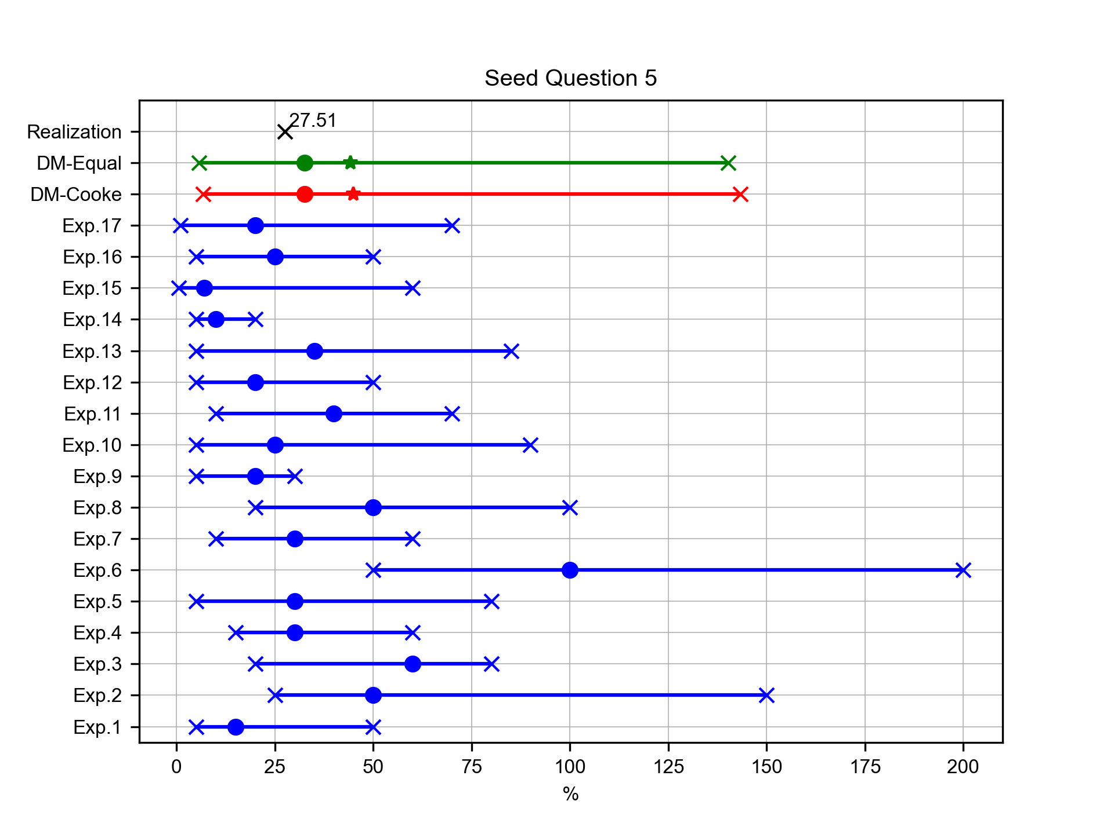
Mean relative uncertainty of eruption duration for Layers 3-5 at Cotopaxi
Expert elicitation 17-Jul-2024
Biass and Bonadonna (2011) quantified the uncertainty associated with the estimation of eruption durations for past eruptions: they applied different methodologies (empirical and analytical) for calculating total mass and MFR, and they quantified the propagation of uncertainty up to the final estimation of eruption duration (total mass/MFR). In this way, they calculated such parameters for the Plinian eruptions of Layer 3 and Layer 5 of Cotopaxi volcano. What is the mean relative uncertainty (in %) with respect to the calculations of eruption duration for Layers 3 and 5 made by Biass and Bonadonna (2011)? (example: two estimations have values of 500±5 minutes and 350±150 minutes; the two relative uncertainties are [5/500]*100=1% and [150/350]*100=42.8% and the mean is 21.9%)

Slide 10
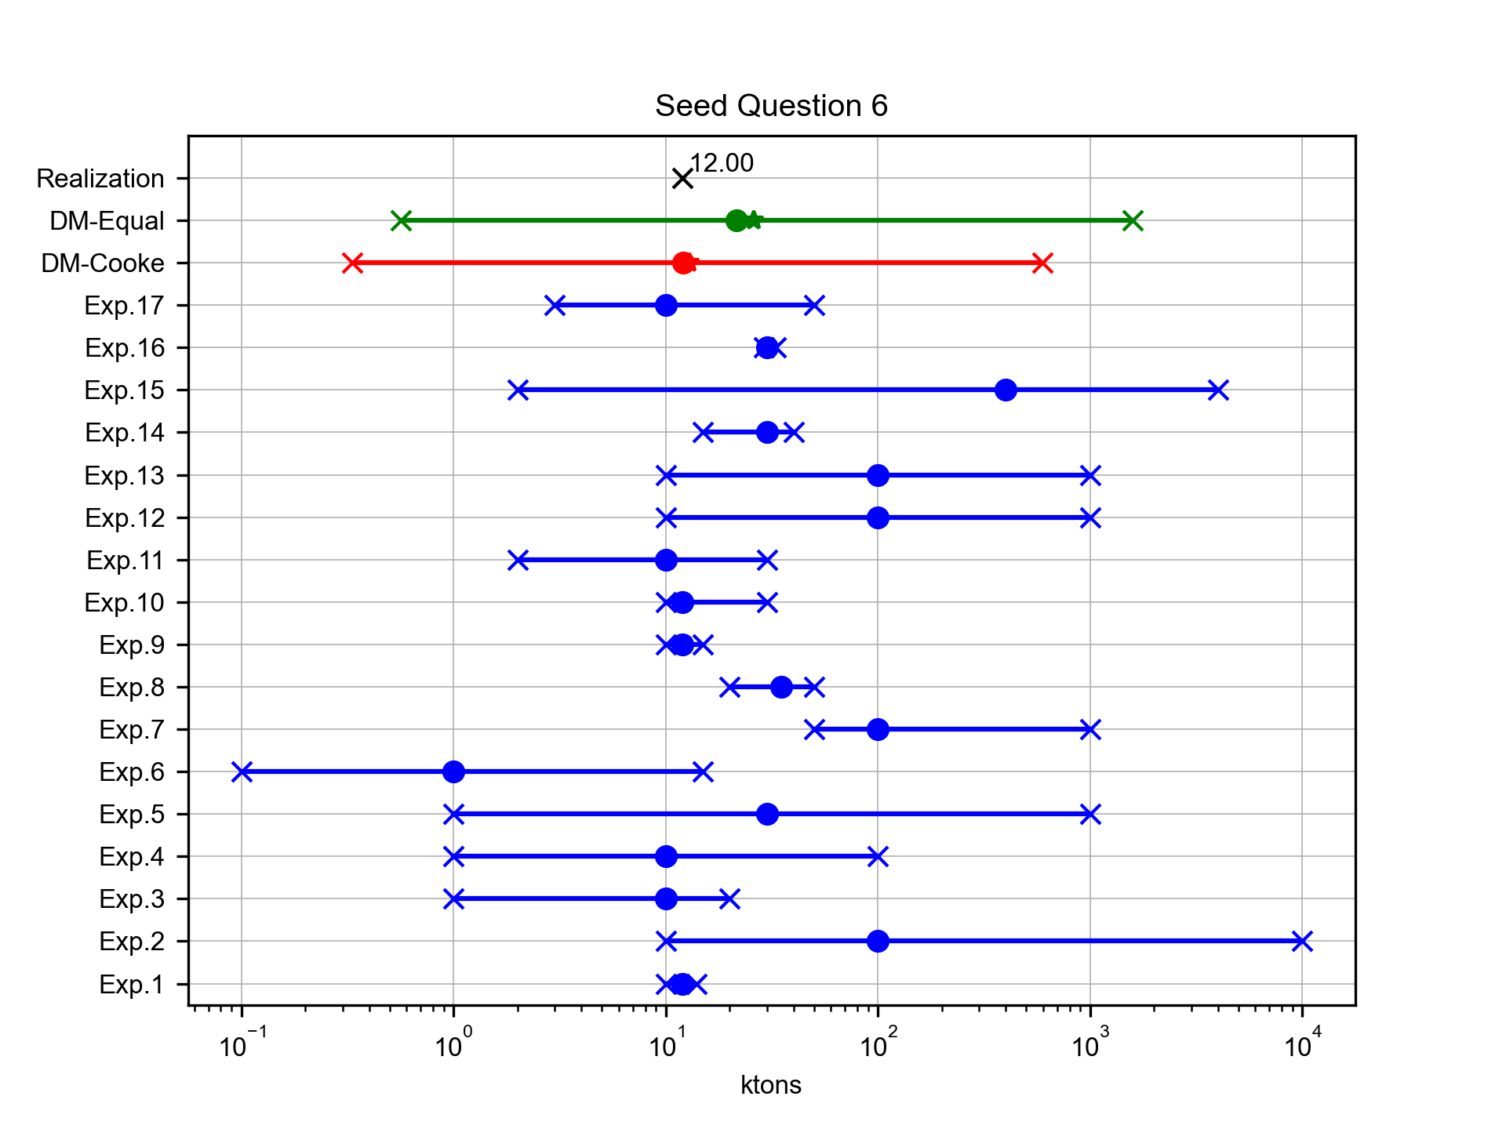
Total SO2 production from Tungurahua at 14/07/2006
Expert elicitation 17-Jul-2024
Carn et al. [2008] measured the daily emission of SO2 from active volcanoes in Ecuador between September 2004 and September 2006 from the Ozone Monitoring Instrument (OMI) on NASA's EOS/Aura satellite. How much was the total SO2 production (in ktons) of the 14/07/2006 eruptive event of Tungurahua (duration 1 day)?

Slide 11
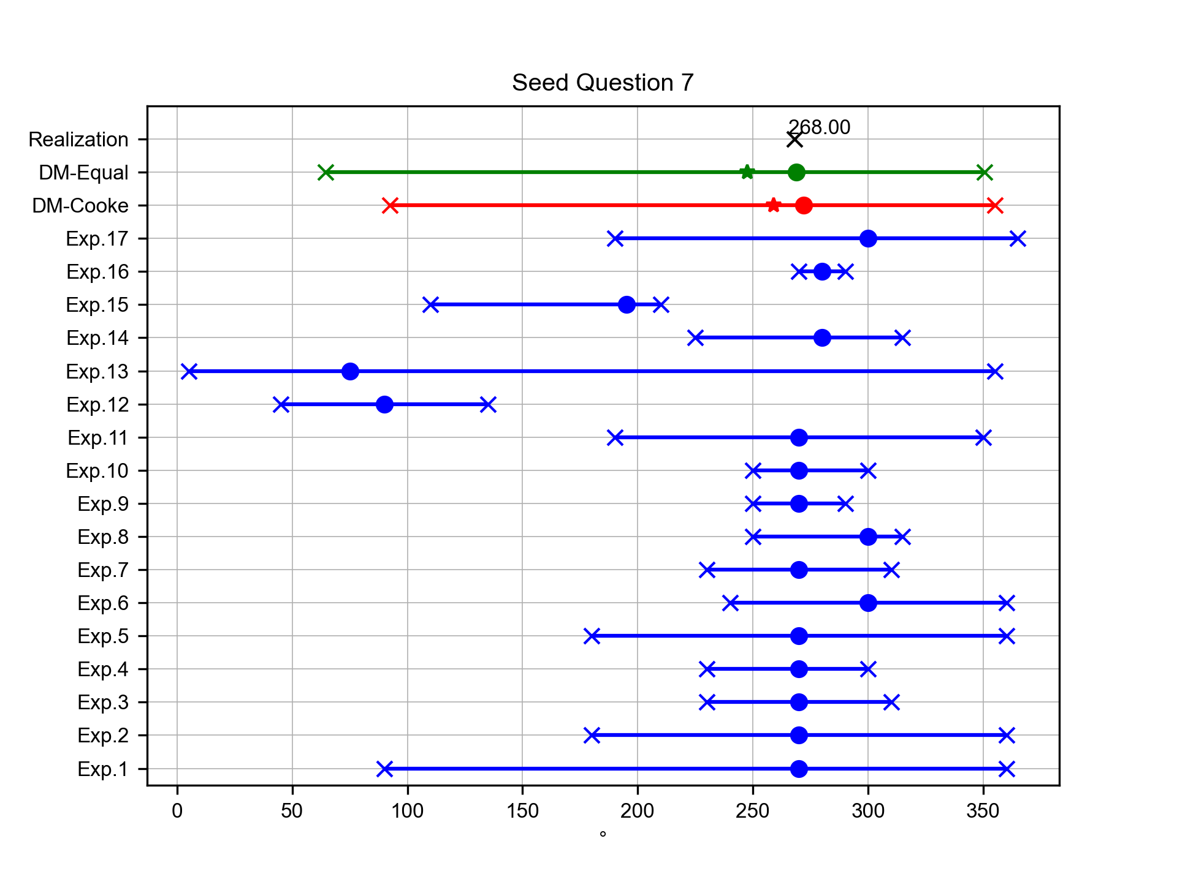
Mean elongation direction of fallout deposits for Plinian eruption at Cotopaxi
Expert elicitation 17-Jul-2024
What is the mean direction (in degrees from N) of the axis of main elongation of the isopachs (i.e. the downwind range) of the F2, F4, Layer 3 and Layer 5 plinian fall deposits at Cotopaxi volcano, described in Hall and Mothes [2008] and Barberi et al. [1995]?

Slide 12
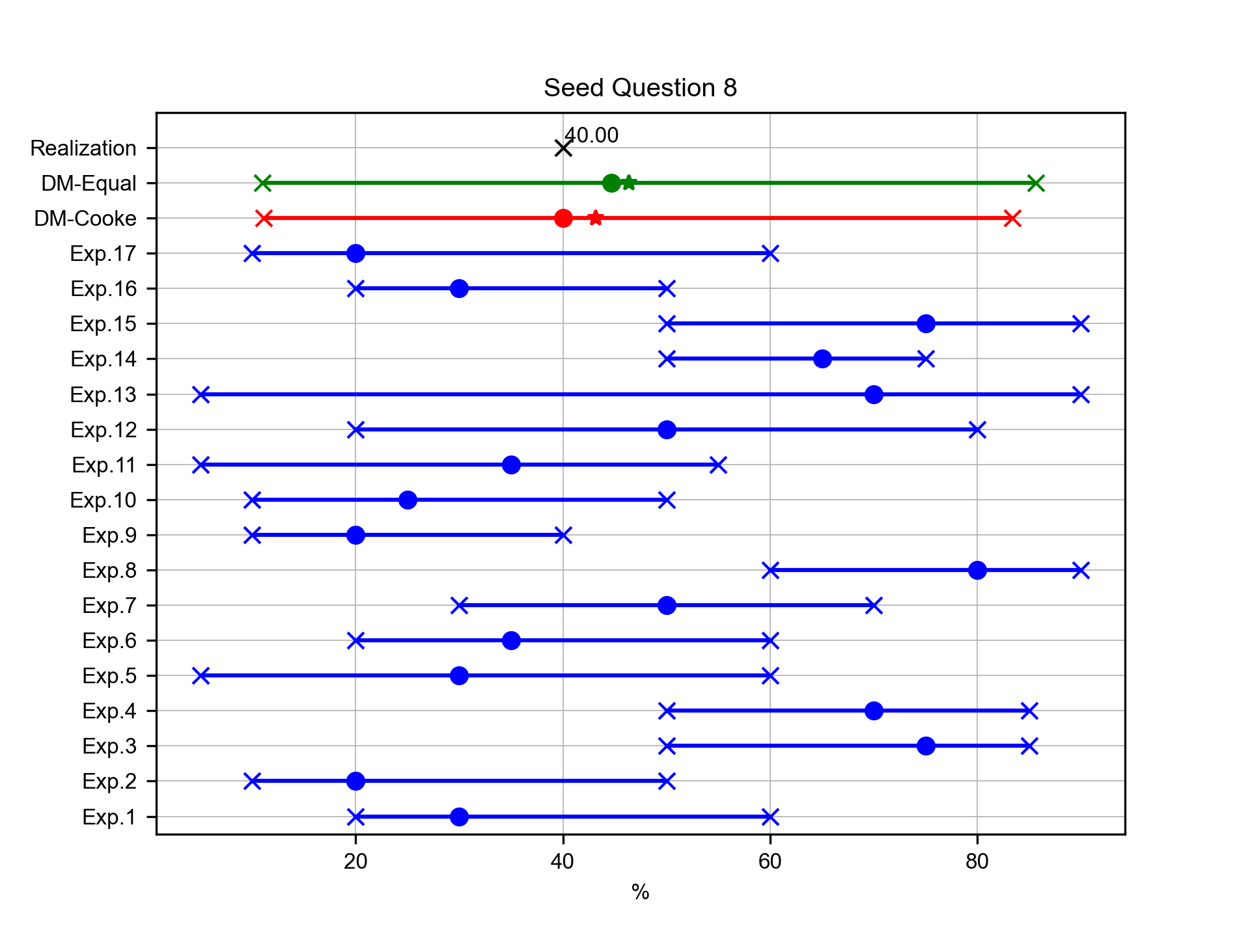
Volumetric percentage of andesites at Cotopaxi (last 0.5 Ma)
Expert elicitation 17-Jul-2024
With respect to the calculations of Hall and Mothes [2008], what is the percentage (volumetrically) of volcanic products of andesitic composition with respect to the total amount of material erupted over the past 0.5 Ma at Cotopaxi volcano?

Slide 13
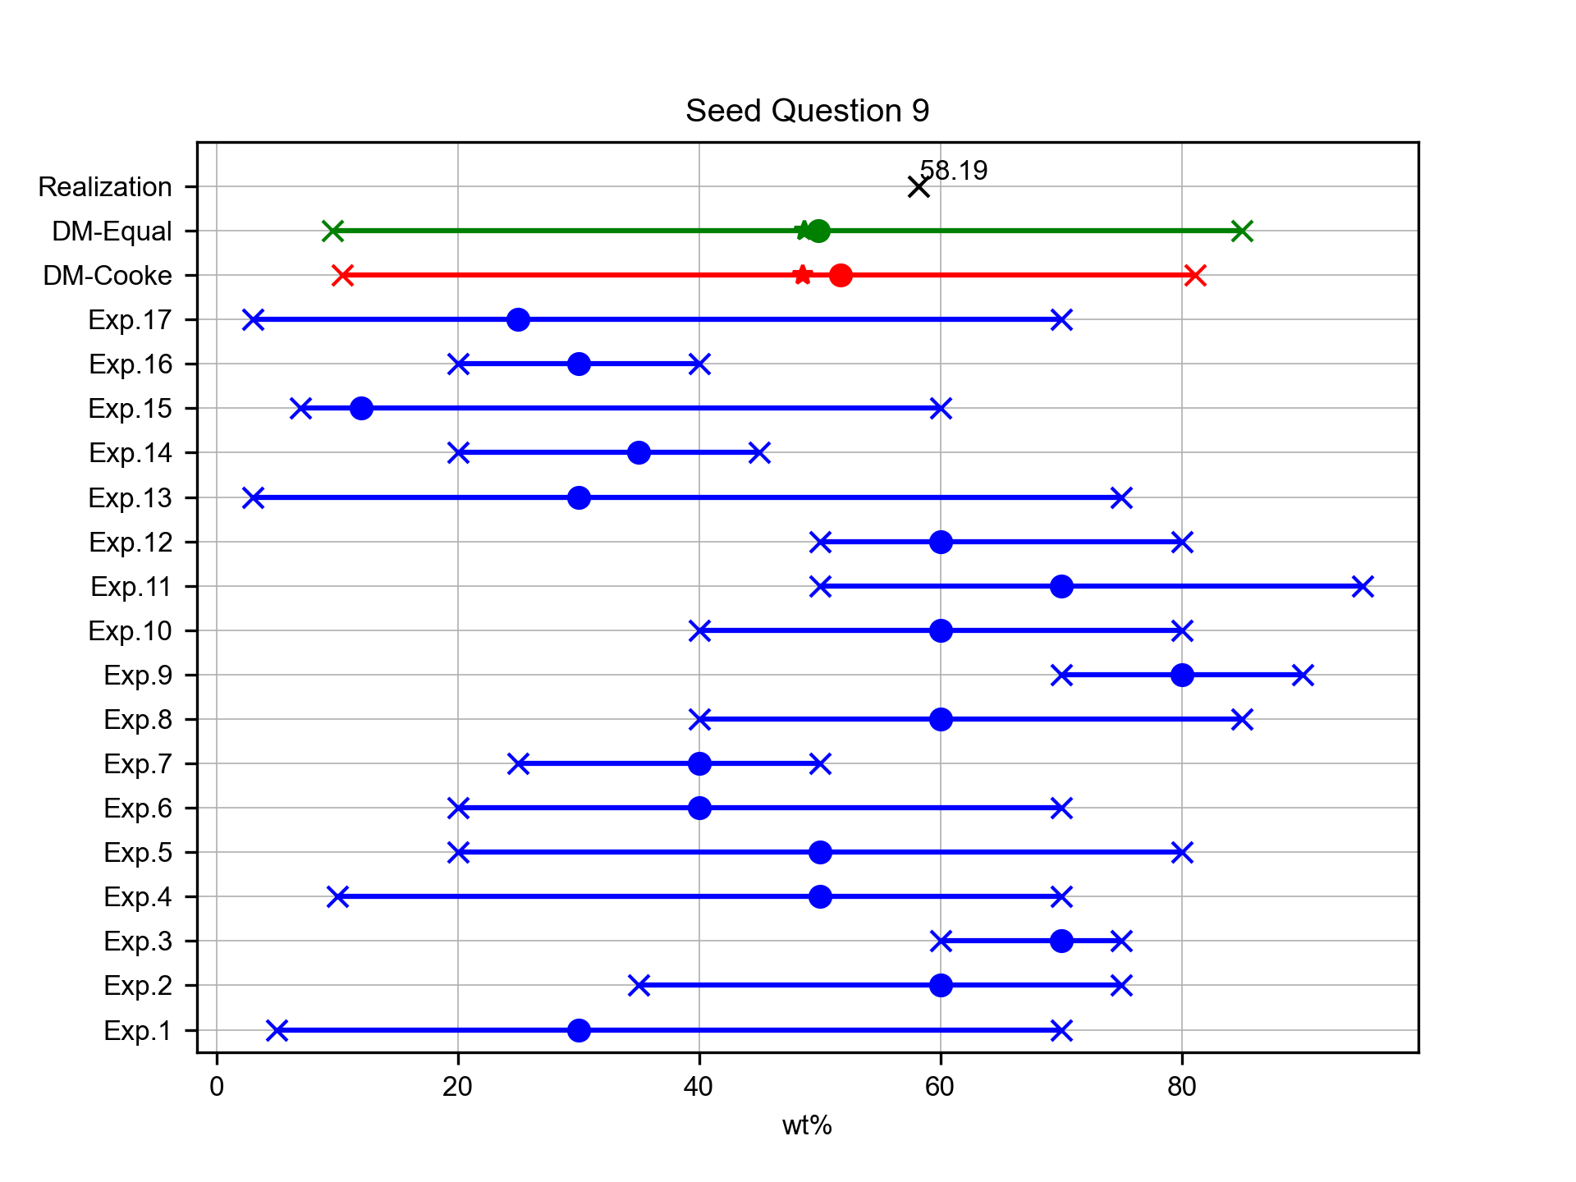
Average amount of ash in BF2 layer of Pululagua
Expert elicitation 17-Jul-2024
Volentik et al. [2010] calculated the Total Grain Size Distribution for the climactic phase of the 2450 BP Plinian eruption of Pululagua volcano (BF2 layer) using different techniques and datasets. According to their calculations, what is the average amount (in wt%) of ash (D < 2mm) in this layer?

Slide 14
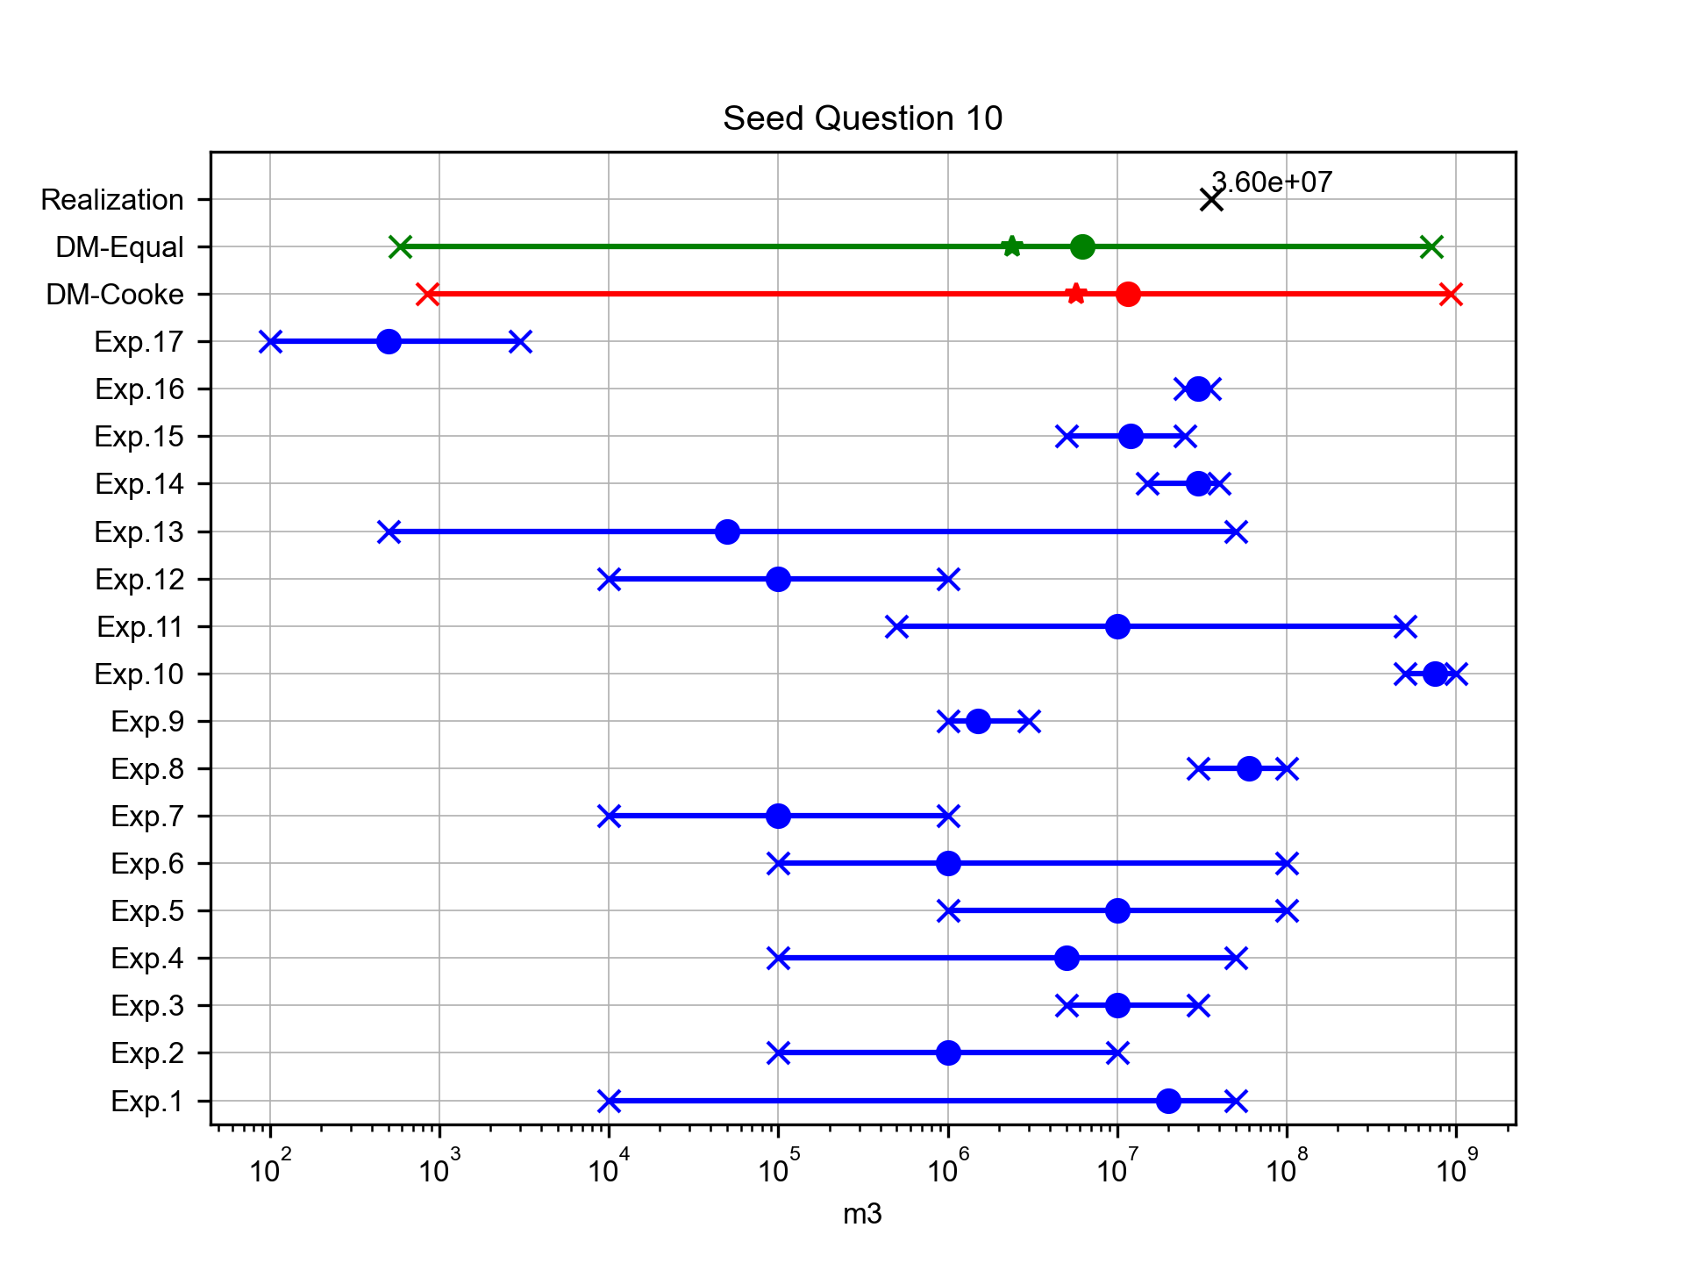
Total volume of lava flow deposits of the 2002 eruption of Reventador
Expert elicitation 17-Jul-2024
The complex sub-Plinian to Plinian 2002 eruption of El Reventador produced different types of volcanic deposits (tephra fall, PDC and lava flows). What is the total volume (in m3) of lava flow deposits? (Sources: Johnson et al. [2006]; Ridolfi et al. [2008])

Slide 15
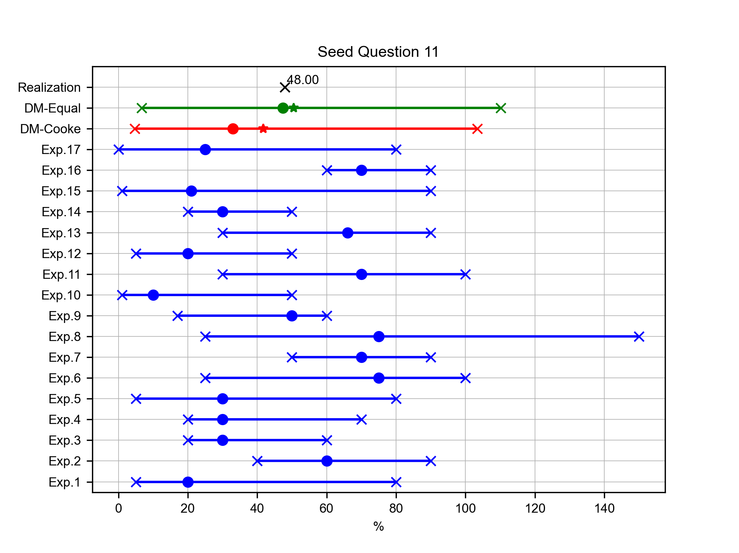
Mean difference between min-max estimation of Terminal Fall Velocity
Expert elicitation 17-Jul-2024
Terminal Fall Velocity (TFV) is a parameter that strongly controls particle sedimentation, and various models for calculating this parameter have been proposed. Alfano et al. [2011] compared alternative existing models and different morphological characterizations of particles for the calculation of TFV of tephra particles from various eruptions. According to their results, what is the mean difference (in %) between the maximum and the minimum estimates of TFV for the grain size φ = -1 (2 mm) for tephra particles of Fontana Lapilli deposit from the basaltic Plinian eruption of Masaya volcano (Nicaragua)?

Slide 16
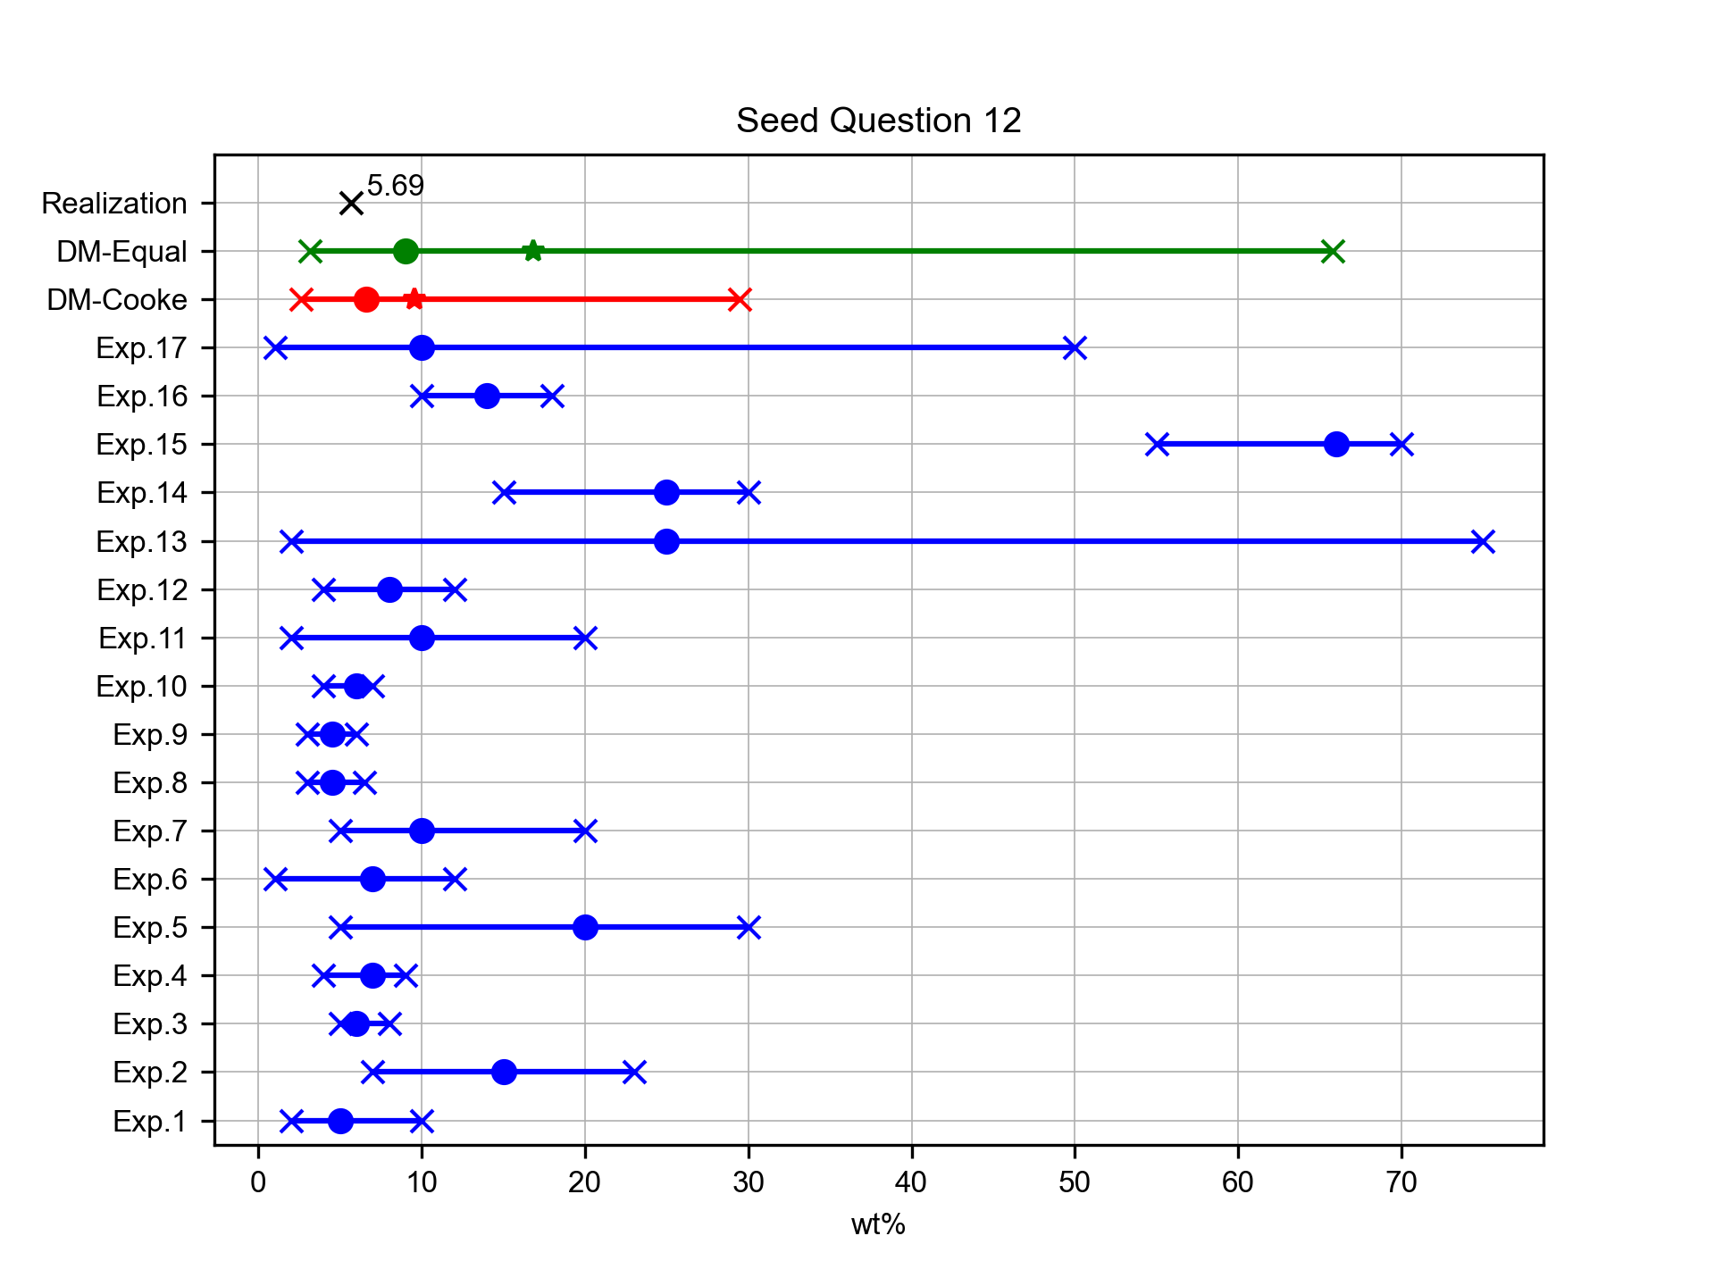
Mean wt% of Na2O+K2O of Guagua Pichincha products (last 55 ka years)
Expert elicitation 17-Jul-2024
What is the mean content (in weight %) of Na2O+K2O of the volcanic products of the Guagua Pichincha volcano from the last 55 ka years, as reported in Chiaradia et al. [2009]

Slide 17
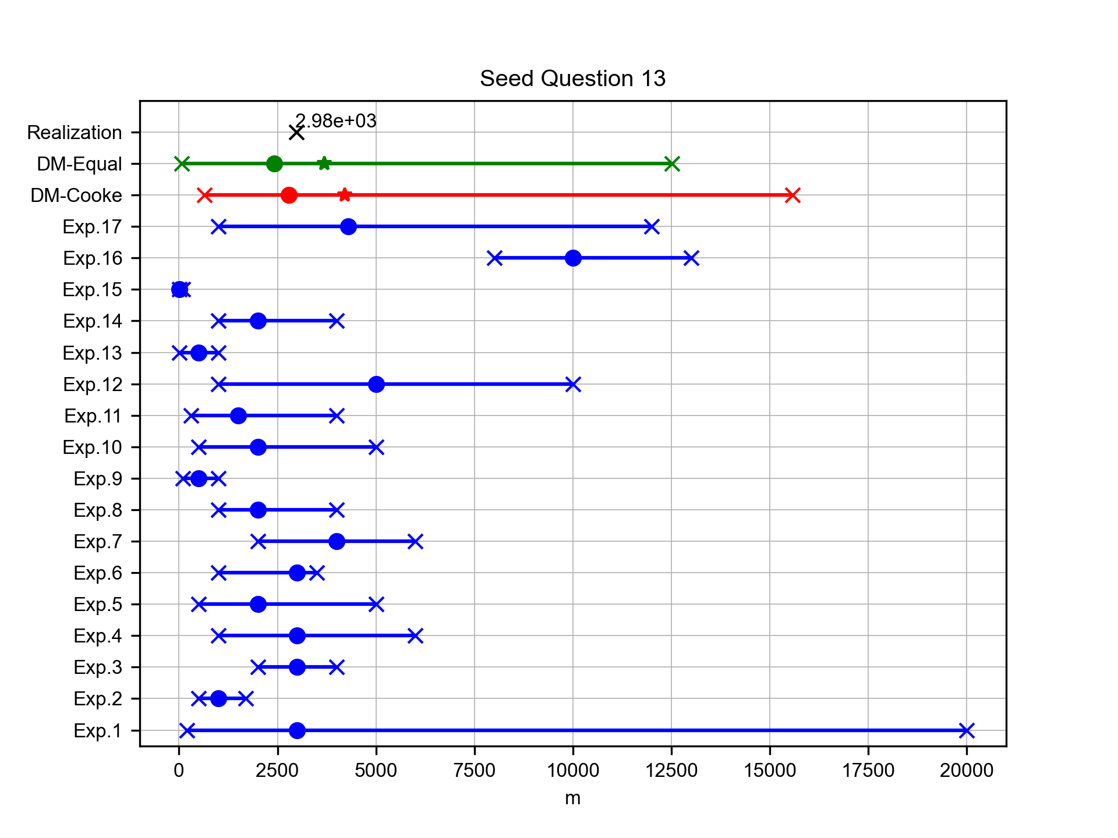
Mean difference between min-max estimation of plume heights for the August 2006 eruption at Tungurahua
Expert elicitation 17-Jul-2024
For the calculation of volcanic plume heights without using field deposit data, several techniques are presently available. Among them, Steffke et al. [2010] used the velocity determination and plume top temperature (PTT) models to calculate the plume heights (above vent level) of the most recent eruptions at Tungurahua volcano. What is the mean difference (in m) between the minimum and the maximum estimation of plume heights (above vent level) for the whole August 2006 eruption (25 measurements every 30 min; period 16/08/2006 20:15 – 17/08/2006 11:15)?

Slide 18
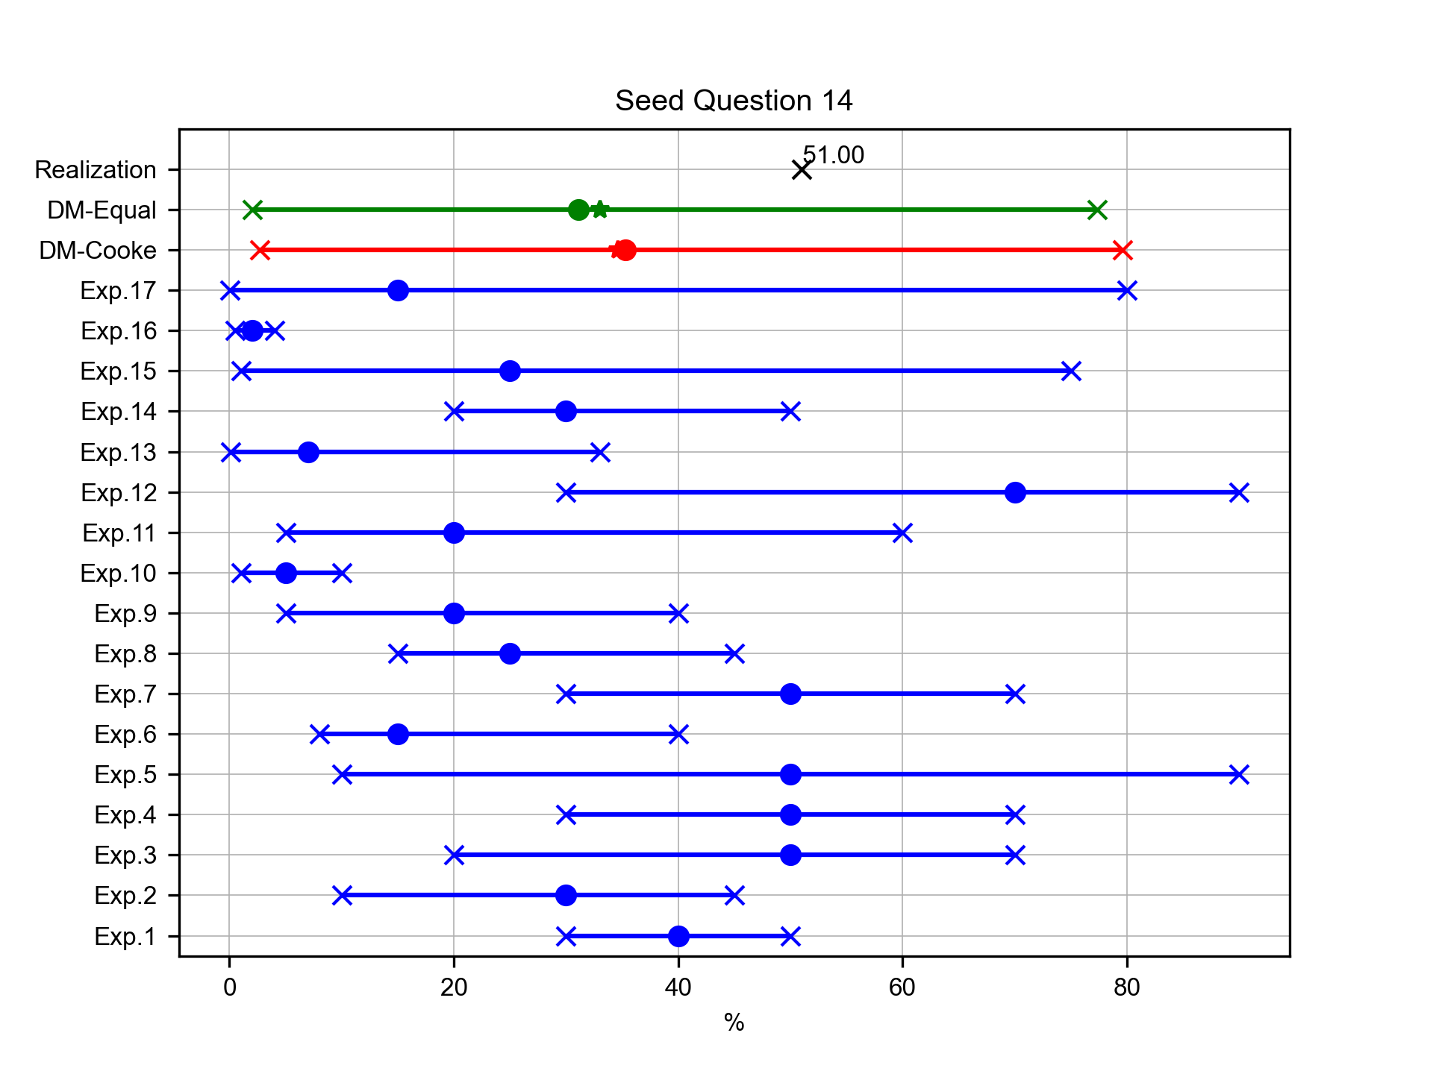
Mean value of porosity for 1999 eruption of Guagua Pichincha
Expert elicitation 17-Jul-2024
Wright et al. [2007] measured the values of connected porosity (i.e. the volumetric part of the sample through which gases and/or liquids can freely flow) for 9 breadcrust bombs from the 1999 vulcanian eruption of Guagua Pichincha volcano. What is the mean value of connected porosity (in %) of the samples studied?

Slide 19
Target Answers
Expert elicitation 17-Jul-2024

Slide 20
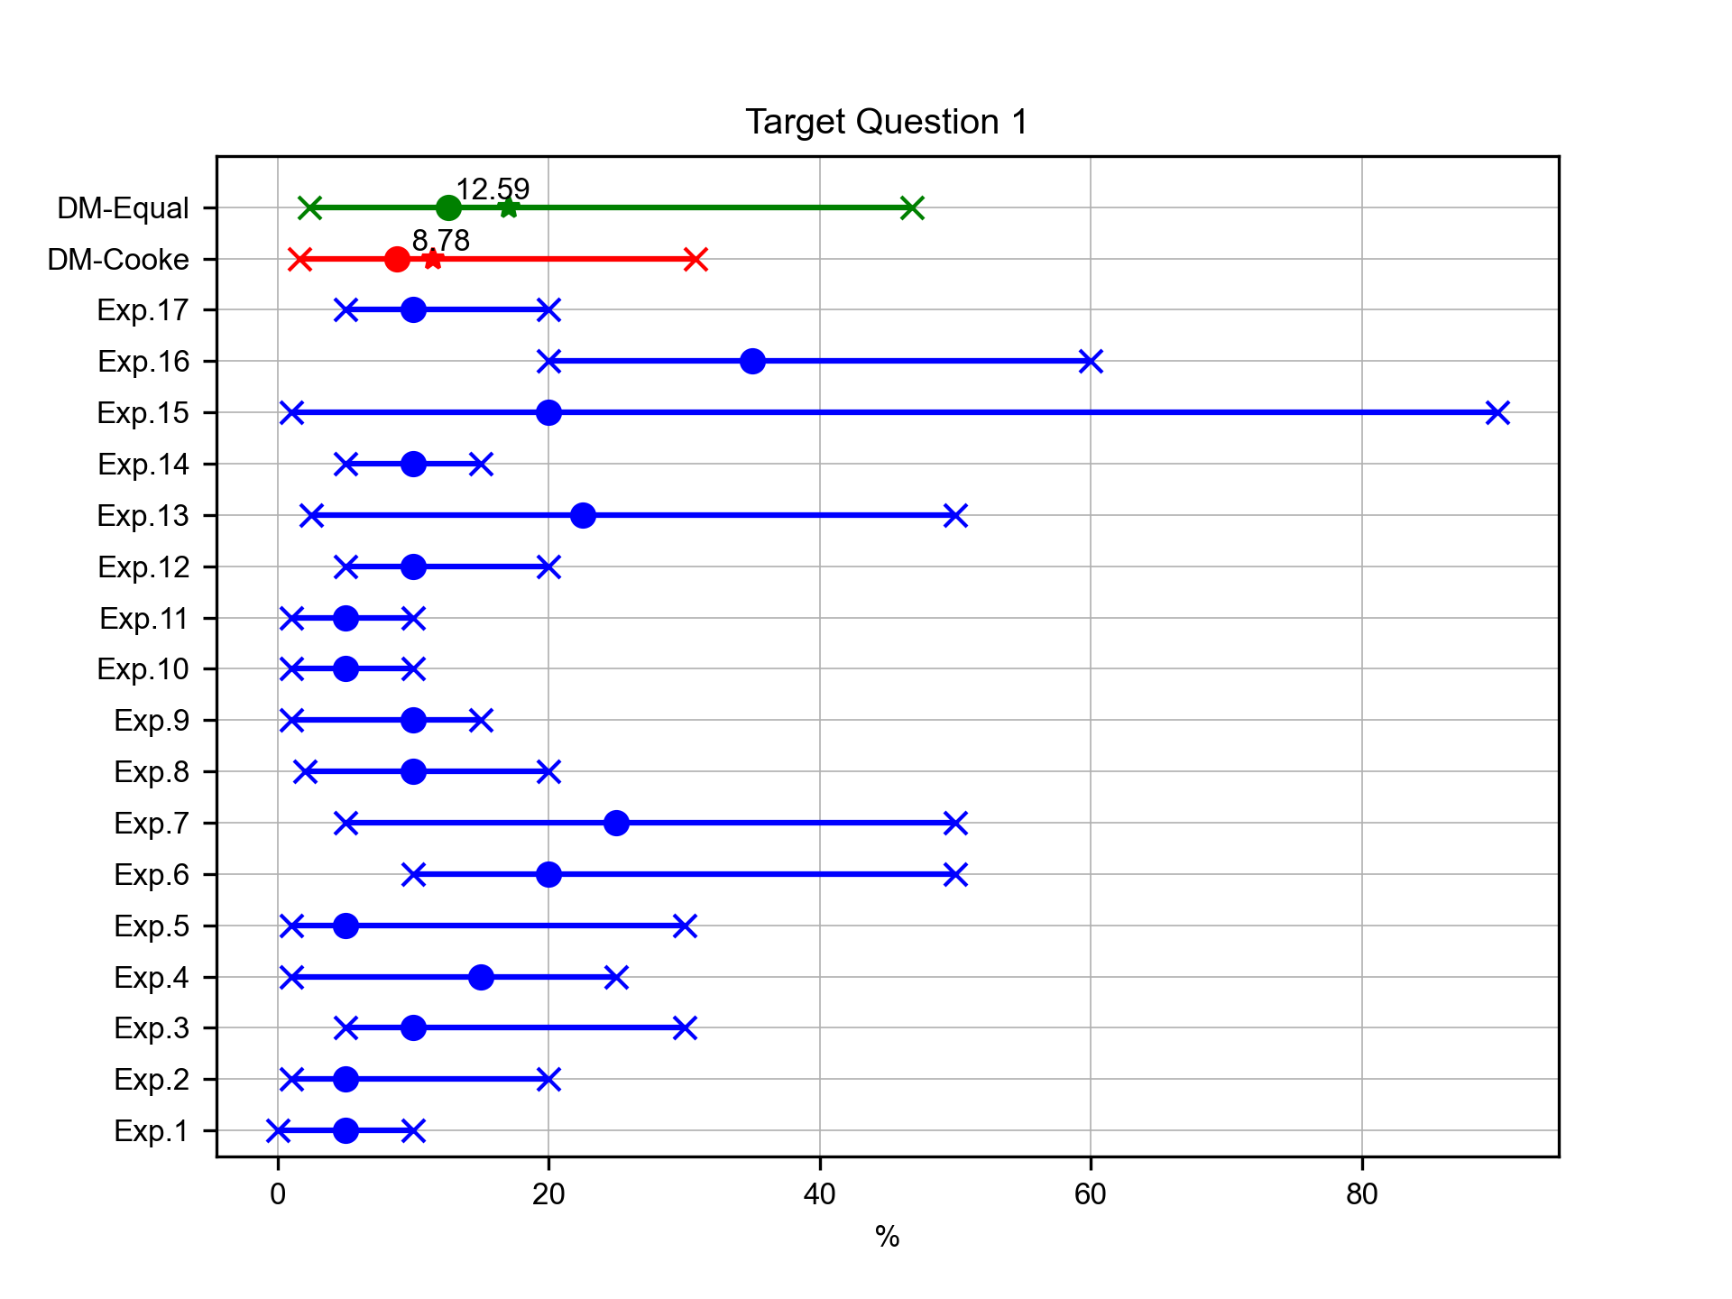
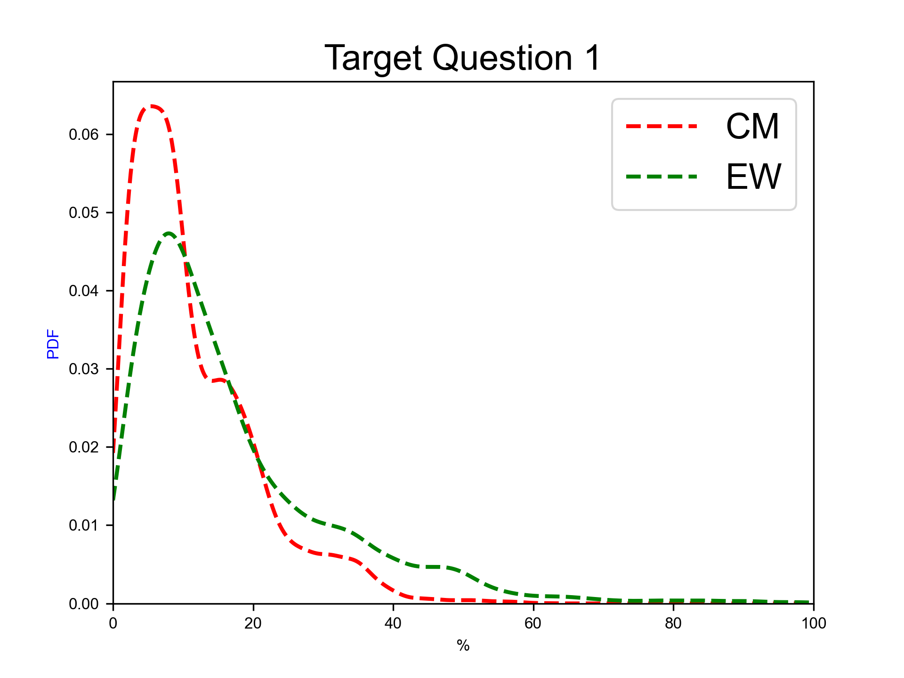
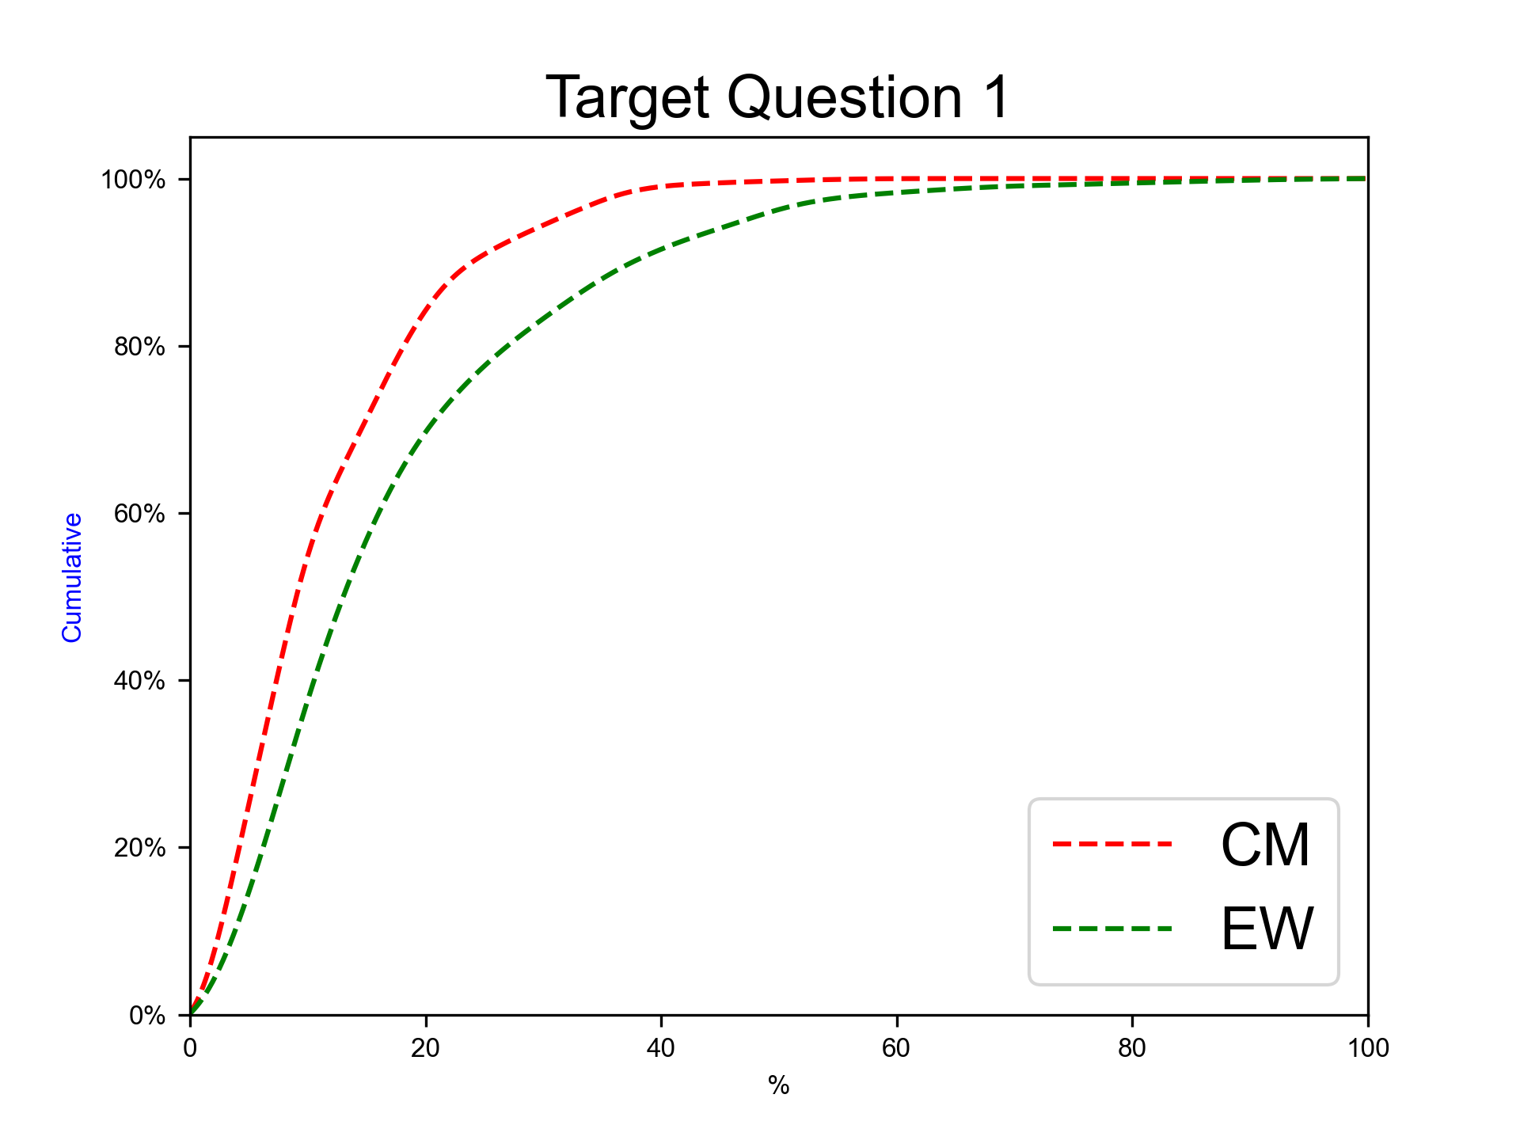
Next eruption, rhyolitic magma
Expert elicitation 17-Jul-2024
Given the present state of Cotopaxi volcano and your knowledge of its past eruptive chronology, how much probability do you assign to the possibility that, for the next eruption at Cotopaxi, the magma involved would be totally or predominantly of rhyolitic composition?
N.B. The sum of 50%iles for questions 1-2 have to sum to 100.0.

Slide 21
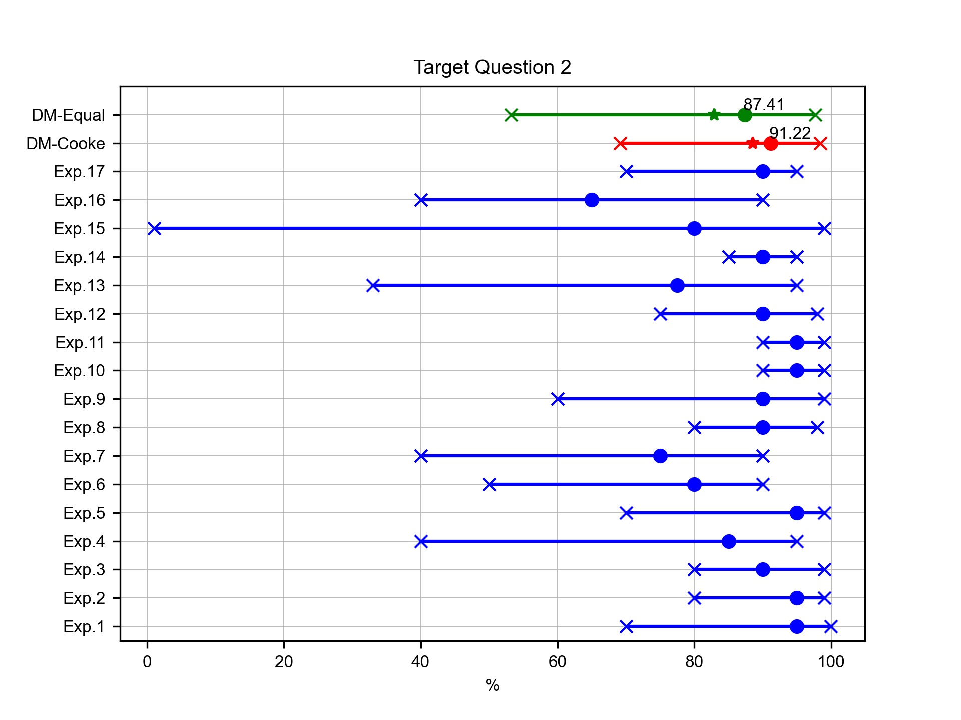
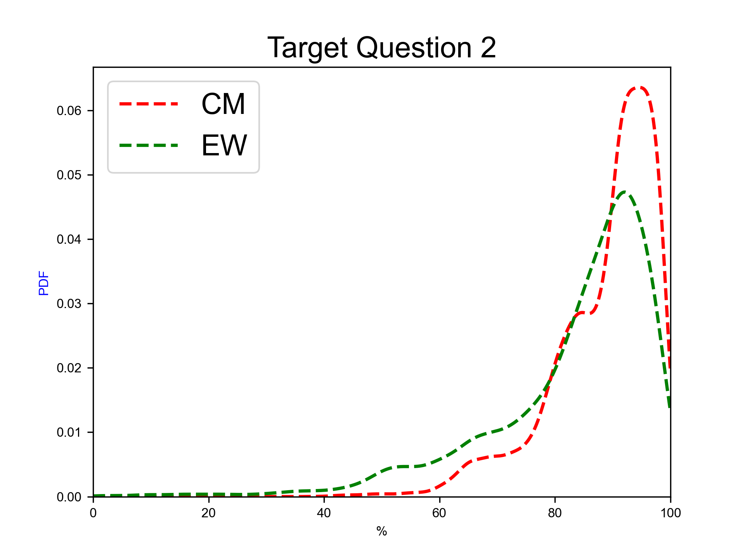
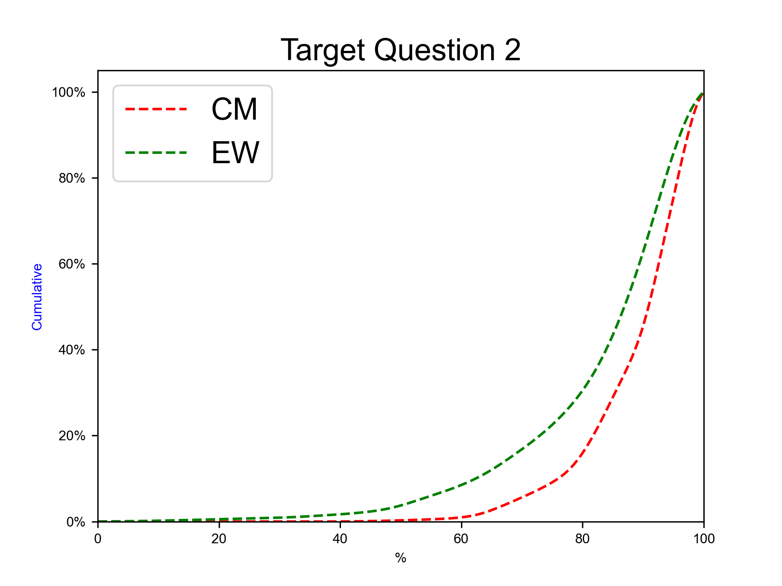
Next eruption, andesitic magma
Expert elicitation 17-Jul-2024
Given the present state of Cotopaxi volcano and your knowledge of its past eruptive chronology, how much probability do you assign to the possibility that, for the next eruption at Cotopaxi, the magma involved would be totally or predominantly of andesitic composition?
N.B. The sum of 50%iles for questions 1-2 have to sum to 100.0.

Slide 22
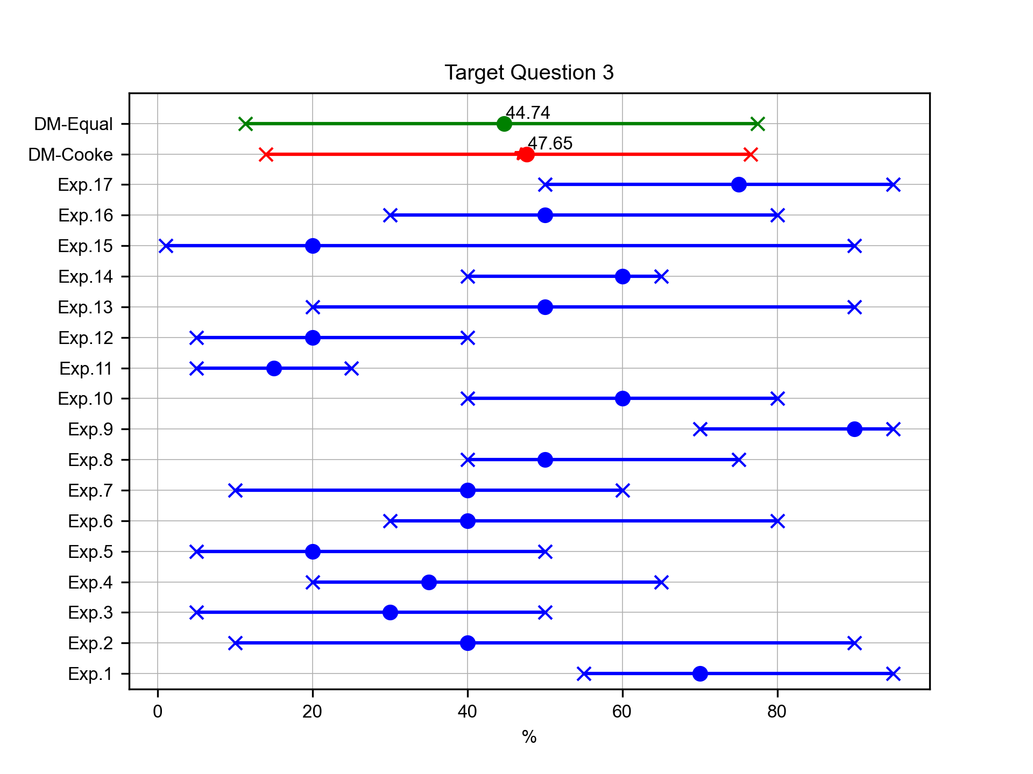
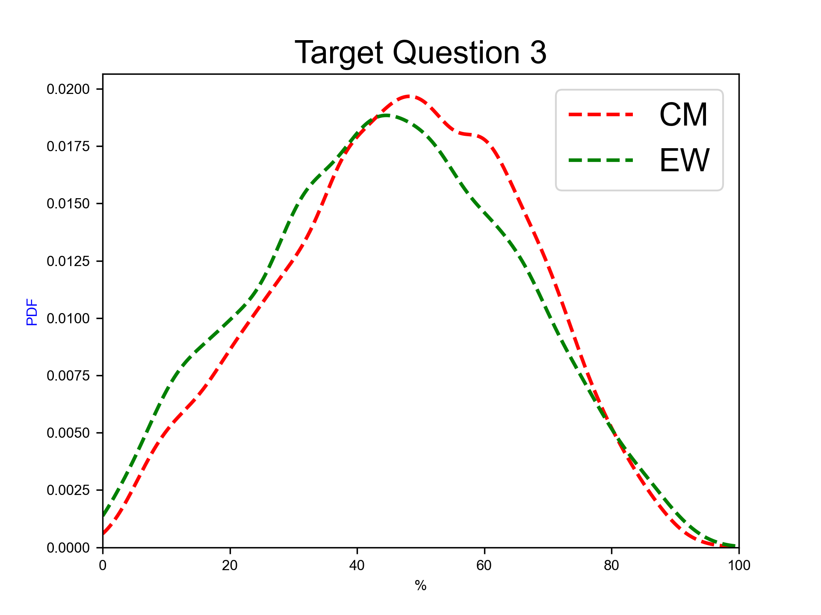
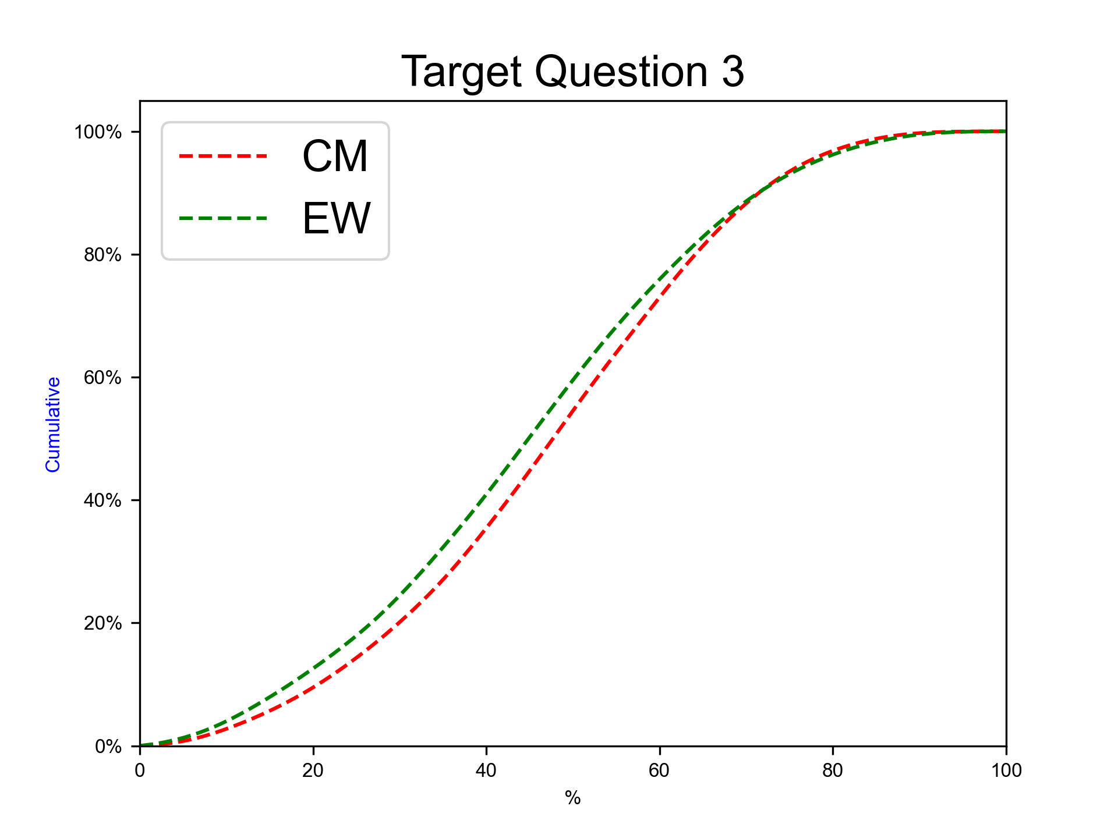
Next eruption, rhyolitic magma, SubPlinian eruption
Expert elicitation 17-Jul-2024
Given the present state of Cotopaxi volcano and your knowledge of its past eruptive chronology, how much probability do you assign to the possibility that at Cotopaxi, in case that the next eruption would involve totally or predominantly rhyolitic magma, the eruption would be SubPlinian (VEI 3-4)?
N.B. The sum of 50%iles for questions 3-5 have to sum to 100.0.

Slide 23
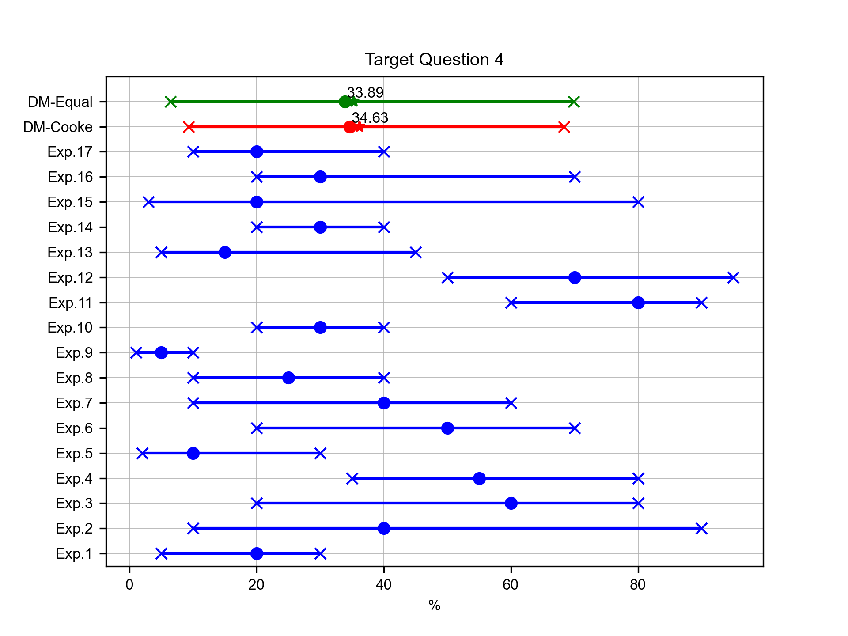
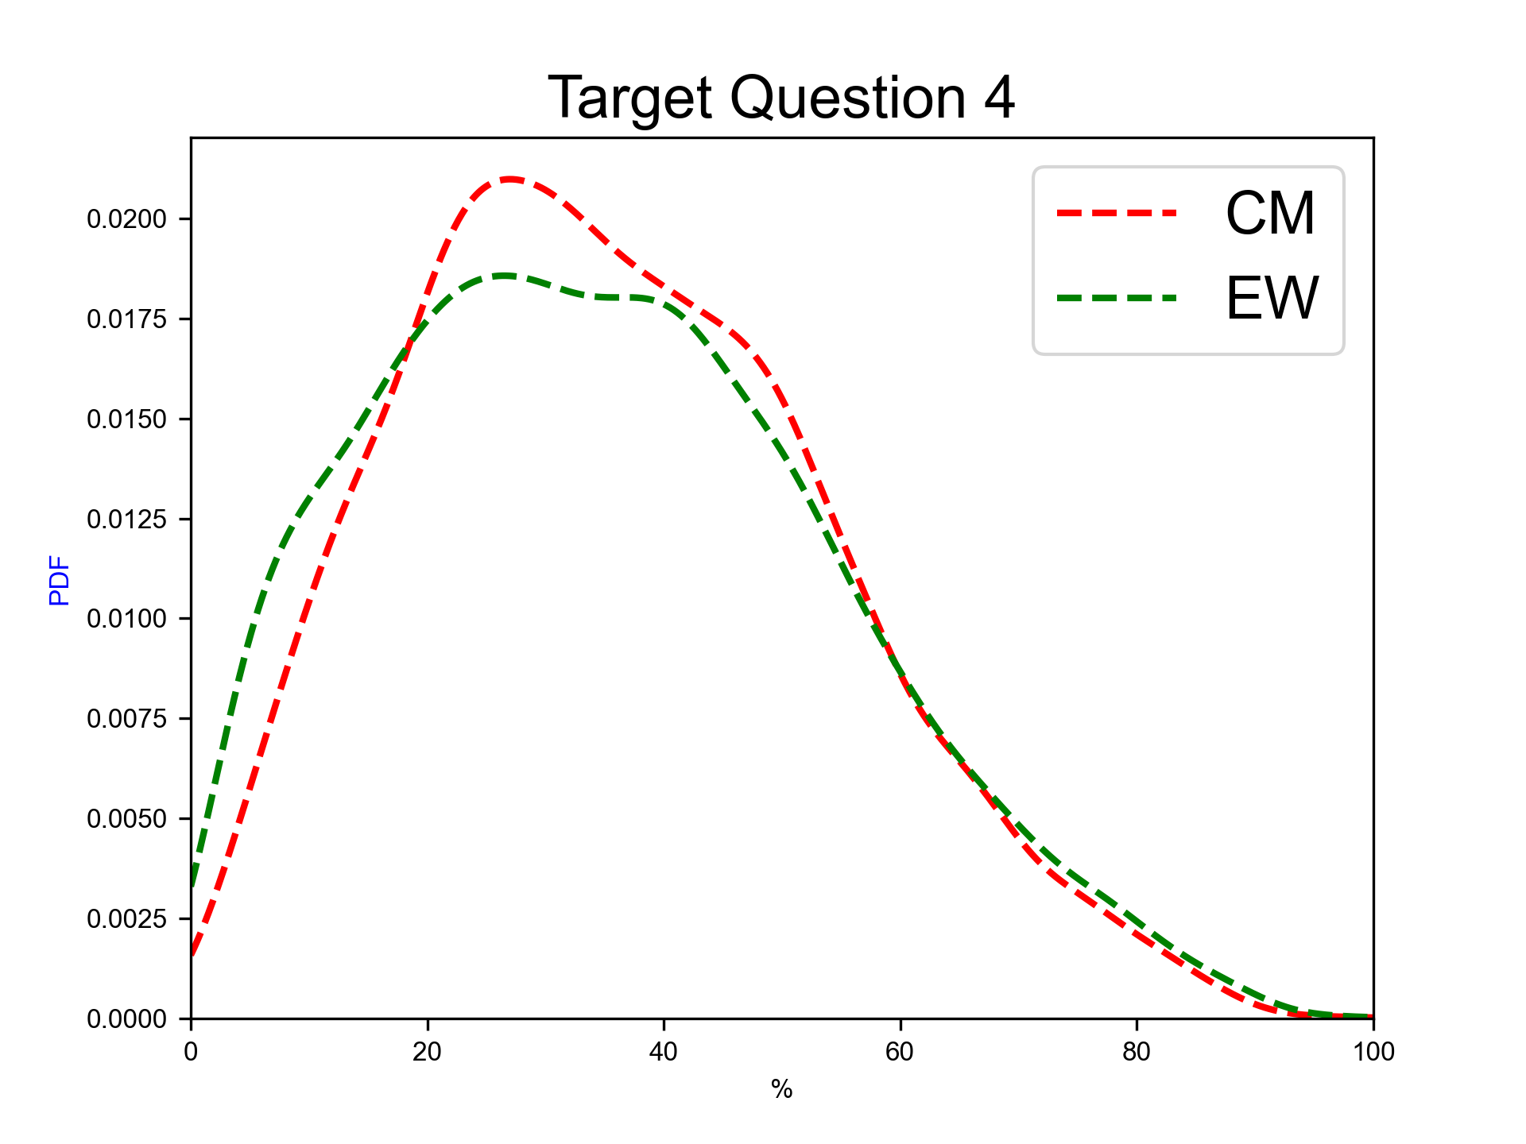
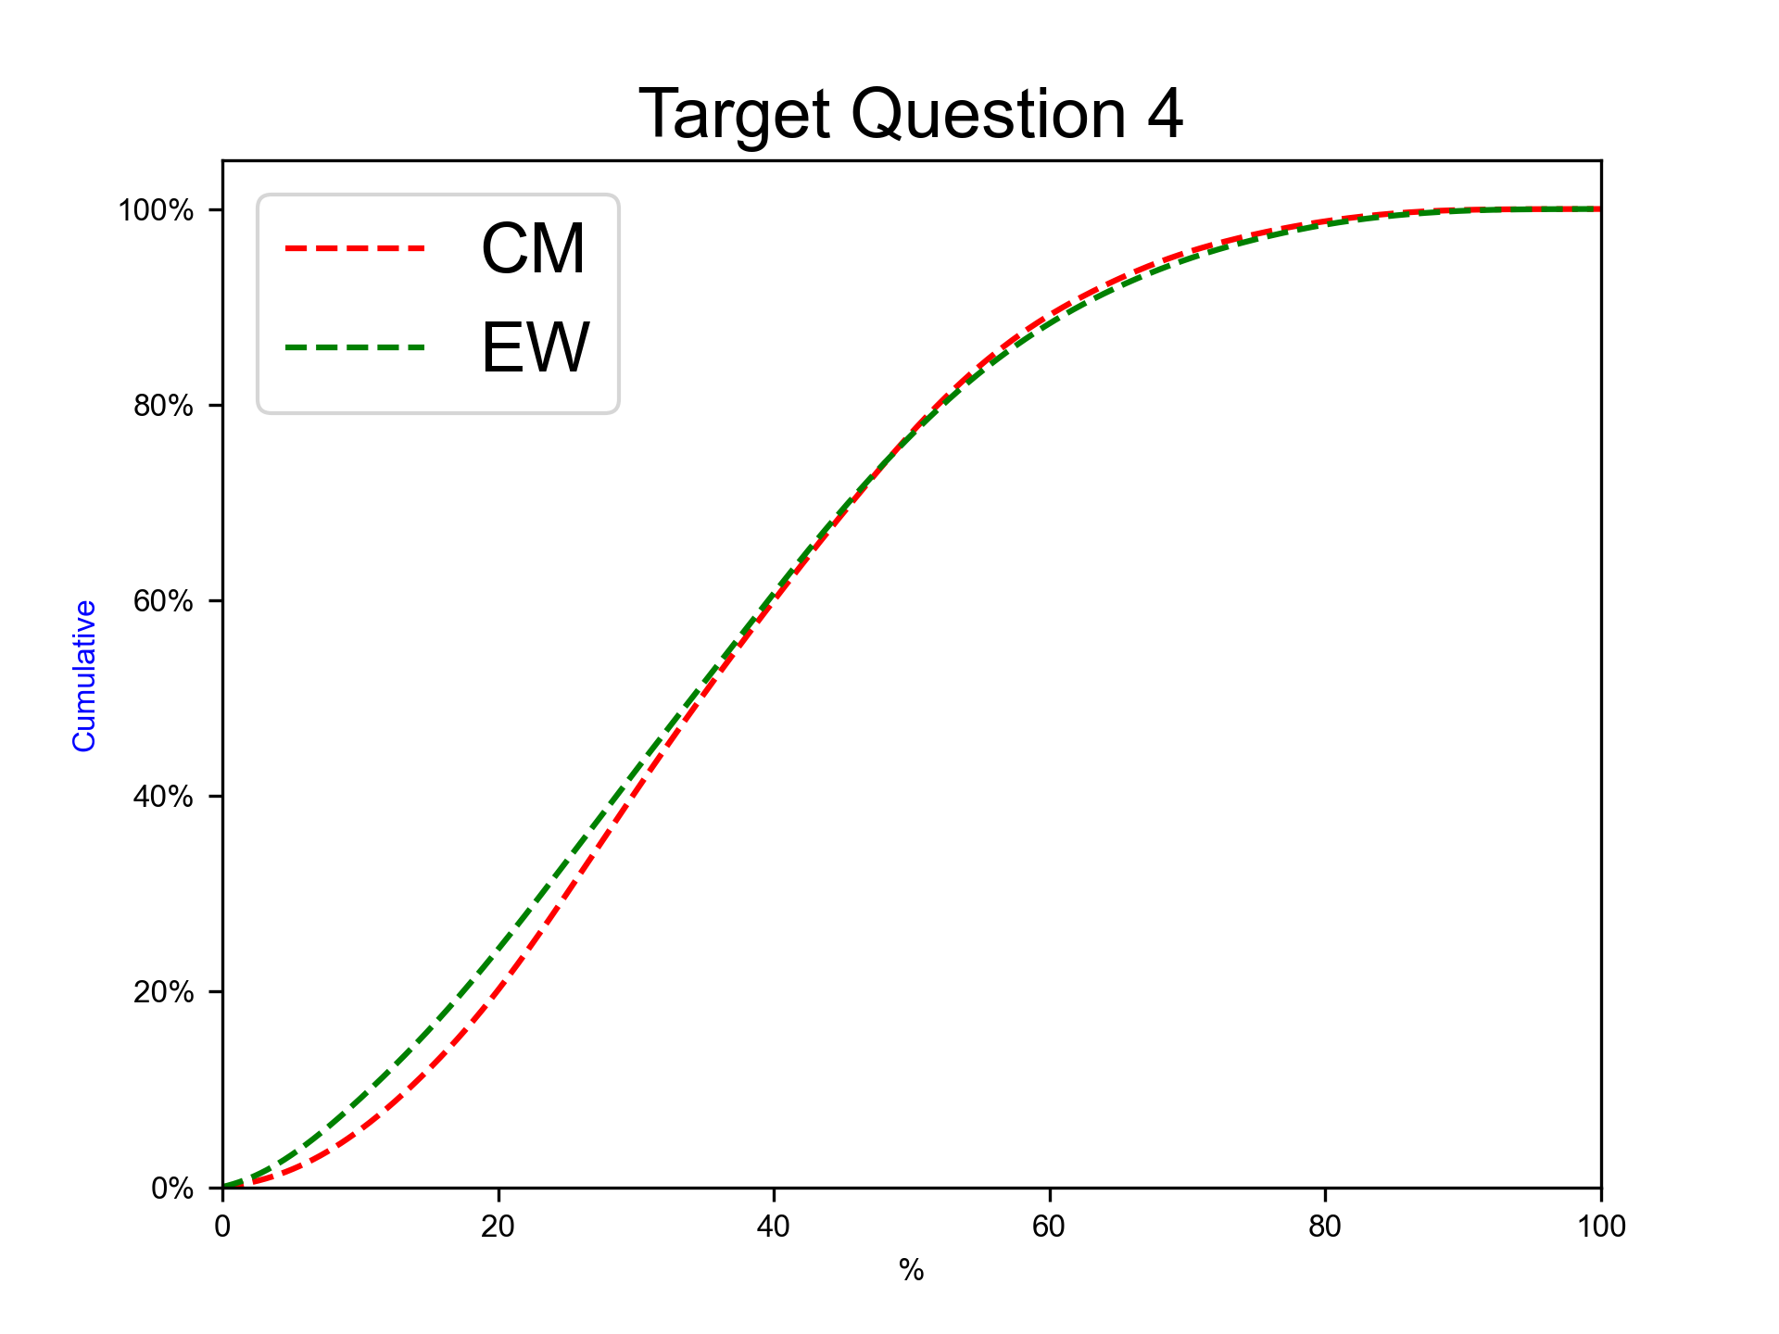
Next eruption, rhyolitic magma, Plinian eruption
Expert elicitation 17-Jul-2024
Given the present state of Cotopaxi volcano and your knowledge of its past eruptive chronology, how much probability do you assign to the possibility that at Cotopaxi, in case that the next eruption would involve totally or predominantly rhyolitic magma, the eruption would be similar to the F-2/F-4 ones (Plinian, VEI 4-5)?
N.B. The sum of 50%iles for questions 3-5 have to sum to 100.0.

Slide 24
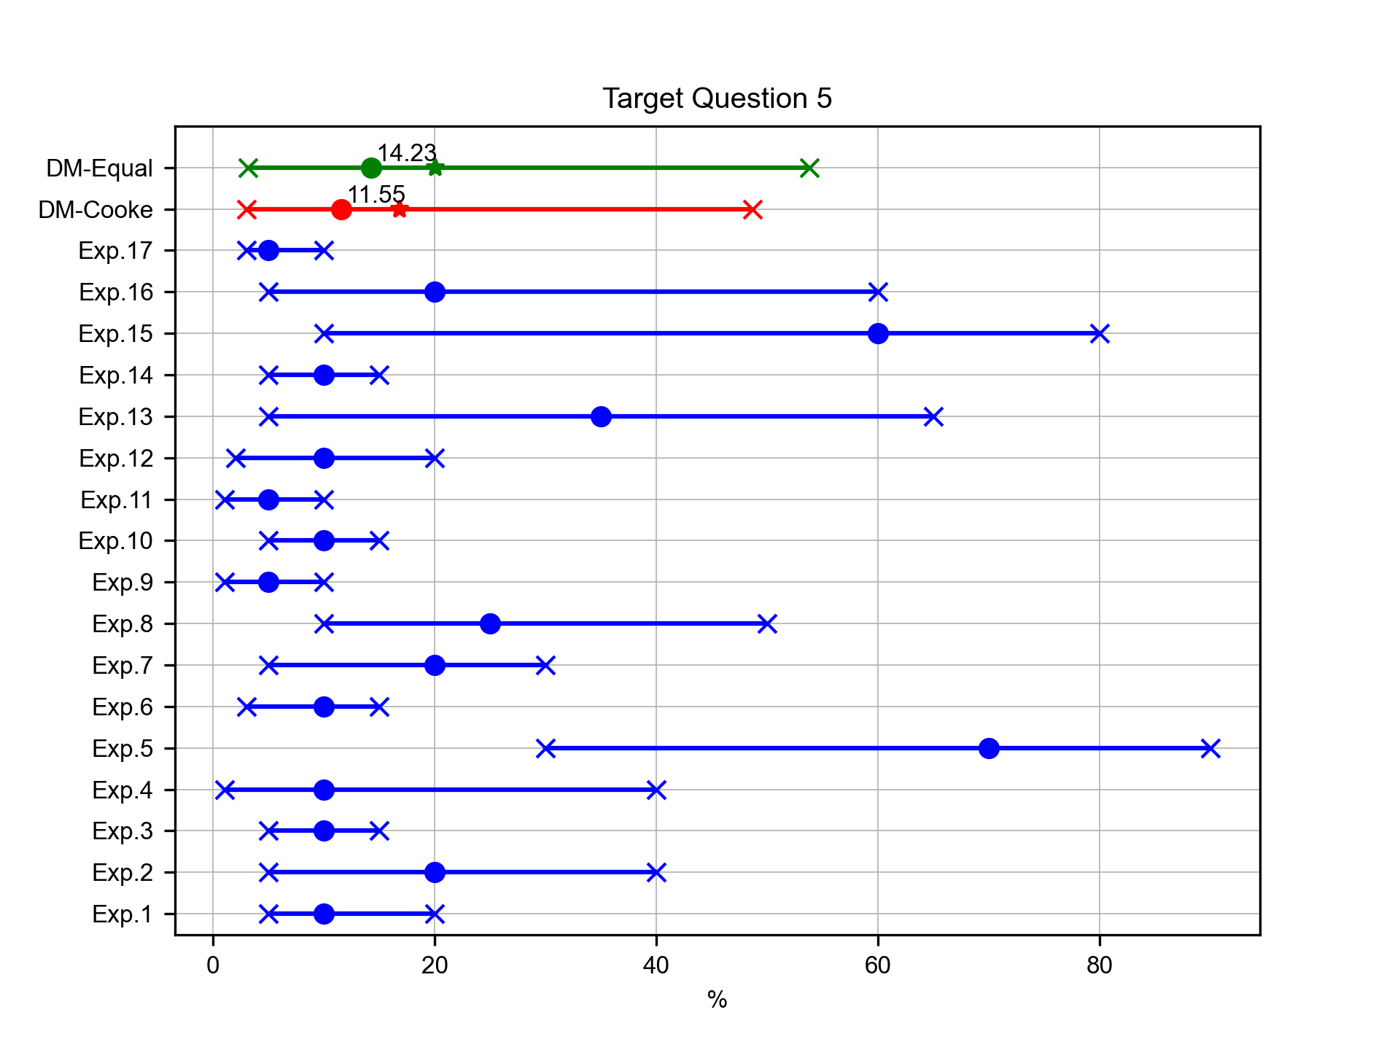
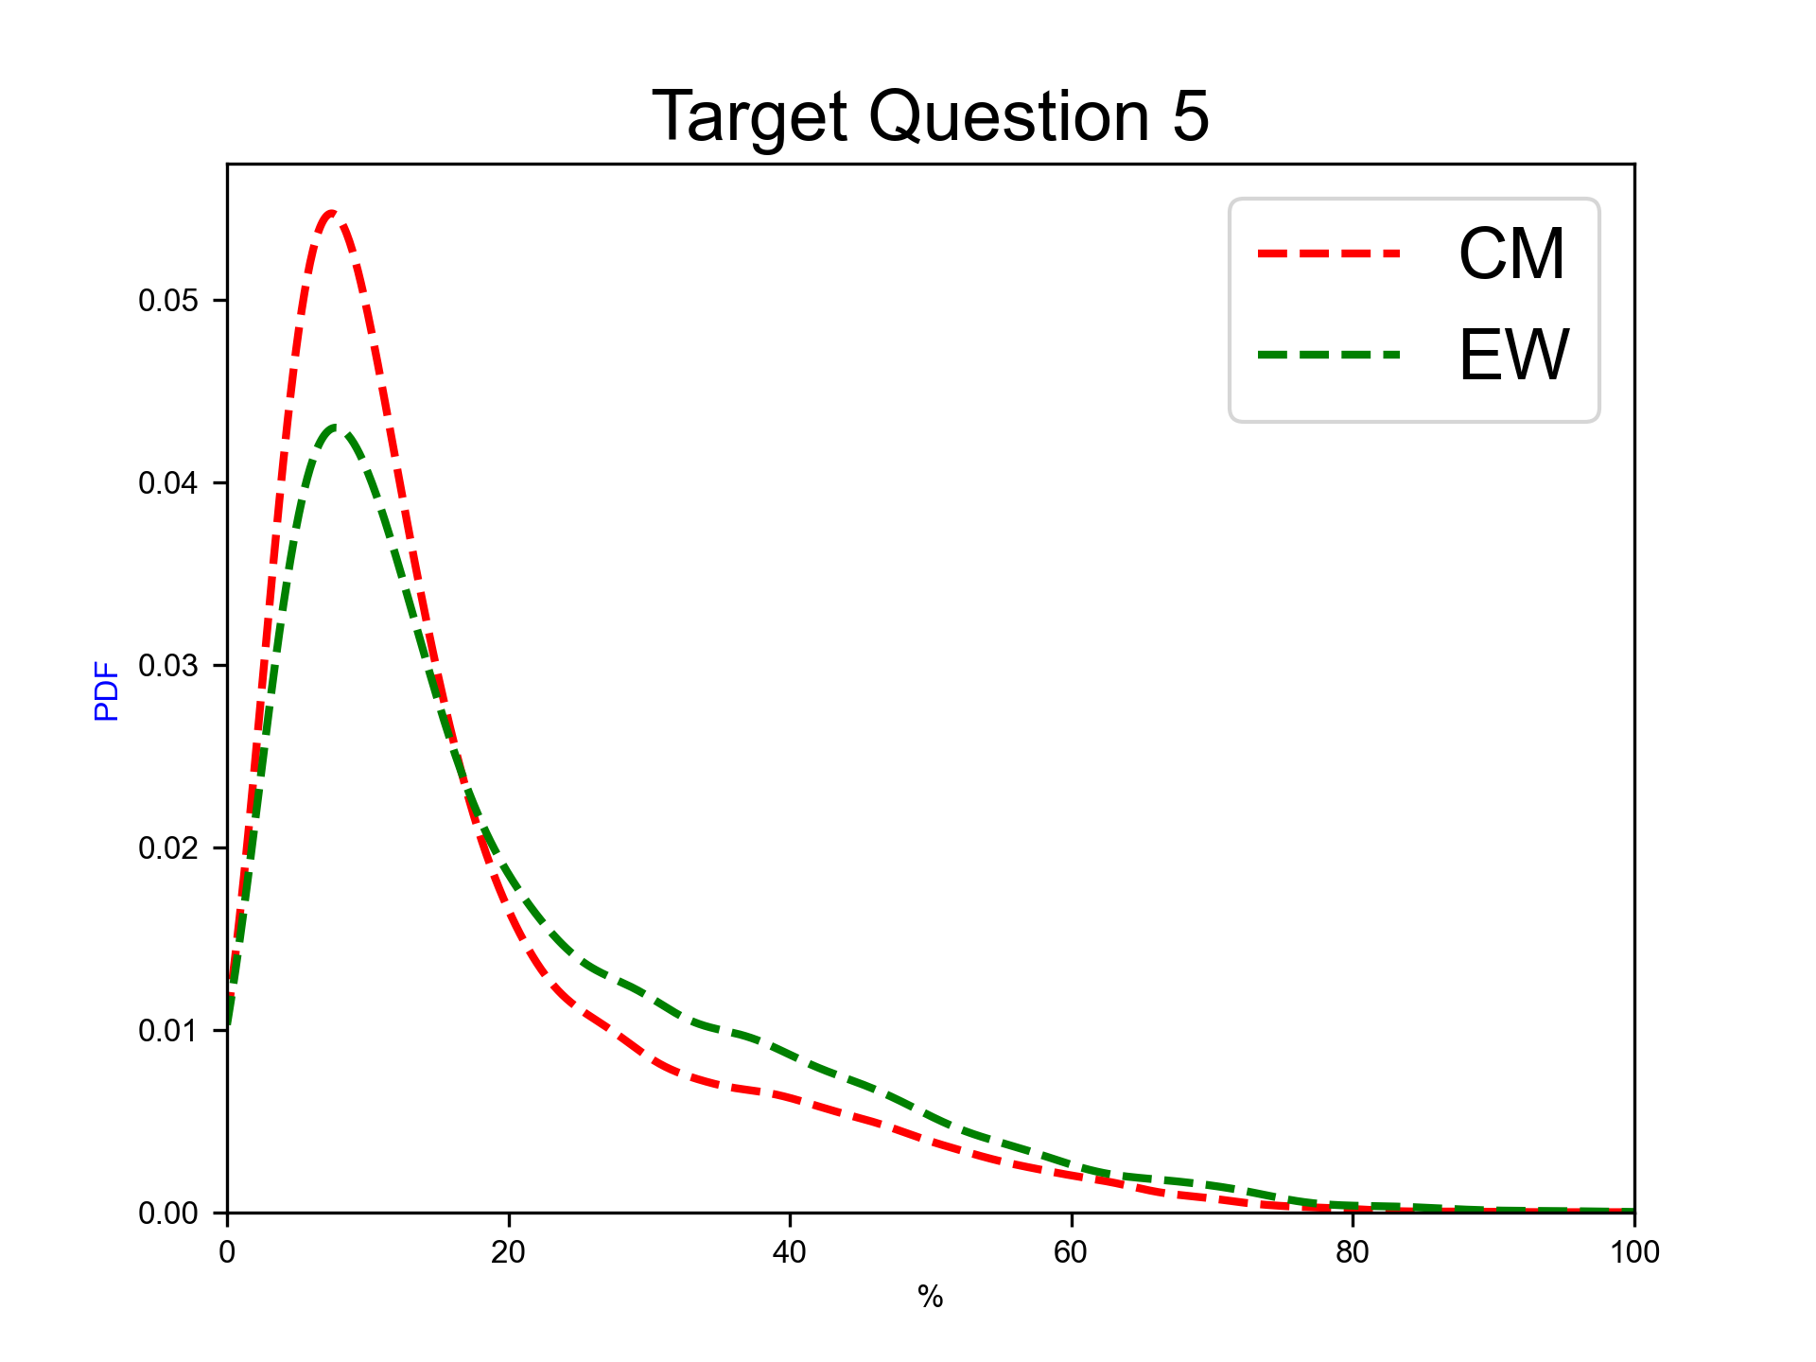
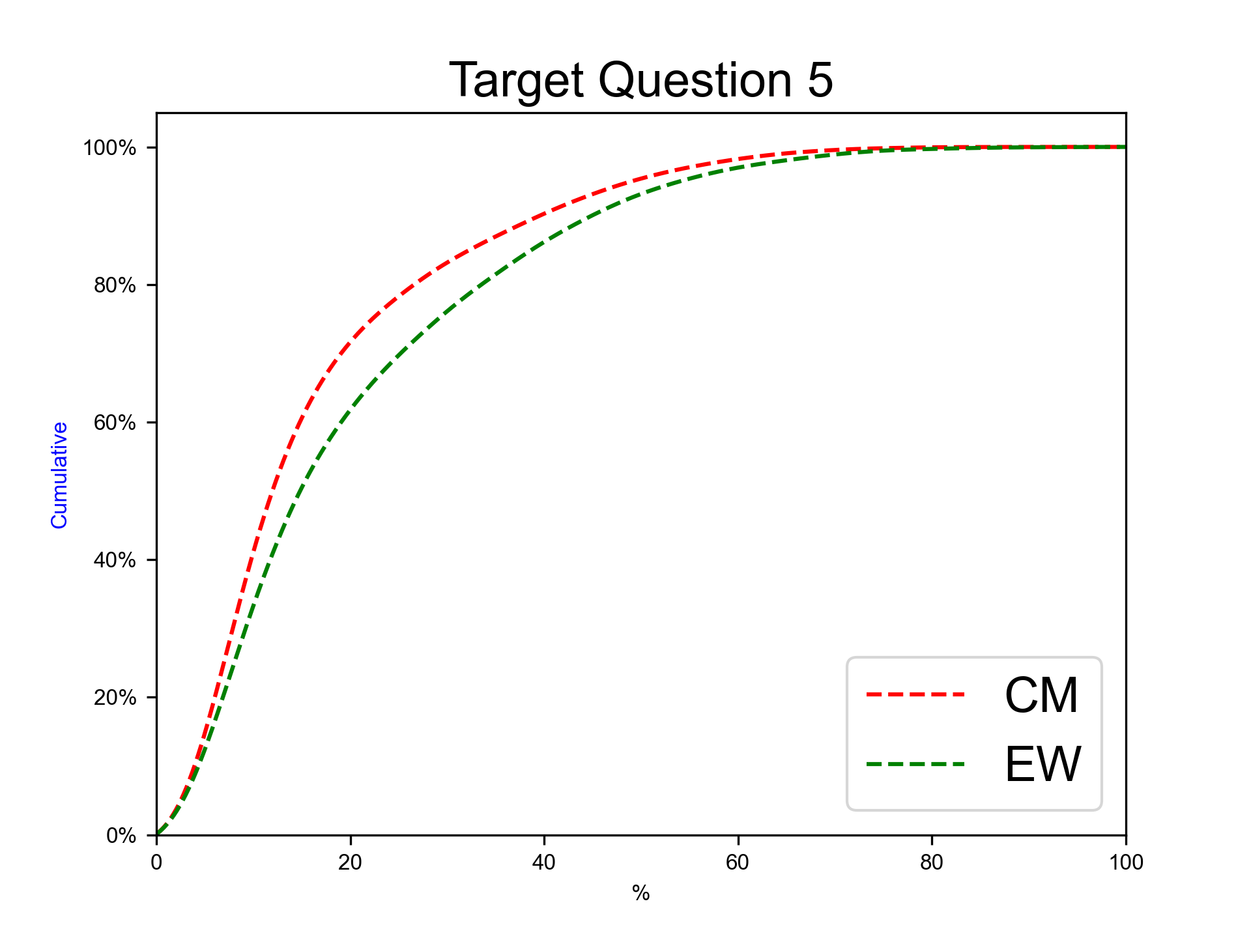
Next eruption, rhyolitic magma, other eruption type
Expert elicitation 17-Jul-2024
Given the present state of Cotopaxi volcano and your knowledge of its past eruptive chronology, how much probability do you assign to the possibility that at Cotopaxi, in case that the next eruption would involve totally or predominantly rhyolitic magma, the eruption would be of different type with respect to the previous ones?
N.B. The sum of 50%iles for questions 3-5 have to sum to 100.0.

Slide 25
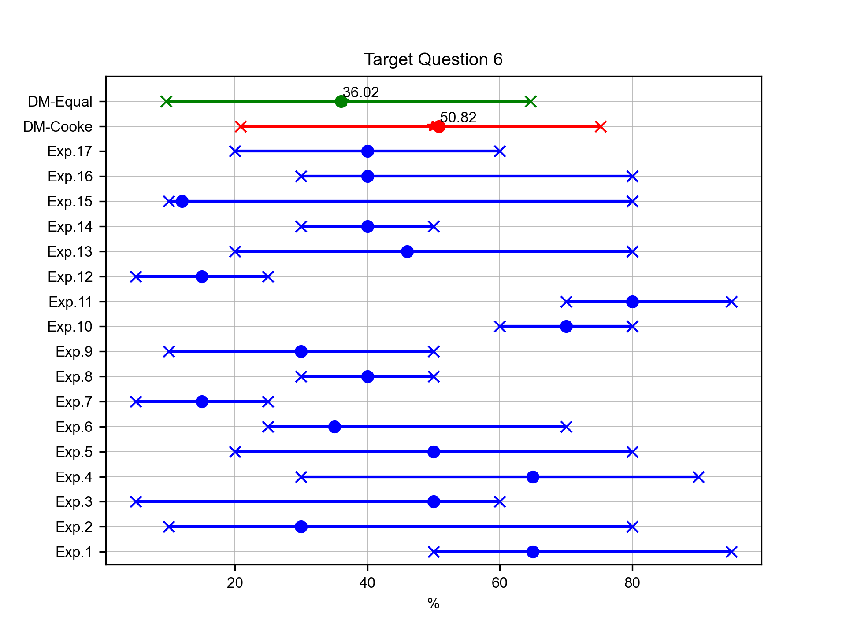
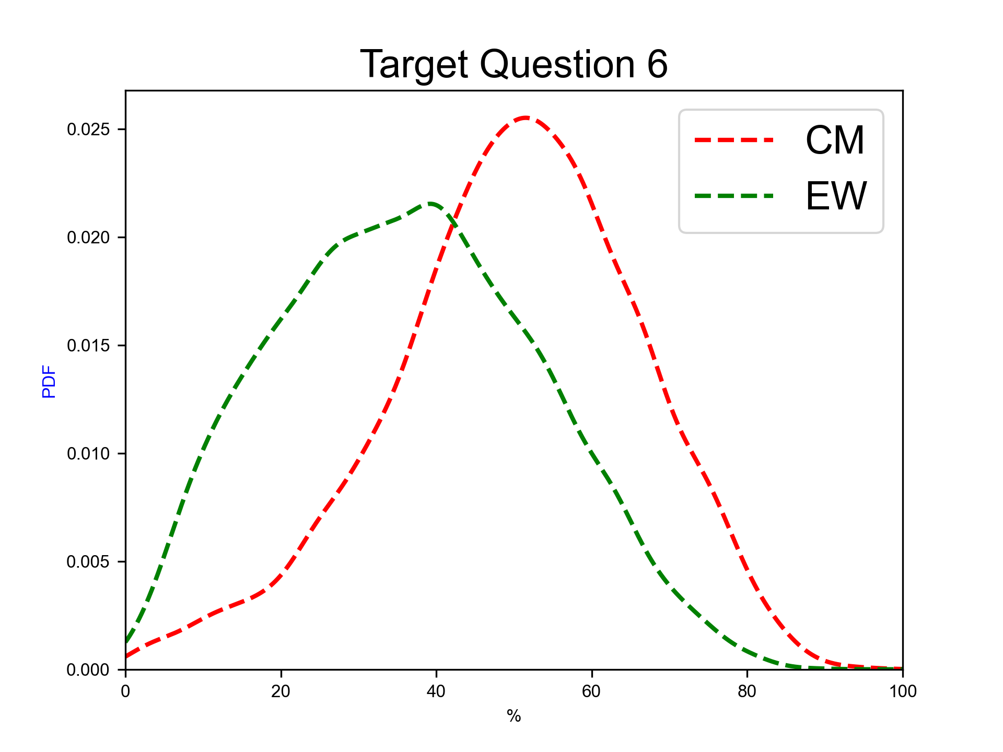
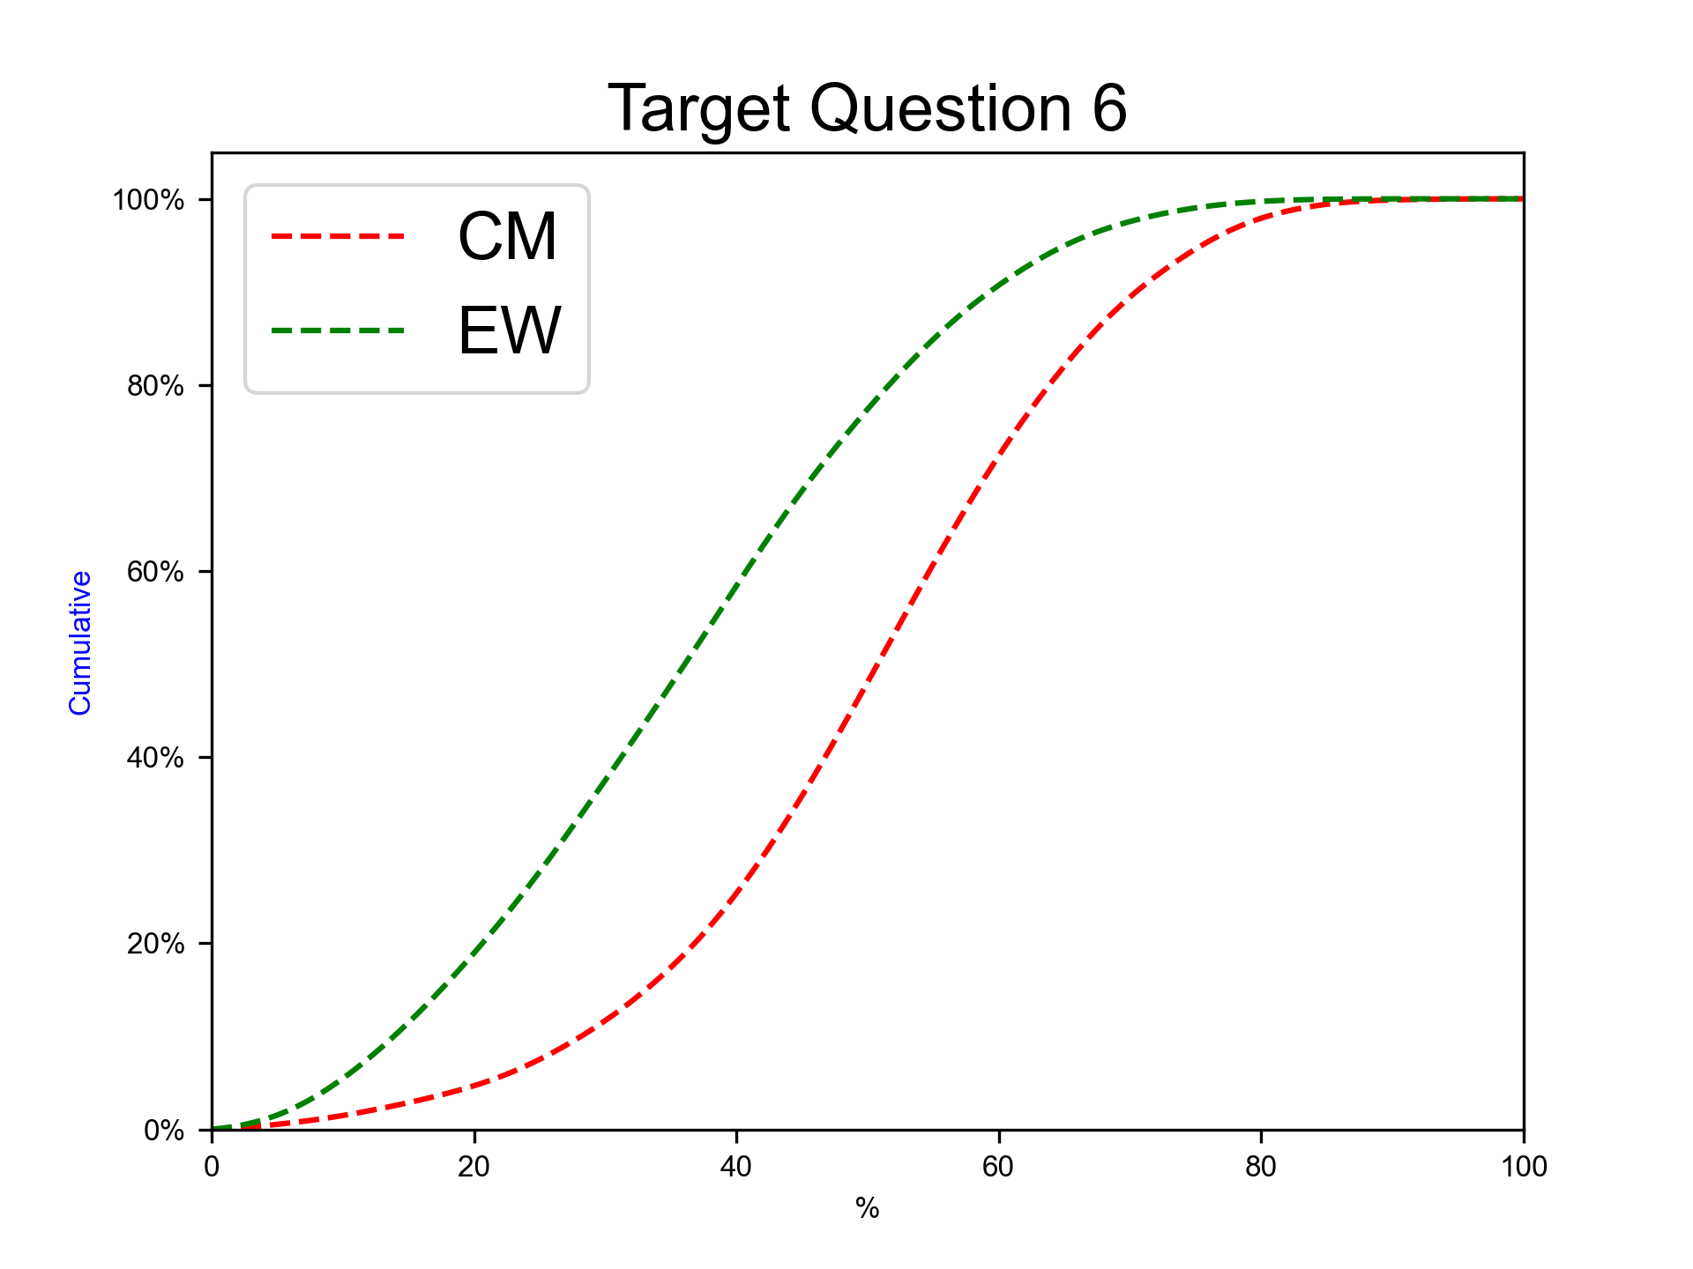
Next eruption, andesitic magma, Hydrovolcanic/Continuos ash emission eruption
Expert elicitation 17-Jul-2024
Given the present state of Cotopaxi volcano and your knowledge of its past eruptive chronology, how much probability do you assign to the possibility that at Cotopaxi, in case that the next eruption would involve totally or predominantly andesitic magma, the eruption would be similar to the AD 2015 one (Hydrovolcanic to long-lasting ash emission, VEI 1-2)?
N.B. The sum of 50%iles for questions 6-10 have to sum to 100.0.

Slide 26
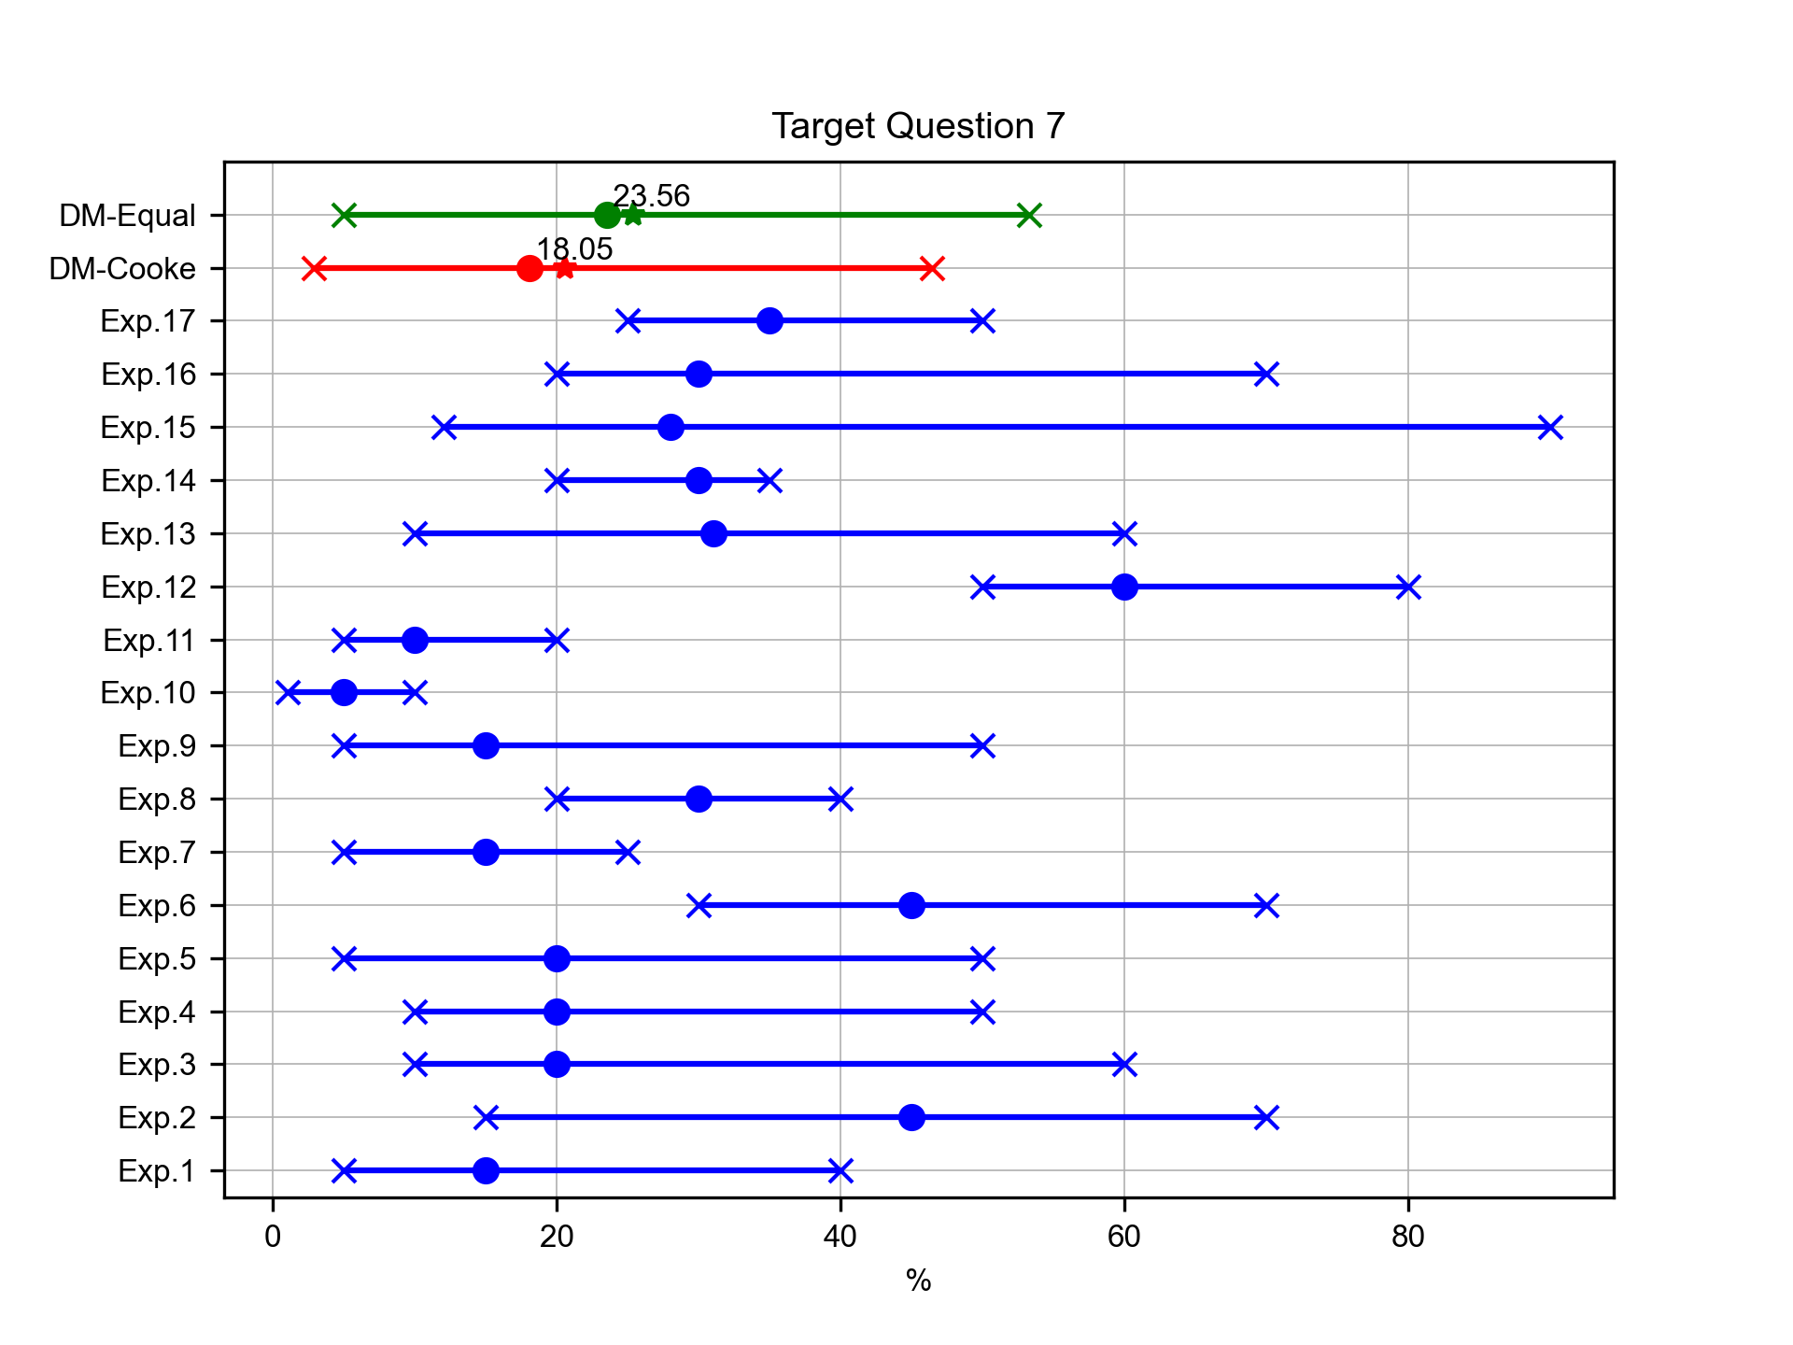
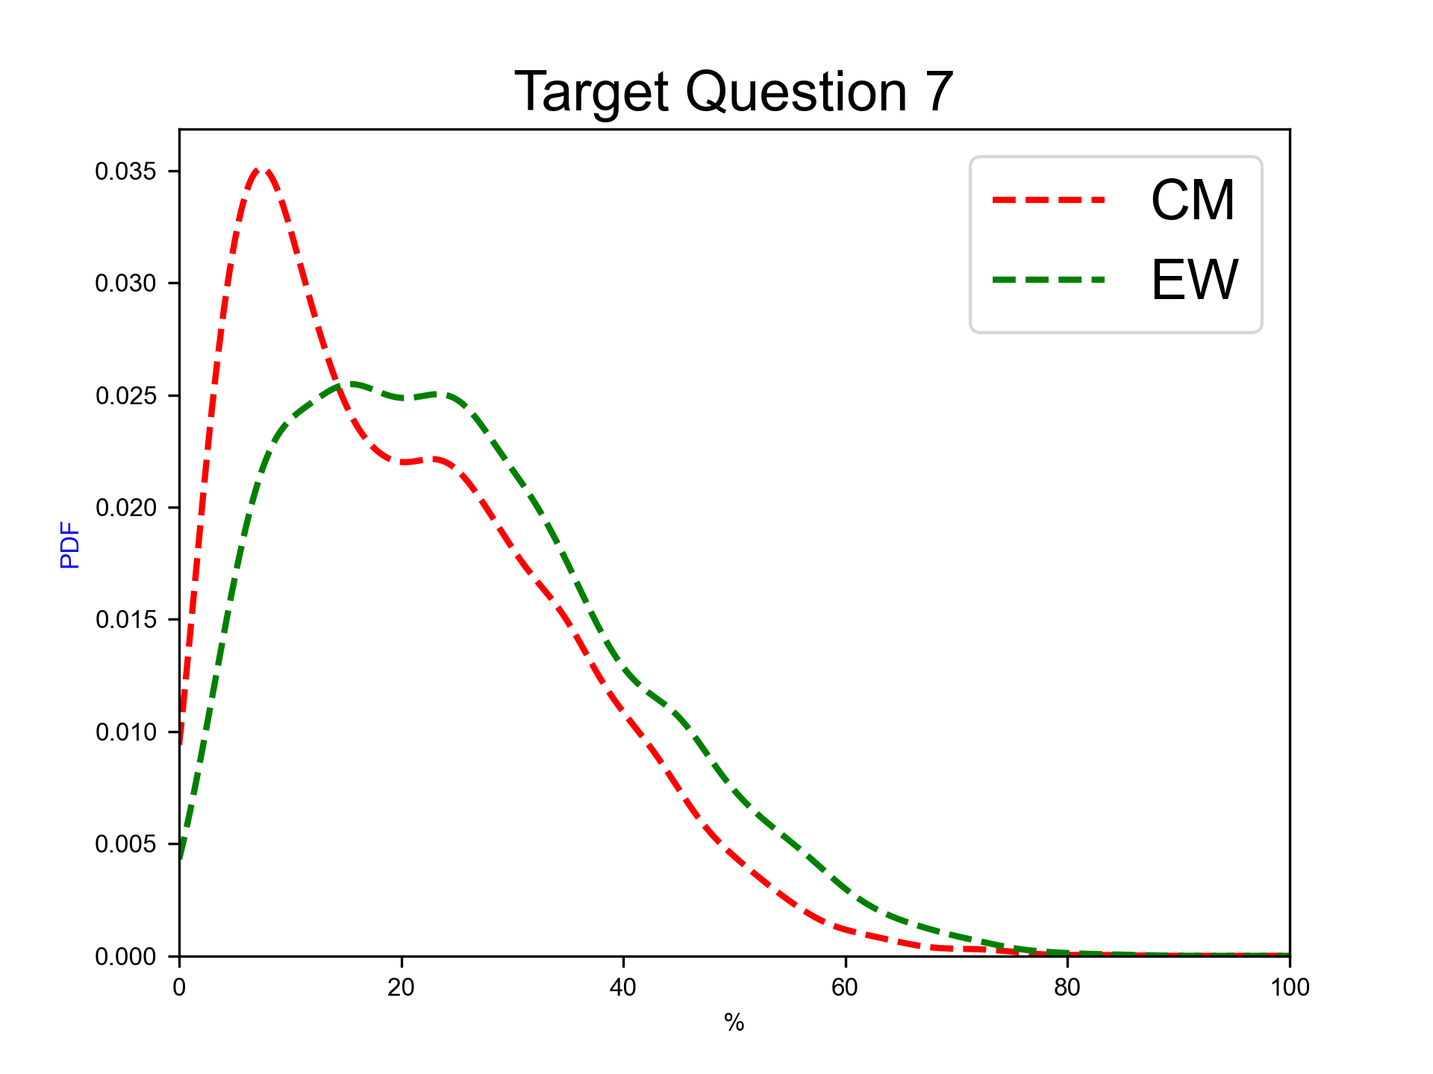
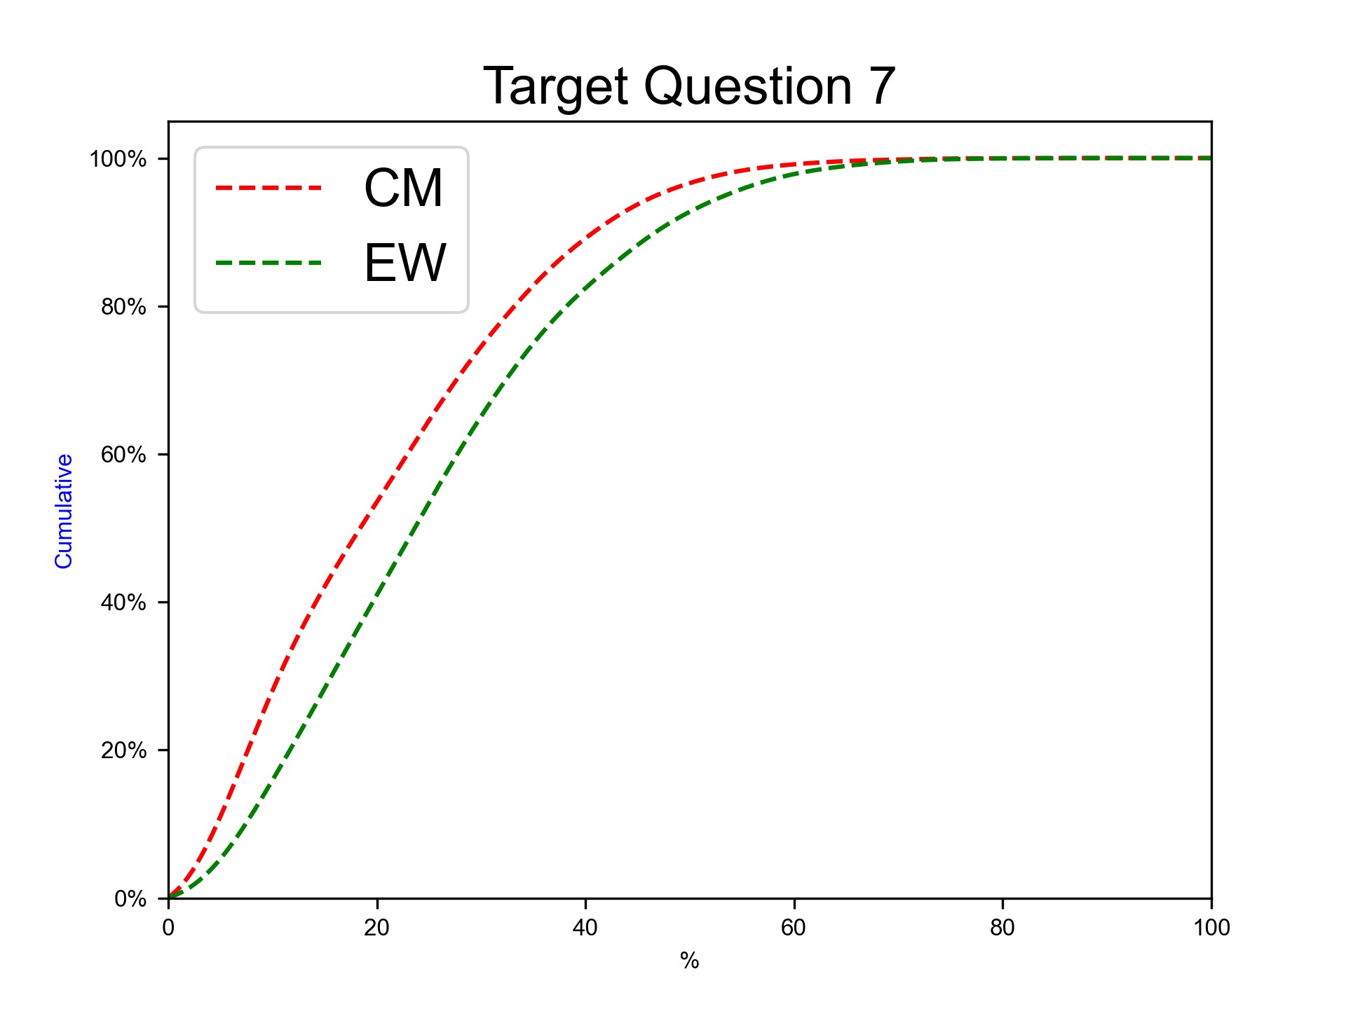
Next eruption, andesitic magma, Violent Strombolian eruption
Expert elicitation 17-Jul-2024
Given the present state of Cotopaxi volcano and your knowledge of its past eruptive chronology, how much probability do you assign to the possibility that at Cotopaxi, in case that the next eruption would involve totally or predominantly andesitic magma, the eruption would be similar to the ones in the XIX century (Violent Strombolian, VEI 2-3)?
N.B. The sum of 50%iles for questions 6-10 have to sum to 100.0.

Slide 27
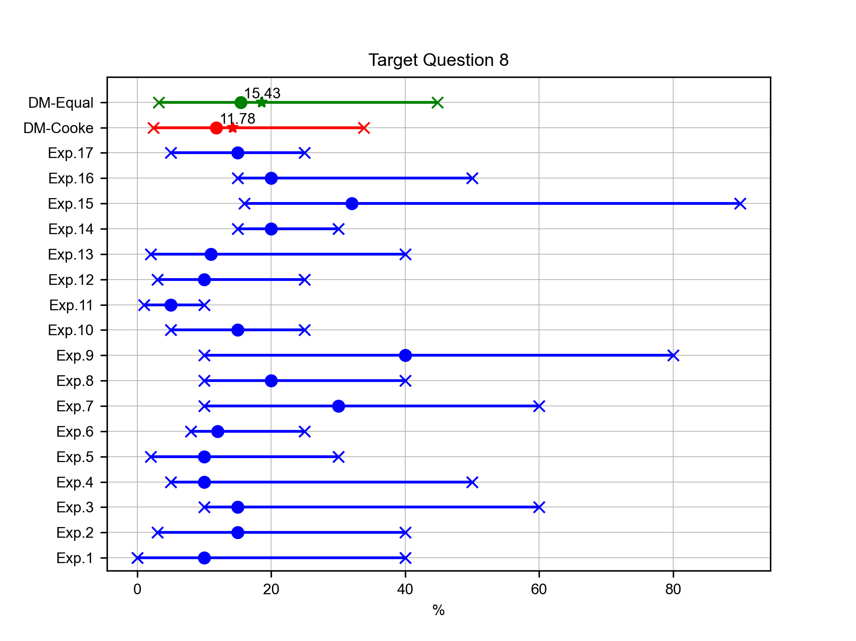
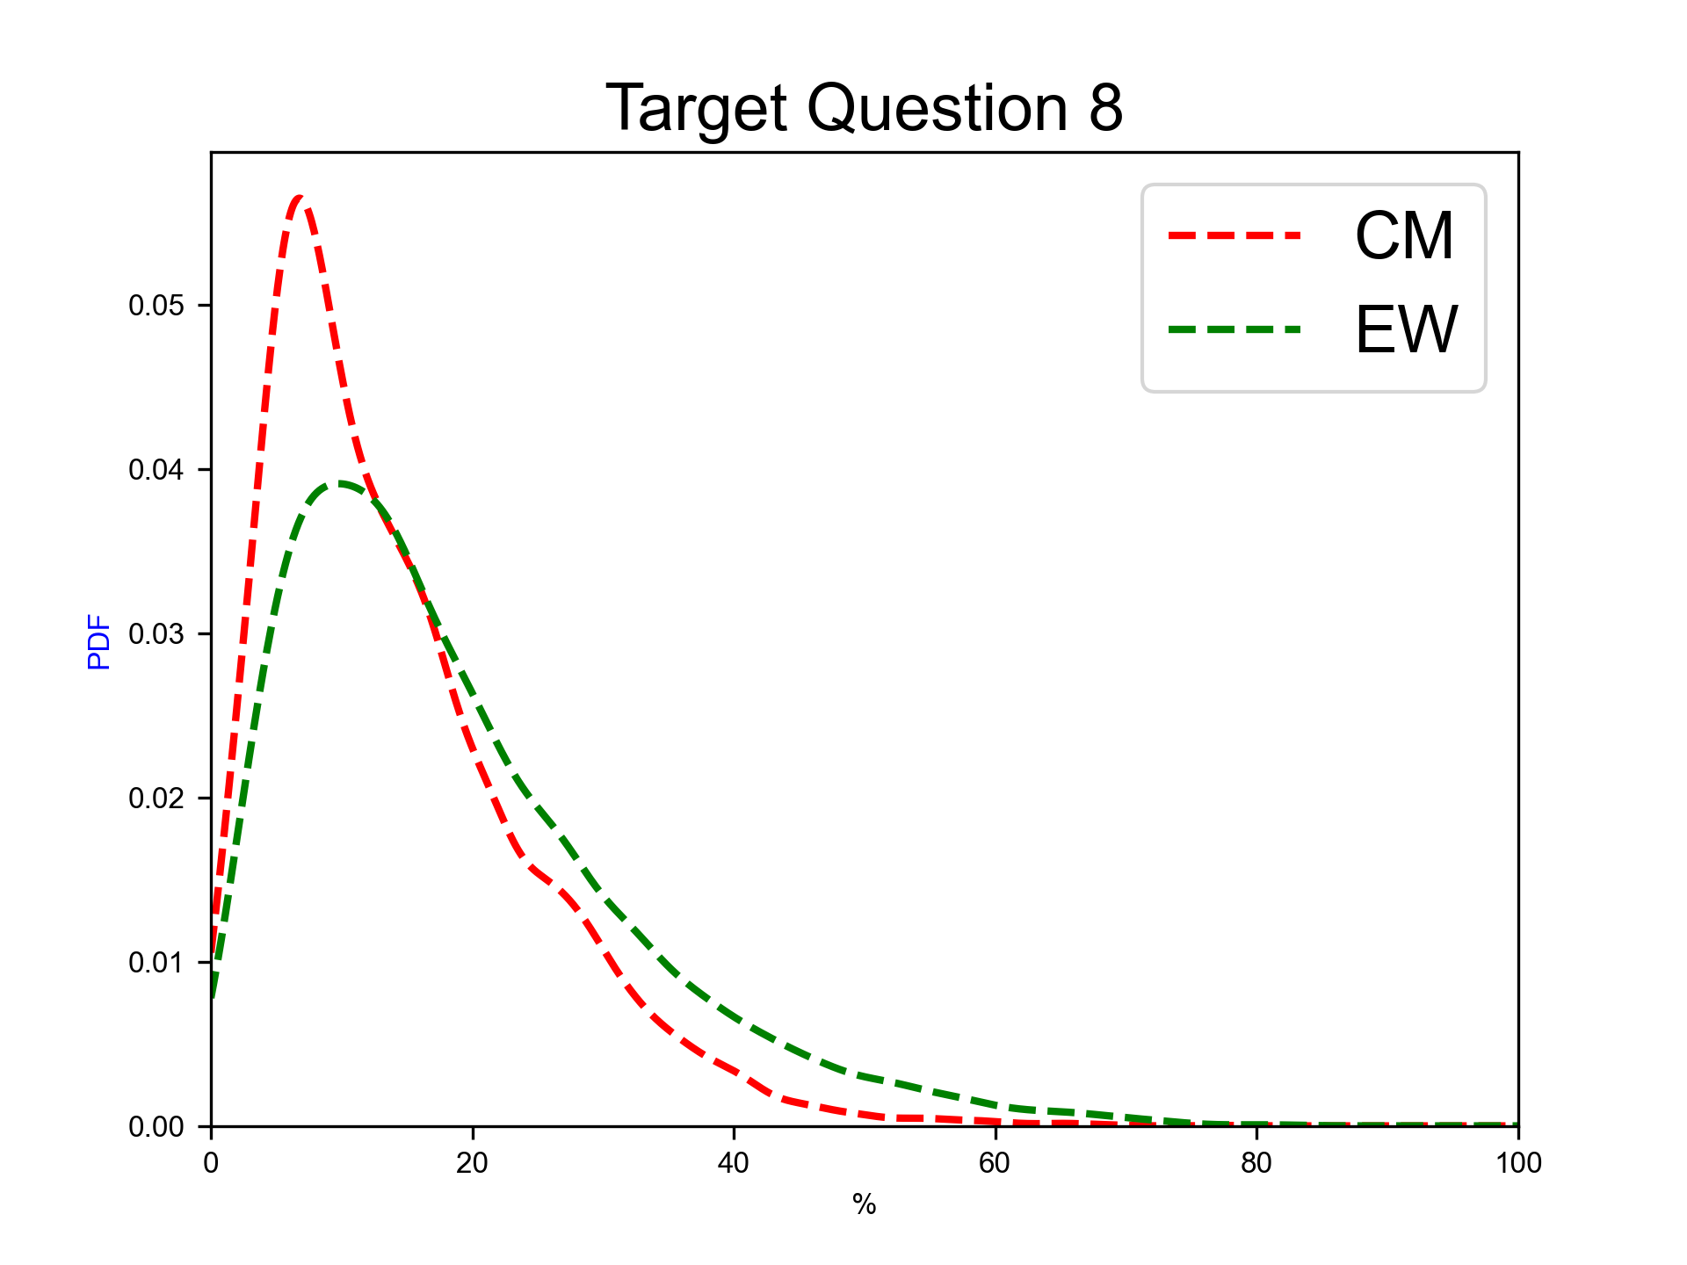
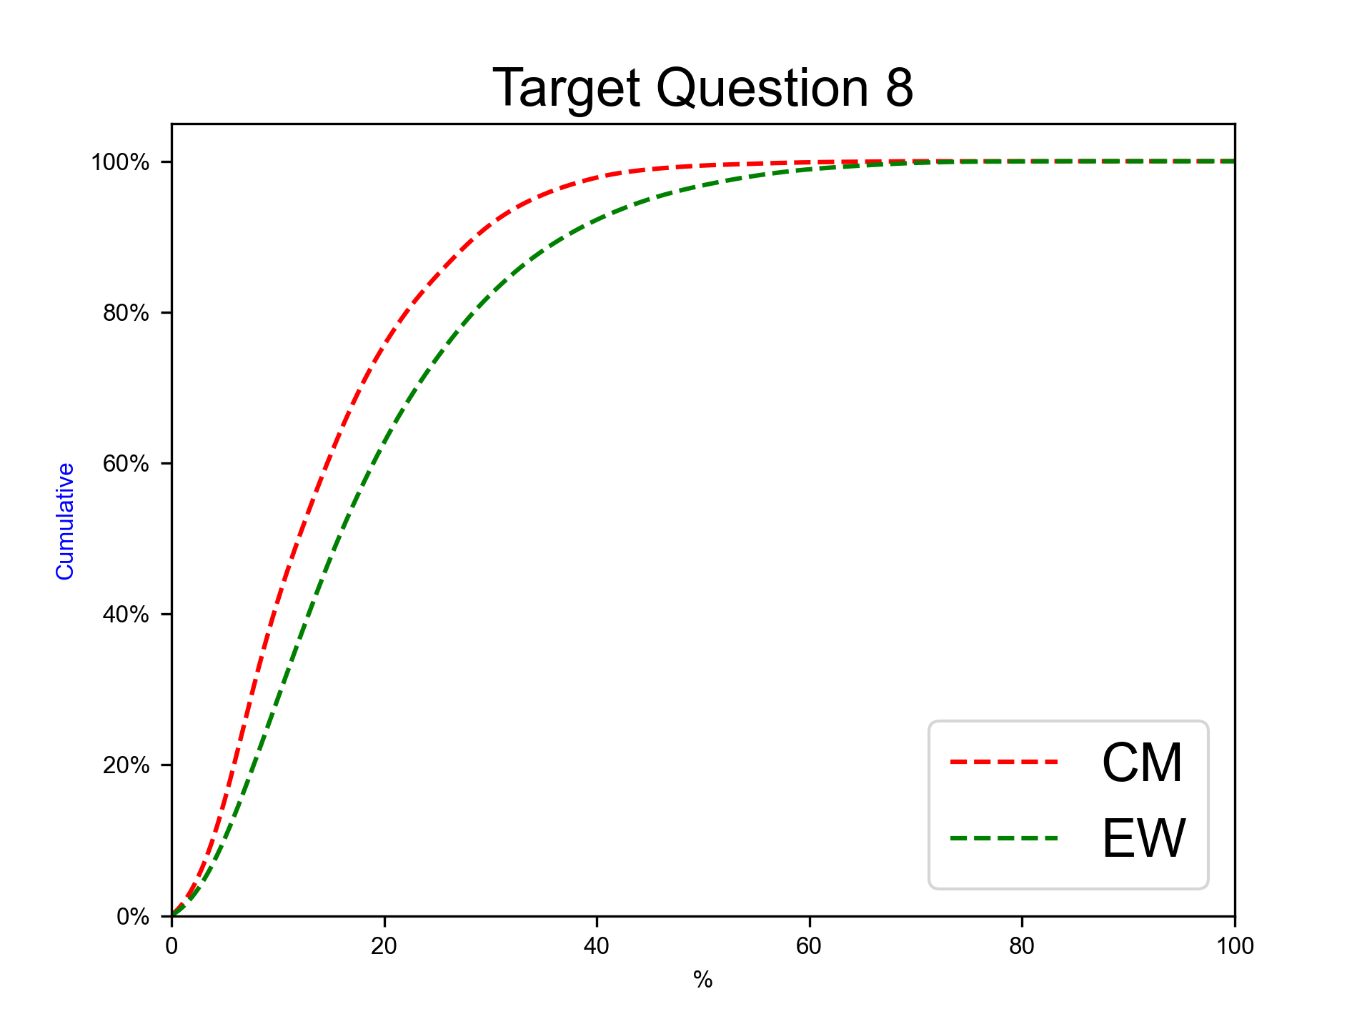
Next eruption, andesitic magma, SubPlinian eruption
Expert elicitation 17-Jul-2024
Given the present state of Cotopaxi volcano and your knowledge of its past eruptive chronology, how much probability do you assign to the possibility that at Cotopaxi, in case that the next eruption would involve totally or predominantly andesitic magma, the eruption would be similar to the AD 1877 one (SubPlinian, VEI 3-4)?
N.B. The sum of 50%iles for questions 6-10 have to sum to 100.0.

Slide 28
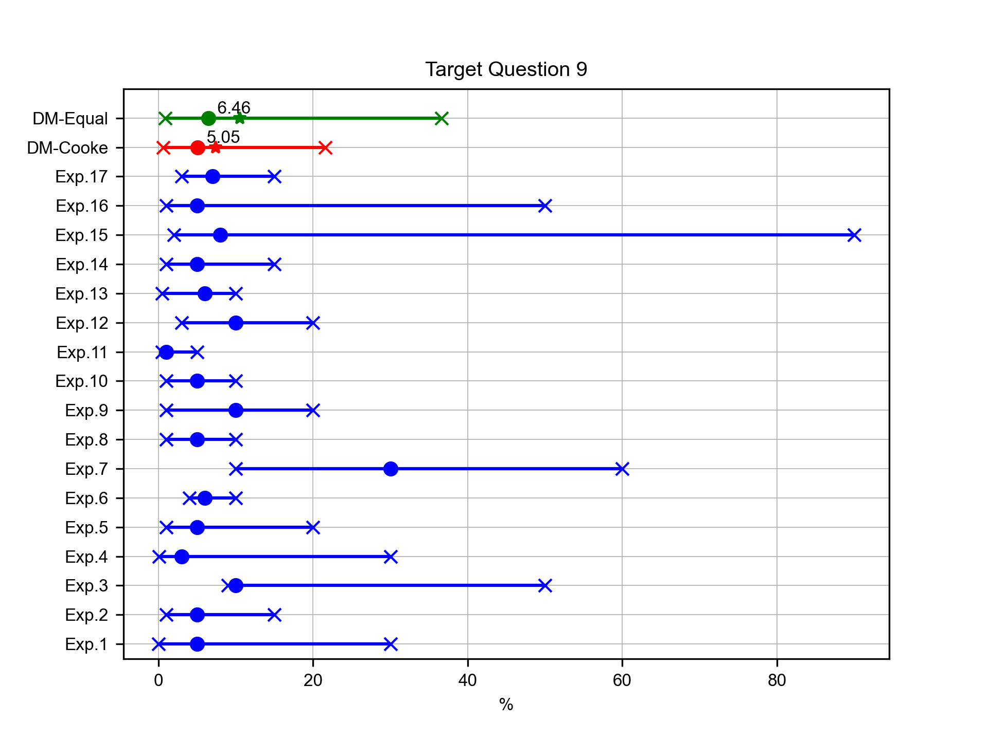
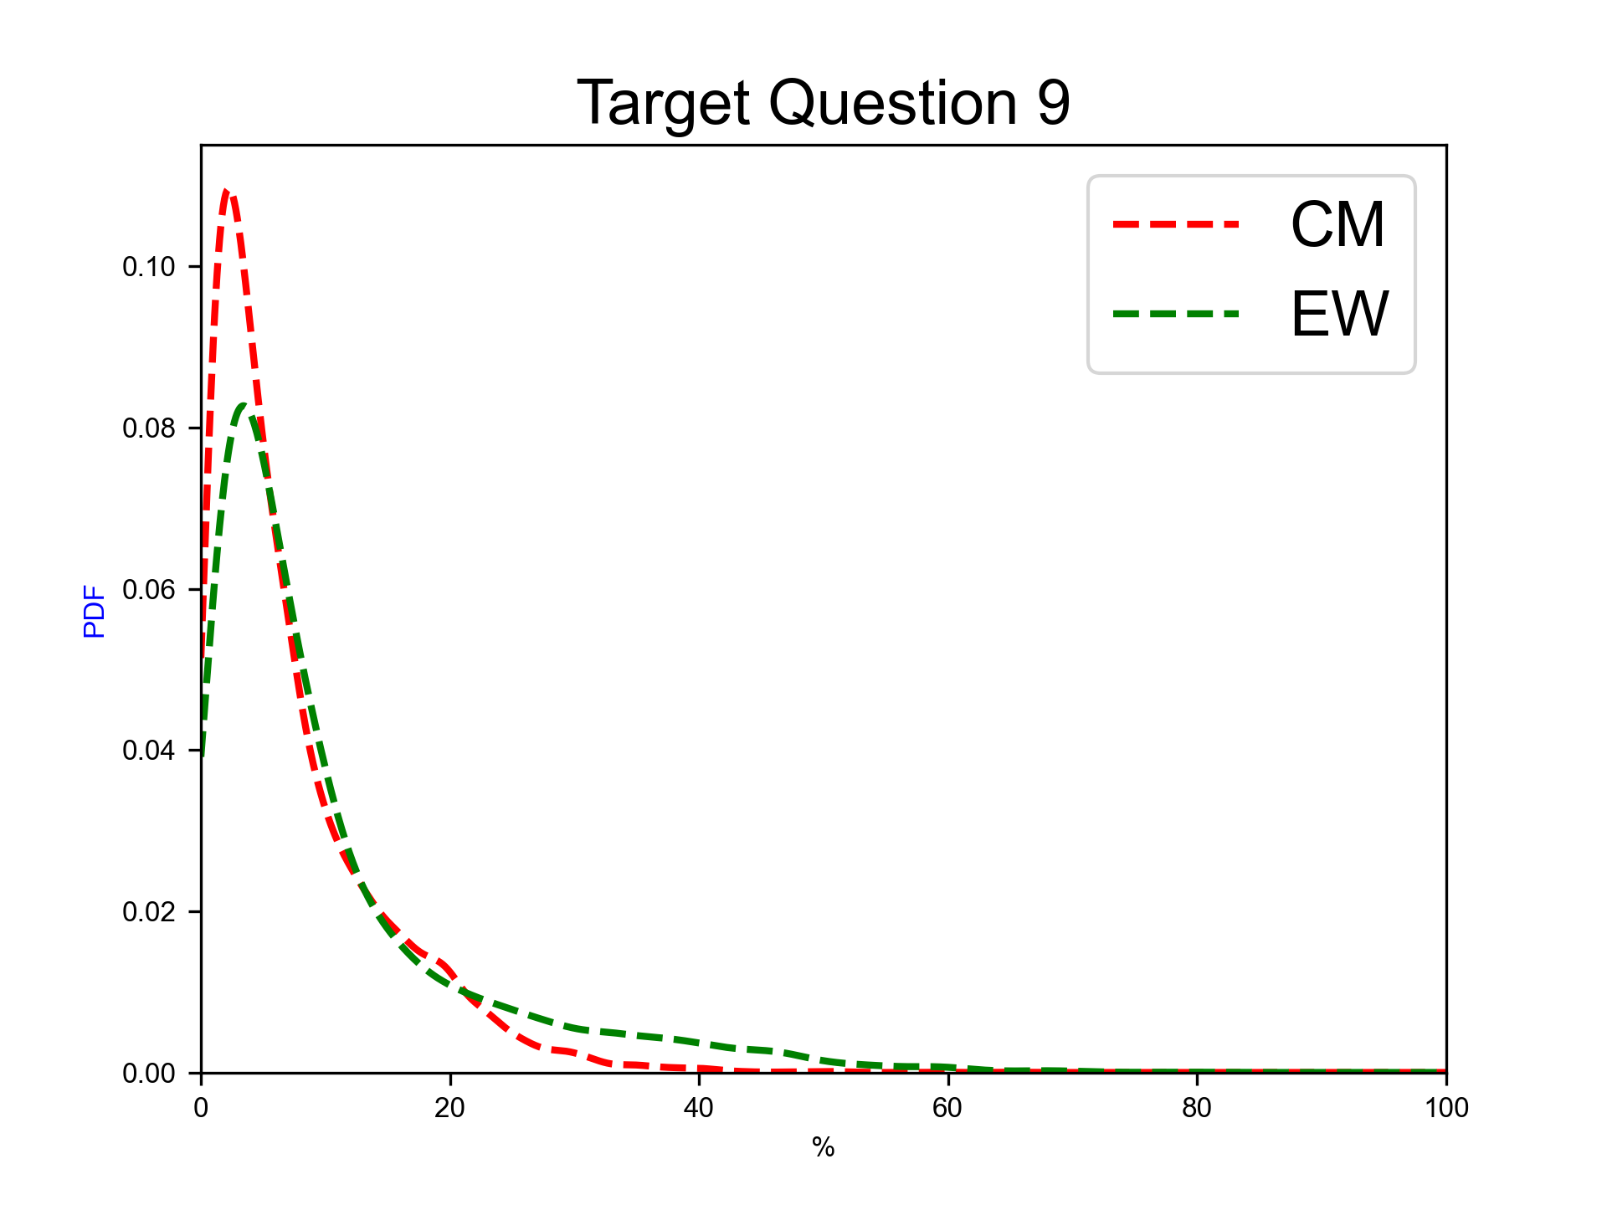
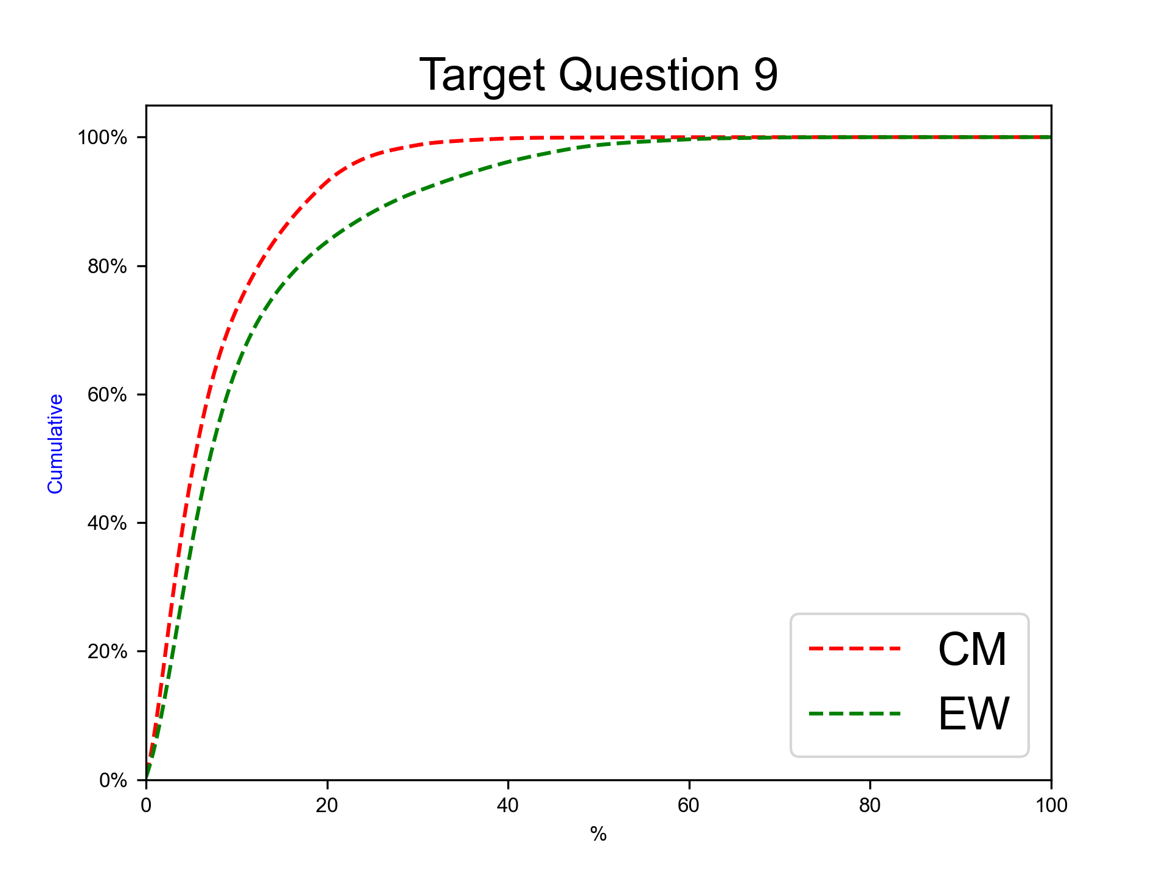
Next eruption, andesitic magma, Plinian eruption
Expert elicitation 17-Jul-2024
Given the present state of Cotopaxi volcano and your knowledge of its past eruptive chronology, how much probability do you assign to the possibility that at Cotopaxi, in case that the next eruption would involve totally or predominantly andesitic magma, the eruption would be similar to the Layers 3/5 ones (Plinian, VEI 4-5)?
N.B. The sum of 50%iles for questions 6-10 have to sum to 100.0.

Slide 29
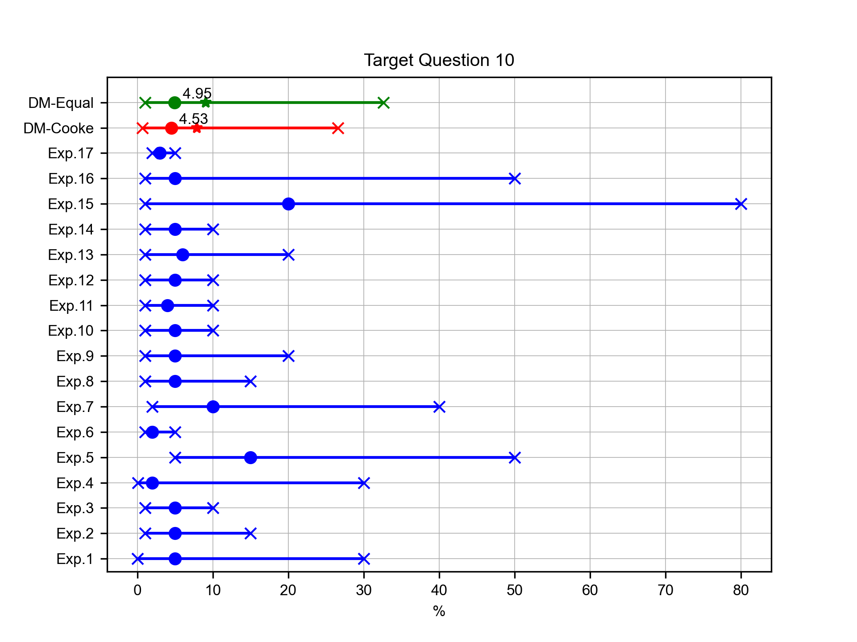
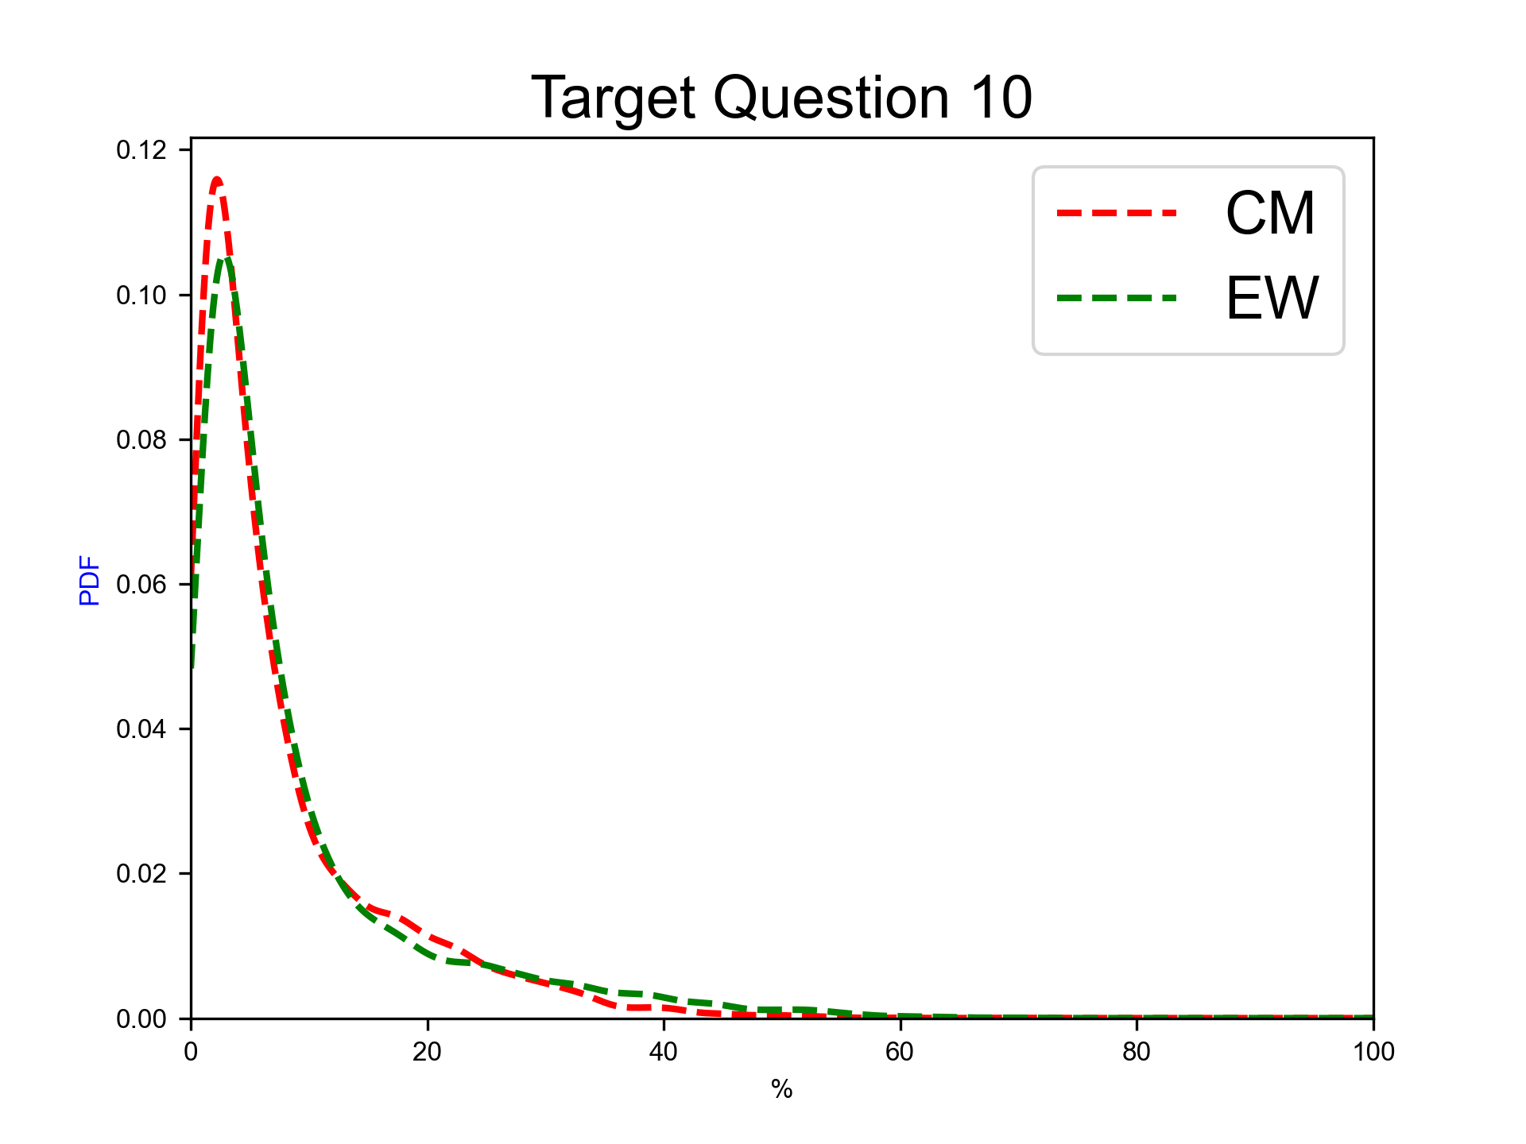
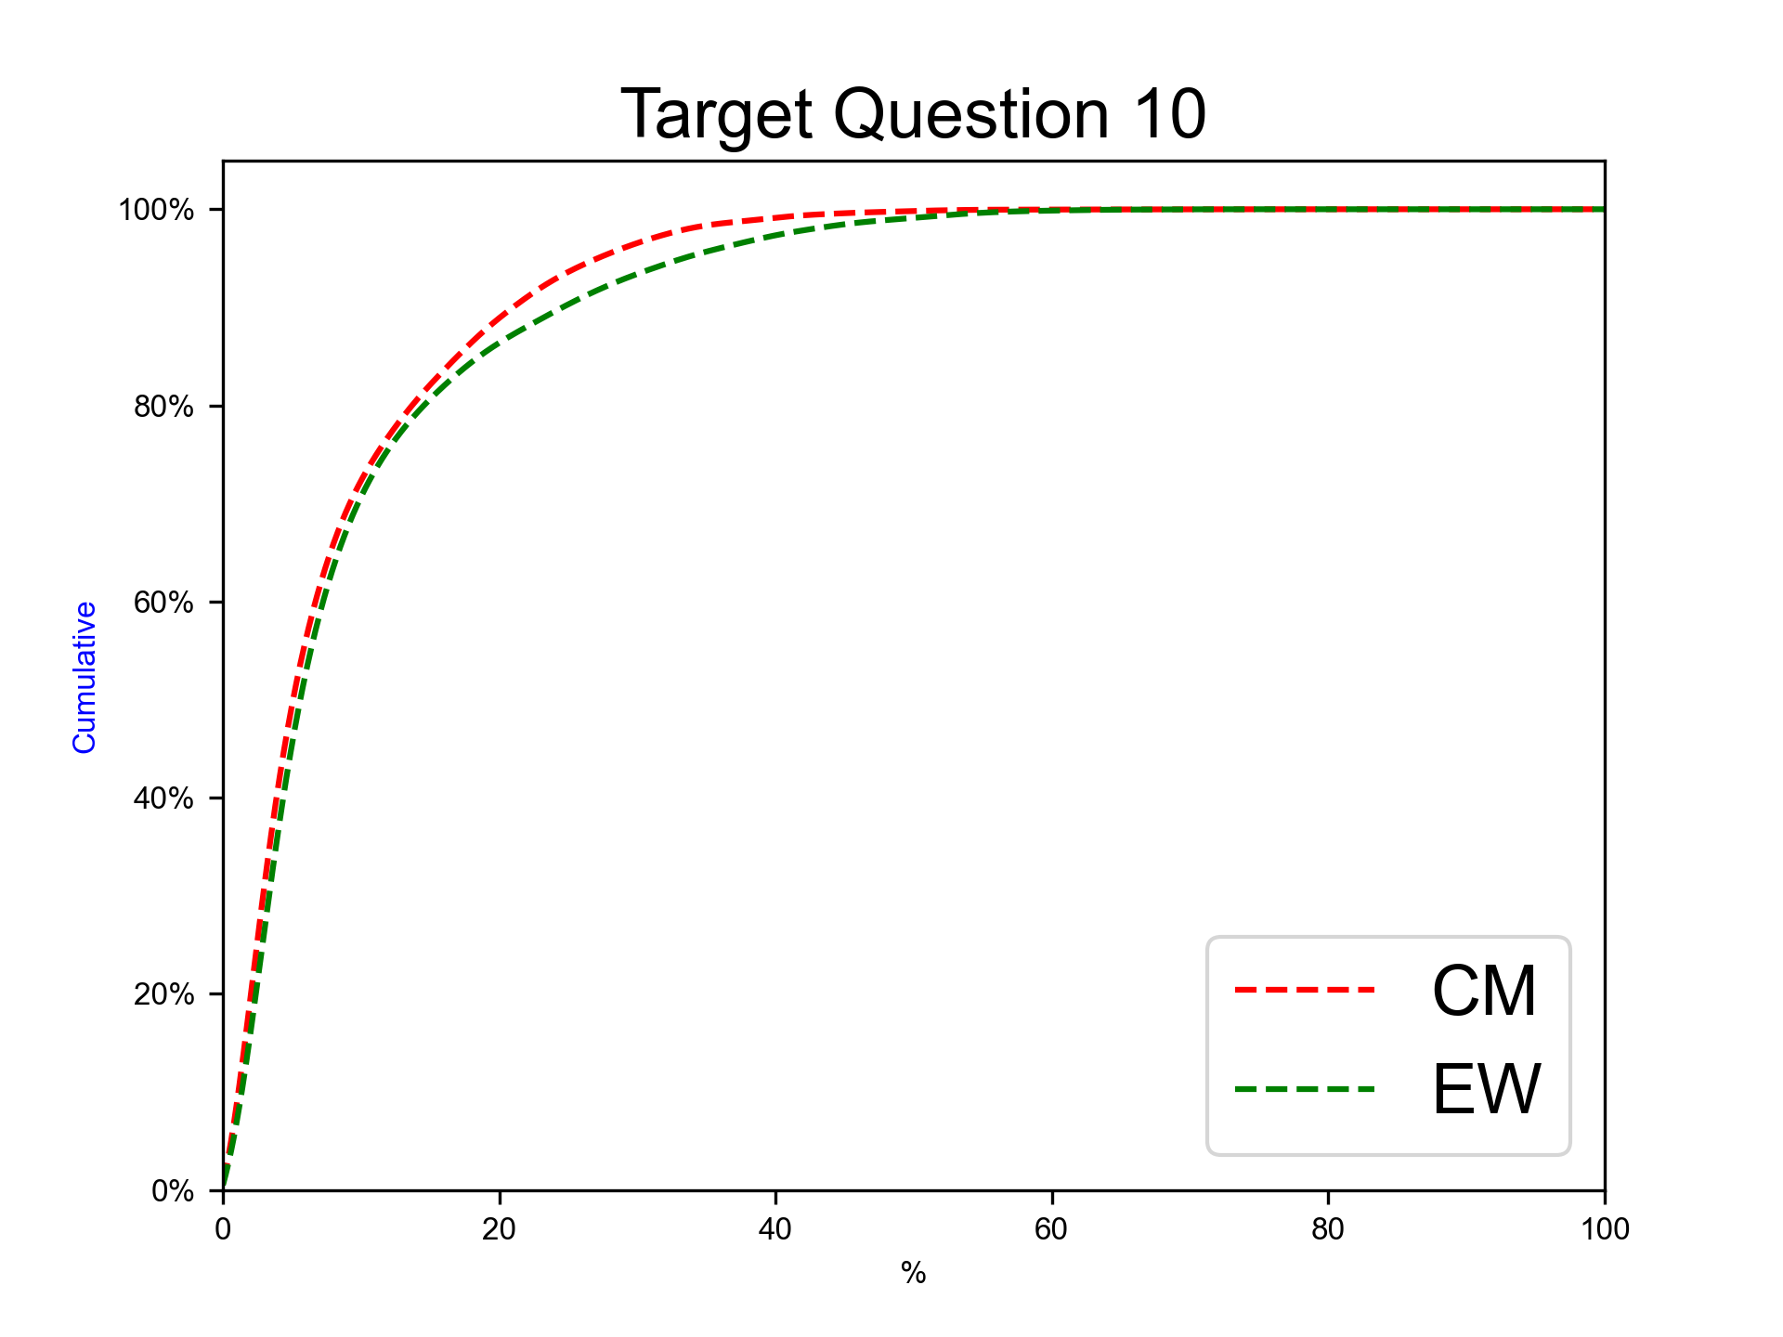
Next eruption, andesitic magma, other eruption type
Expert elicitation 17-Jul-2024
Given the present state of Cotopaxi volcano and your knowledge of its past eruptive chronology, how much probability do you assign to the possibility that at Cotopaxi, in case that the next eruption would involve totally or predominantly andesitic magma, the eruption would be of different type with respect to the previous ones?
N.B. The sum of 50%iles for questions 6-10 have to sum to 100.0.

Slide 30
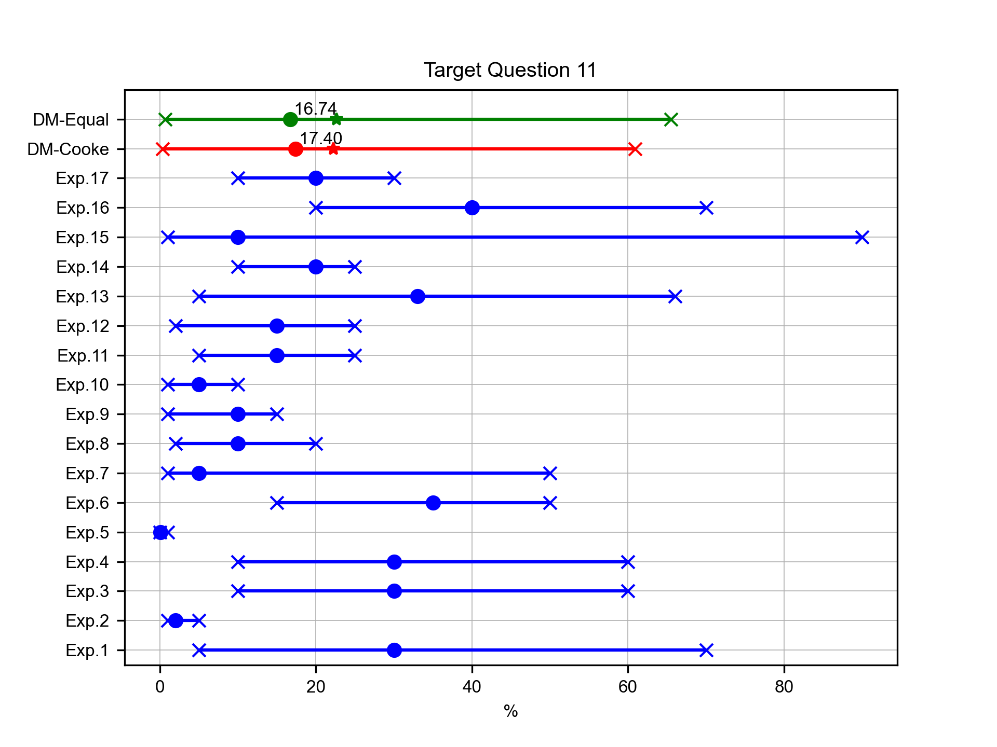
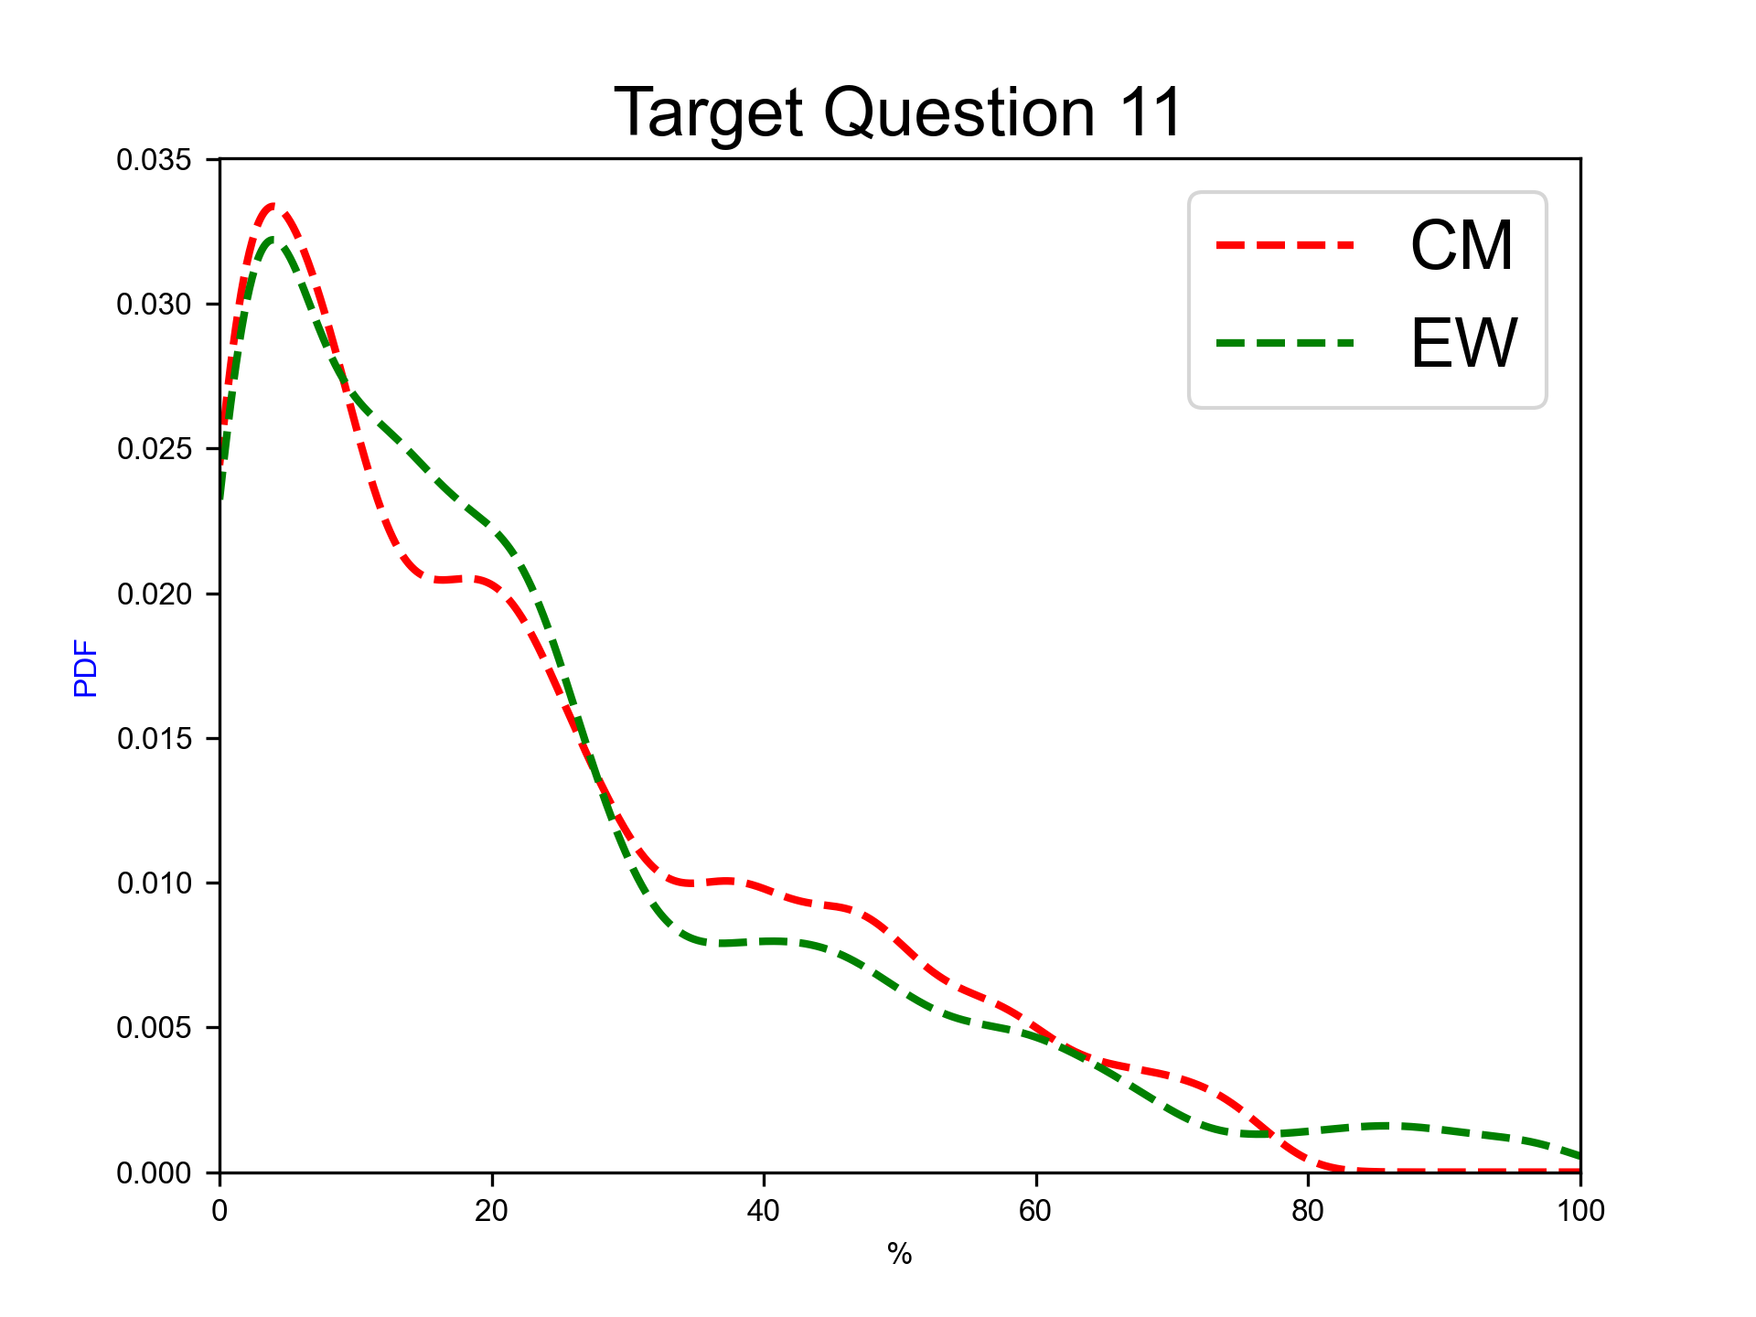
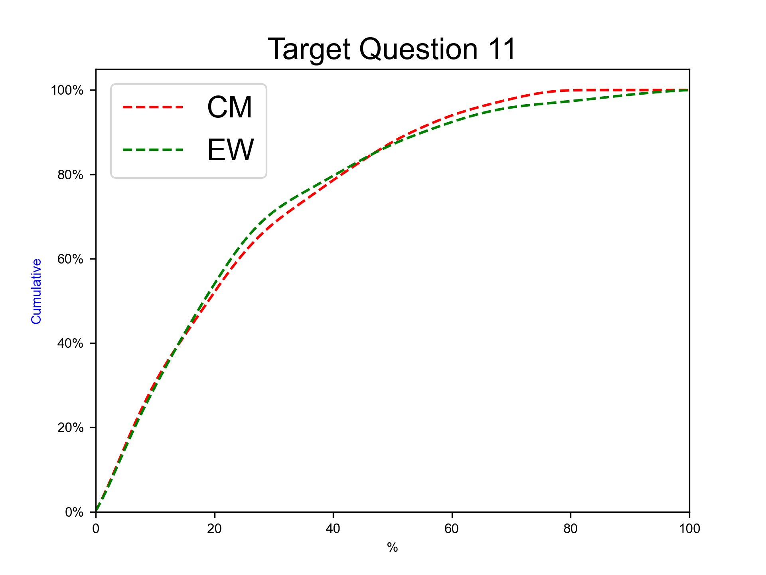
Next 100 years, rhyolitic magma
Expert elicitation 17-Jul-2024
Given the present state of Cotopaxi volcano and your knowledge of its past eruptive chronology, how much probability do you assign to the possibility that, for the next 100 years at Cotopaxi, there will be at least 1 eruption involving magma totally or predominantly of rhyolitic composition?

Slide 31
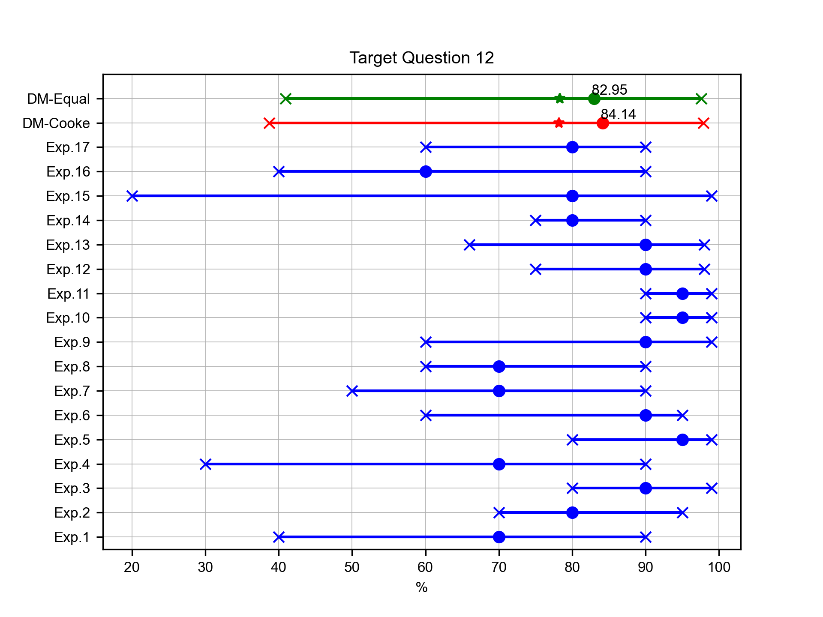
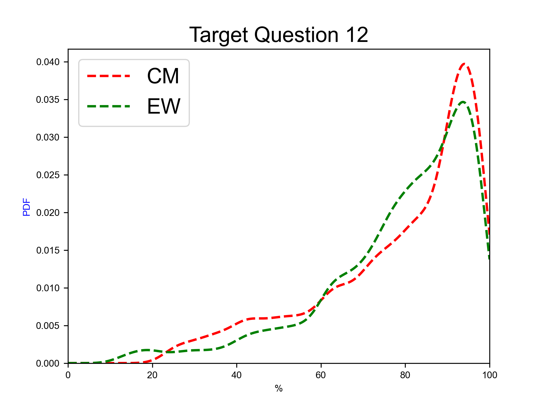
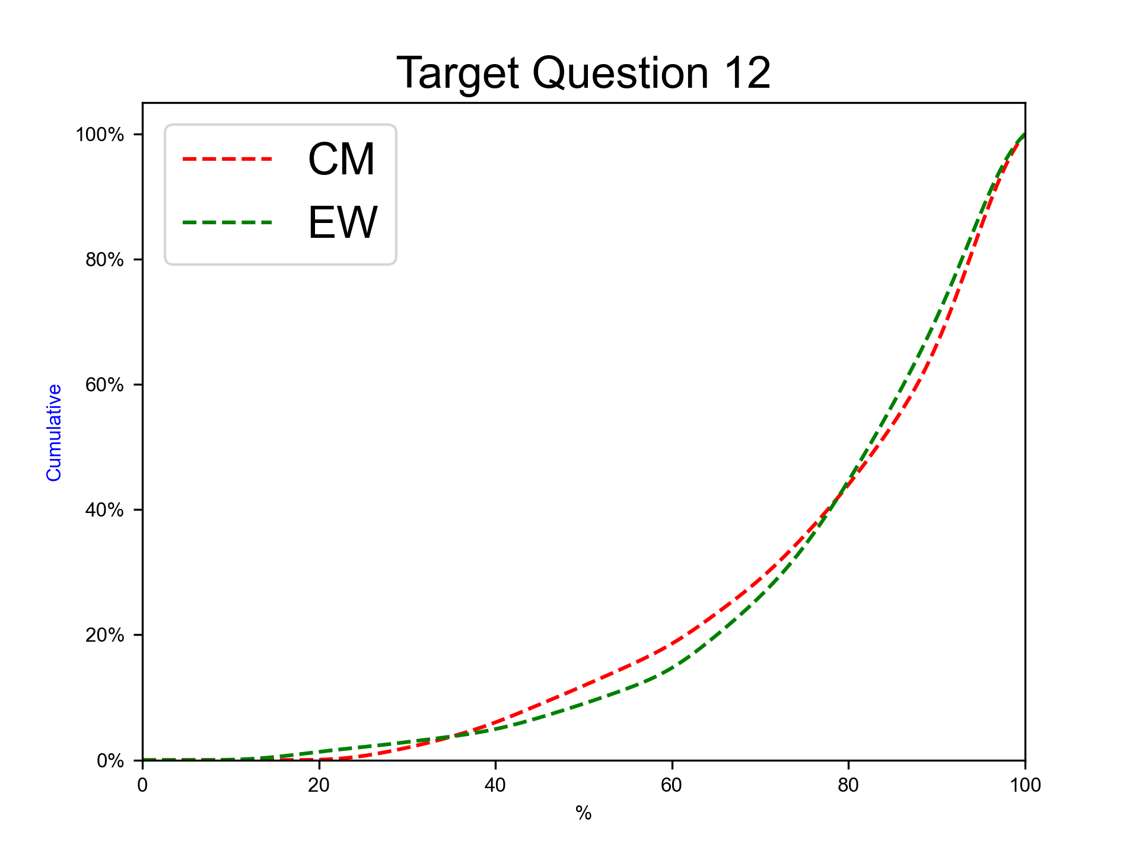
Next 100 years, andesitic magma
Expert elicitation 17-Jul-2024
Given the present state of Cotopaxi volcano and your knowledge of its past eruptive chronology, how much probability do you assign to the possibility that, for the next 100 years at Cotopaxi, there will be at least 1 eruption involving magma totally or predominantly of andesitic composition?

Slide 32



Next 100 years, rhyolitic magma, SubPlinian eruption
Expert elicitation 17-Jul-2024
Given the present state of Cotopaxi volcano and your knowledge of its past eruptive chronology, how much probability do you assign to the possibility that, for the next 100 years at Cotopaxi, in case totally or predominantly rhyolitic magma would be involved, there will be at least 1 SubPlinian eruption (VEI 3-4)?

Slide 33



Next 100 years, rhyolitic magma, Plinian eruption
Expert elicitation 17-Jul-2024
Given the present state of Cotopaxi volcano and your knowledge of its past eruptive chronology, how much probability do you assign to the possibility that, for the next 100 years at Cotopaxi, in case totally or predominantly rhyolitic magma would be involved, there will be at least 1 eruption similar to the F-2/F-4 ones (Plinian, VEI 4-5)?

Slide 34



Next 100 years, rhyolitic magma, other eruption type
Expert elicitation 17-Jul-2024
Given the present state of Cotopaxi volcano and your knowledge of its past eruptive chronology, how much probability do you assign to the possibility that, for the next 100 years at Cotopaxi, in case totally or predominantly rhyolitic magma would be involved, there will be at least 1 eruption of different type with respect to the previous ones?

Slide 35



Next 100 years, andesitic magma, Hydrovolcanic/Continuos ash emission eruption
Expert elicitation 17-Jul-2024
Given the present state of Cotopaxi volcano and your knowledge of its past eruptive chronology, how much probability do you assign to the possibility that, for the next 100 years at Cotopaxi, in case totally or predominantly andesitic magma would be involved, there will be at least 1 eruption similar to the AD 2015 one (Hydrovolcanic to long-lasting ash emission, VEI 1-2)?

Slide 36



Next 100 years, andesitic magma, Violent Strombolian eruption
Expert elicitation 17-Jul-2024
Given the present state of Cotopaxi volcano and your knowledge of its past eruptive chronology, how much probability do you assign to the possibility that, for the next 100 years at Cotopaxi, in case totally or predominantly andesitic magma would be involved, there will be at least 1 eruption similar to the ones in the XIX century (Violent Strombolian, VEI 2-3)?

Slide 37



Next 100 years, andesitic magma, SubPlinian eruption
Expert elicitation 17-Jul-2024
Given the present state of Cotopaxi volcano and your knowledge of its past eruptive chronology, how much probability do you assign to the possibility that, for the next 100 years at Cotopaxi, in case totally or predominantly andesitic magma would be involved, there will be at least 1 eruption similar to the AD 1877 one (SubPlinian, VEI 3-4)?

Slide 38



Next 100 years, andesitic magma, Plinian eruption
Expert elicitation 17-Jul-2024
Given the present state of Cotopaxi volcano and your knowledge of its past eruptive chronology, how much probability do you assign to the possibility that, for the next 100 years at Cotopaxi, in case totally or predominantly andesitic magma would be involved, there will be at least 1 eruption similar to the Layers 3/5 ones (Plinian, VEI 4-5)?

Slide 39



Next 100 years, andesitic magma, other eruption type
Expert elicitation 17-Jul-2024
Given the present state of Cotopaxi volcano and your knowledge of its past eruptive chronology, how much probability do you assign to the possibility that, for the next 100 years at Cotopaxi, in case totally or predominantly andesitic magma would be involved, there will be at least 1 eruption of different type with respect to the previous ones?

Slide 40



SubPlinian rhyolitic, duration
Expert elicitation 17-Jul-2024
SubPlinian eruptions – rhyolitic magma: what is the mean duration of this kind of eruption?

Slide 41



SubPlinian rhyolitic, total mass fallout
Expert elicitation 17-Jul-2024
SubPlinian eruptions – rhyolitic magma: what is the total amount of mass of the tephra fallout deposits associated to this kind of eruption?

Slide 42



SubPlinian rhyolitic, average plume height
Expert elicitation 17-Jul-2024
SubPlinian eruptions – rhyolitic magma: what is the average plume height of this kind of eruption?

Slide 43



Plinian rhyolitic, duration
Expert elicitation 17-Jul-2024
Plinian eruptions – rhyolitic magma: what is the mean duration of this kind of eruption?

Slide 44



Plinian rhyolitic, total mass fallout
Expert elicitation 17-Jul-2024
Plinian eruptions – rhyolitic magma: what is the total amount of mass of the tephra fallout deposits associated to this kind of eruption?

Slide 45



Plinian rhyolitic, average plume height
Expert elicitation 17-Jul-2024
Plinian eruptions – rhyolitic magma: what is the average plume height of this kind of eruption?

Slide 46



Hydrovolcanic/Continuos ash emission andesitic, duration
Expert elicitation 17-Jul-2024
Hydrovolcanic to long-lasting ash emission eruptions – andesitic magma: what is the mean duration of this kind of eruption?

Slide 47



Hydrovolcanic/Continuos ash emission andesitic, total mass fallout
Expert elicitation 17-Jul-2024
Hydrovolcanic to long-lasting ash emission eruptions – andesitic magma: what is the total amount of mass of the tephra fallout deposits associated to this kind of eruption?

Slide 48



Hydrovolcanic/Continuos ash emission andesitic, average plume height
Expert elicitation 17-Jul-2024
Hydrovolcanic to long-lasting ash emission eruptions – andesitic magma: what is the average plume height of this kind of eruption?

Slide 49



Violent Strombolian andesitic, duration
Expert elicitation 17-Jul-2024
Violent Strombolian eruptions – andesitic magma: what is the mean duration of this kind of eruption?

Slide 50



Violent Strombolian andesitic, total mass fallout
Expert elicitation 17-Jul-2024
Violent Strombolian eruptions – andesitic magma: what is the total amount of mass of the tephra fallout deposits associated to this kind of eruption?

Slide 51



Violent Strombolian andesitic, average plume height
Expert elicitation 17-Jul-2024
Violent Strombolian eruptions – andesitic magma: what is the average plume height of this kind of eruption?

Slide 52



SubPlinian andesitic, duration
Expert elicitation 17-Jul-2024
Subplinian eruptions – andesitic magma: what is the mean duration of this kind of eruption?

Slide 53



SubPlinian andesitic, total mass fallout
Expert elicitation 17-Jul-2024
Subplinian eruptions – andesitic magma: what is the total amount of mass of the tephra fallout deposits associated to this kind of eruption?

Slide 54



SubPlinian andesitic, average plume height
Expert elicitation 17-Jul-2024
Subplinian eruptions – andesitic magma: what is the average plume height of this kind of eruption?

Slide 55



Plinian andesitic, duration
Expert elicitation 17-Jul-2024
Plinian eruptions – andesitic magma: what is the mean duration of this kind of eruption?

Slide 56



Plinian andesitic, total mass fallout
Expert elicitation 17-Jul-2024
Plinian eruptions – andesitic magma: what is the total amount of mass of the tephra fallout deposits associated to this kind of eruption?

Slide 57



Plinian andesitic, average plume height
Expert elicitation 17-Jul-2024
Plinian eruptions – andesitic magma: what is the average plume height of this kind of eruption?

Slide 58
Target Percentiles
Expert elicitation 17-Jul-2024

Slide 59
Percentiles of target questions
Expert elicitation 17-Jul-2024
 | Q05 (EW) | Q50 (EW) | Q95 (EW) | Qmean (EW) | Q05 (Cooke) | Q50 (Cooke) | Q95 (Cooke) | Qmean (Cooke)
TQ 1 | 2.33 | 12.59 | 46.81 | 17.08 | 1.59 | 8.78 | 30.83 | 11.46
TQ 2 | 53.19 | 87.41 | 97.67 | 82.92 | 69.17 | 91.22 | 98.41 | 88.54
TQ 3 | 11.29 | 44.74 | 77.47 | 44.72 | 13.93 | 47.65 | 76.58 | 46.98
TQ 4 | 6.43 | 33.89 | 69.89 | 35.27 | 9.27 | 34.63 | 68.38 | 36.22
TQ 5 | 3.15 | 14.23 | 53.76 | 20.01 | 2.99 | 11.55 | 48.66 | 16.81
TQ 6 | 9.64 | 36.02 | 64.61 | 36.37 | 20.89 | 50.82 | 75.20 | 49.89
TQ 7 | 4.95 | 23.56 | 53.25 | 25.39 | 2.86 | 18.05 | 46.45 | 20.59
TQ 8 | 3.24 | 15.43 | 44.83 | 18.62 | 2.45 | 11.78 | 33.85 | 14.26
TQ 9 | 0.92 | 6.46 | 36.61 | 10.57 | 0.63 | 5.05 | 21.61 | 7.38
TQ 10 | 1.01 | 4.95 | 32.60 | 9.06 | 0.67 | 4.53 | 26.58 | 7.88
TQ 11 | 0.69 | 16.74 | 65.48 | 22.62 | 0.36 | 17.40 | 60.90 | 22.25
TQ 12 | 40.90 | 82.95 | 97.60 | 78.33 | 38.71 | 84.14 | 97.90 | 78.20
TQ 13 | 5.52 | 49.57 | 91.30 | 49.43 | 10.36 | 48.42 | 85.26 | 48.48
TQ 14 | 2.86 | 40.75 | 87.29 | 42.65 | 5.44 | 44.73 | 88.15 | 47.66
TQ 15 | 1.72 | 12.07 | 75.94 | 20.52 | 1.49 | 9.84 | 68.51 | 16.74
TQ 16 | 13.59 | 60.49 | 93.37 | 57.56 | 17.79 | 75.12 | 93.71 | 66.52
TQ 17 | 12.33 | 52.86 | 90.57 | 50.38 | 12.70 | 62.45 | 93.05 | 58.73
TQ 18 | 5.28 | 29.66 | 79.93 | 34.39 | 7.06 | 39.80 | 85.28 | 41.48

Slide 60
Percentiles of target questions
Expert elicitation 17-Jul-2024
 | Q05 (EW) | Q50 (EW) | Q95 (EW) | Qmean (EW) | Q05 (Cooke) | Q50 (Cooke) | Q95 (Cooke) | Qmean (Cooke)
TQ 19 | 1.51 | 14.95 | 57.84 | 19.93 | 2.26 | 19.58 | 46.25 | 21.25
TQ 20 | 1.26 | 10.73 | 56.68 | 17.22 | 1.75 | 9.42 | 42.77 | 13.63
TQ 21 | 9.13E+00 | 1.91E+02 | 3.89E+03 | 1.71E+02 | 1.77E+01 | 1.47E+02 | 5.48E+03 | 1.87E+02
TQ 22 | 3.07E+05 | 3.50E+10 | 7.83E+11 | 1.26E+10 | 3.25E+09 | 5.02E+10 | 7.28E+11 | 4.98E+10
TQ 23 | 1.54E+03 | 1.69E+04 | 2.82E+04 | 1.38E+04 | 6.67E+03 | 1.61E+04 | 2.50E+04 | 1.48E+04
TQ 24 | 1.39E+01 | 3.20E+02 | 9.30E+03 | 2.85E+02 | 2.85E+01 | 3.29E+02 | 1.13E+04 | 3.42E+02
TQ 25 | 1.01E+06 | 5.00E+11 | 3.78E+13 | 1.73E+11 | 2.44E+10 | 4.08E+11 | 6.34E+12 | 4.26E+11
TQ 26 | 6.27E+03 | 2.63E+04 | 4.16E+04 | 2.23E+04 | 1.12E+04 | 2.48E+04 | 3.88E+04 | 2.35E+04
TQ 27 | 3.31E+01 | 4.34E+04 | 7.53E+05 | 1.75E+04 | 2.91E+02 | 4.63E+04 | 1.19E+06 | 3.58E+04
TQ 28 | 1.31E+04 | 8.49E+08 | 6.29E+10 | 1.94E+08 | 1.66E+05 | 7.71E+08 | 9.34E+10 | 4.23E+08
TQ 29 | 2.19E+02 | 3.00E+03 | 1.27E+04 | 2.66E+03 | 3.32E+02 | 3.97E+03 | 1.33E+04 | 3.25E+03
TQ 30 | 6.14E+00 | 4.44E+01 | 4.12E+03 | 7.15E+01 | 6.53E+00 | 4.23E+01 | 3.45E+03 | 6.09E+01
TQ 31 | 3.80E+06 | 9.04E+08 | 5.39E+10 | 7.86E+08 | 1.59E+07 | 5.12E+09 | 7.44E+10 | 3.02E+09
TQ 32 | 1.40E+03 | 9.54E+03 | 2.73E+04 | 8.10E+03 | 1.45E+03 | 8.51E+03 | 1.67E+04 | 7.29E+03
TQ 33 | 8.10E+00 | 5.52E+01 | 4.98E+03 | 7.84E+01 | 8.90E+00 | 7.46E+01 | 8.05E+03 | 1.02E+02
TQ 34 | 3.73E+07 | 1.90E+10 | 3.34E+11 | 1.09E+10 | 1.26E+09 | 3.21E+10 | 3.37E+11 | 2.63E+10
TQ 35 | 7.35E+03 | 1.94E+04 | 2.78E+04 | 1.75E+04 | 6.92E+03 | 1.82E+04 | 2.50E+04 | 1.66E+04
TQ 36 | 1.21E+01 | 1.49E+02 | 1.21E+04 | 1.82E+02 | 1.12E+01 | 1.49E+02 | 1.64E+04 | 2.05E+02

Slide 61
Percentiles of target questions
Expert elicitation 17-Jul-2024
 | Q05 (EW) | Q50 (EW) | Q95 (EW) | Qmean (EW) | Q05 (Cooke) | Q50 (Cooke) | Q95 (Cooke) | Qmean (Cooke)
TQ 37 | 3.47E+07 | 2.71E+11 | 8.39E+12 | 1.60E+11 | 1.51E+10 | 2.32E+11 | 2.81E+12 | 2.39E+11
TQ 38 | 1.30E+04 | 2.59E+04 | 3.61E+04 | 2.46E+04 | 1.37E+04 | 2.58E+04 | 3.50E+04 | 2.45E+04

Slide 62
Trend plots
Expert elicitation 17-Jul-2024

Slide 63

Target questions Group 1
Expert elicitation 17-Jul-2024
TQ3. Next eruption, rhyolitic magma, SubPlinian eruption.
TQ4. Next eruption, rhyolitic magma, Plinian eruption.
TQ5. Next eruption, rhyolitic magma, other eruption type.

Slide 64
Violin plots
Expert elicitation 17-Jul-2024

Slide 65

Target questions Group 1
Expert elicitation 17-Jul-2024
TQ6. Next eruption, andesitic magma, Hydrovolcanic/Continuos ash emission eruption.
TQ7. Next eruption, andesitic magma, Violent Strombolian eruption.
TQ8. Next eruption, andesitic magma, SubPlinian eruption.
TQ9. Next eruption, andesitic magma, Plinian eruption.
TQ10. Next eruption, andesitic magma, other eruption type.

Slide 66
Pie charts
Expert elicitation 17-Jul-2024

Slide 67

Target questions Group 1
Expert elicitation 17-Jul-2024
TQ3. Next eruption, rhyolitic magma, SubPlinian eruption.
TQ4. Next eruption, rhyolitic magma, Plinian eruption.
TQ5. Next eruption, rhyolitic magma, other eruption type.

Slide 68

Target questions Group 2
Expert elicitation 17-Jul-2024
TQ6. Next eruption, andesitic magma, Hydrovolcanic/Continuos ash emission eruption.
TQ7. Next eruption, andesitic magma, Violent Strombolian eruption.
TQ8. Next eruption, andesitic magma, SubPlinian eruption.
TQ9. Next eruption, andesitic magma, Plinian eruption.
TQ10. Next eruption, andesitic magma, other eruption type.

Slide 69
Target Barplots
Expert elicitation 17-Jul-2024

Slide 70

Next eruption, rhyolitic magma
Expert elicitation 17-Jul-2024
Given the present state of Cotopaxi volcano and your knowledge of its past eruptive chronology, how much probability do you assign to the possibility that, for the next eruption at Cotopaxi, the magma involved would be totally or predominantly of rhyolitic composition?
 | Q05 | Q50 | Q95 | Qmean
Cooke | 1.59E+00 | 8.78E+00 | 3.08E+01 | 1.15E+01
EW | 2.33E+00 | 1.26E+01 | 4.68E+01 | 1.71E+01

Slide 71

Next eruption, andesitic magma
Expert elicitation 17-Jul-2024
Given the present state of Cotopaxi volcano and your knowledge of its past eruptive chronology, how much probability do you assign to the possibility that, for the next eruption at Cotopaxi, the magma involved would be totally or predominantly of andesitic composition?
 | Q05 | Q50 | Q95 | Qmean
Cooke | 6.92E+01 | 9.12E+01 | 9.84E+01 | 8.85E+01
EW | 5.32E+01 | 8.74E+01 | 9.77E+01 | 8.29E+01

Slide 72

Next eruption, rhyolitic magma, SubPlinian eruption
Expert elicitation 17-Jul-2024
Given the present state of Cotopaxi volcano and your knowledge of its past eruptive chronology, how much probability do you assign to the possibility that at Cotopaxi, in case that the next eruption would involve totally or predominantly rhyolitic magma, the eruption would be SubPlinian (VEI 3-4)?
 | Q05 | Q50 | Q95 | Qmean
Cooke | 1.39E+01 | 4.77E+01 | 7.66E+01 | 4.70E+01
EW | 1.13E+01 | 4.47E+01 | 7.75E+01 | 4.47E+01

Slide 73

Next eruption, rhyolitic magma, Plinian eruption
Expert elicitation 17-Jul-2024
Given the present state of Cotopaxi volcano and your knowledge of its past eruptive chronology, how much probability do you assign to the possibility that at Cotopaxi, in case that the next eruption would involve totally or predominantly rhyolitic magma, the eruption would be similar to the F-2/F-4 ones (Plinian, VEI 4-5)?
 | Q05 | Q50 | Q95 | Qmean
Cooke | 9.27E+00 | 3.46E+01 | 6.84E+01 | 3.62E+01
EW | 6.43E+00 | 3.39E+01 | 6.99E+01 | 3.53E+01

Slide 74

Next eruption, rhyolitic magma, other eruption type
Expert elicitation 17-Jul-2024
Given the present state of Cotopaxi volcano and your knowledge of its past eruptive chronology, how much probability do you assign to the possibility that at Cotopaxi, in case that the next eruption would involve totally or predominantly rhyolitic magma, the eruption would be of different type with respect to the previous ones?
 | Q05 | Q50 | Q95 | Qmean
Cooke | 2.99E+00 | 1.16E+01 | 4.87E+01 | 1.68E+01
EW | 3.15E+00 | 1.42E+01 | 5.38E+01 | 2.00E+01

Slide 75

Next eruption, andesitic magma, Hydrovolcanic/Continuos ash emission eruption
Expert elicitation 17-Jul-2024
Given the present state of Cotopaxi volcano and your knowledge of its past eruptive chronology, how much probability do you assign to the possibility that at Cotopaxi, in case that the next eruption would involve totally or predominantly andesitic magma, the eruption would be similar to the AD 2015 one (Hydrovolcanic to long-lasting ash emission, VEI 1-2)?
 | Q05 | Q50 | Q95 | Qmean
Cooke | 2.09E+01 | 5.08E+01 | 7.52E+01 | 4.99E+01
EW | 9.64E+00 | 3.60E+01 | 6.46E+01 | 3.64E+01

Slide 76

Next eruption, andesitic magma, Violent Strombolian eruption
Expert elicitation 17-Jul-2024
Given the present state of Cotopaxi volcano and your knowledge of its past eruptive chronology, how much probability do you assign to the possibility that at Cotopaxi, in case that the next eruption would involve totally or predominantly andesitic magma, the eruption would be similar to the ones in the XIX century (Violent Strombolian, VEI 2-3)?
 | Q05 | Q50 | Q95 | Qmean
Cooke | 2.86E+00 | 1.81E+01 | 4.64E+01 | 2.06E+01
EW | 4.95E+00 | 2.36E+01 | 5.32E+01 | 2.54E+01

Slide 77

Next eruption, andesitic magma, SubPlinian eruption
Expert elicitation 17-Jul-2024
Given the present state of Cotopaxi volcano and your knowledge of its past eruptive chronology, how much probability do you assign to the possibility that at Cotopaxi, in case that the next eruption would involve totally or predominantly andesitic magma, the eruption would be similar to the AD 1877 one (SubPlinian, VEI 3-4)?
 | Q05 | Q50 | Q95 | Qmean
Cooke | 2.45E+00 | 1.18E+01 | 3.38E+01 | 1.43E+01
EW | 3.24E+00 | 1.54E+01 | 4.48E+01 | 1.86E+01

Slide 78

Next eruption, andesitic magma, Plinian eruption
Expert elicitation 17-Jul-2024
Given the present state of Cotopaxi volcano and your knowledge of its past eruptive chronology, how much probability do you assign to the possibility that at Cotopaxi, in case that the next eruption would involve totally or predominantly andesitic magma, the eruption would be similar to the Layers 3/5 ones (Plinian, VEI 4-5)?
 | Q05 | Q50 | Q95 | Qmean
Cooke | 6.32E-01 | 5.05E+00 | 2.16E+01 | 7.38E+00
EW | 9.15E-01 | 6.46E+00 | 3.66E+01 | 1.06E+01

Slide 79

Next eruption, andesitic magma, other eruption type
Expert elicitation 17-Jul-2024
Given the present state of Cotopaxi volcano and your knowledge of its past eruptive chronology, how much probability do you assign to the possibility that at Cotopaxi, in case that the next eruption would involve totally or predominantly andesitic magma, the eruption would be of different type with respect to the previous ones?
 | Q05 | Q50 | Q95 | Qmean
Cooke | 6.67E-01 | 4.53E+00 | 2.66E+01 | 7.88E+00
EW | 1.01E+00 | 4.95E+00 | 3.26E+01 | 9.06E+00

Slide 80

Next 100 years, rhyolitic magma
Expert elicitation 17-Jul-2024
Given the present state of Cotopaxi volcano and your knowledge of its past eruptive chronology, how much probability do you assign to the possibility that, for the next 100 years at Cotopaxi, there will be at least 1 eruption involving magma totally or predominantly of rhyolitic composition?
 | Q05 | Q50 | Q95 | Qmean
Cooke | 3.61E-01 | 1.74E+01 | 6.09E+01 | 2.22E+01
EW | 6.92E-01 | 1.67E+01 | 6.55E+01 | 2.26E+01

Slide 81

Next 100 years, andesitic magma
Expert elicitation 17-Jul-2024
Given the present state of Cotopaxi volcano and your knowledge of its past eruptive chronology, how much probability do you assign to the possibility that, for the next 100 years at Cotopaxi, there will be at least 1 eruption involving magma totally or predominantly of andesitic composition?
 | Q05 | Q50 | Q95 | Qmean
Cooke | 3.87E+01 | 8.41E+01 | 9.79E+01 | 7.82E+01
EW | 4.09E+01 | 8.29E+01 | 9.76E+01 | 7.83E+01

Slide 82

Next 100 years, rhyolitic magma, SubPlinian eruption
Expert elicitation 17-Jul-2024
Given the present state of Cotopaxi volcano and your knowledge of its past eruptive chronology, how much probability do you assign to the possibility that, for the next 100 years at Cotopaxi, in case totally or predominantly rhyolitic magma would be involved, there will be at least 1 SubPlinian eruption (VEI 3-4)?
 | Q05 | Q50 | Q95 | Qmean
Cooke | 1.04E+01 | 4.84E+01 | 8.53E+01 | 4.85E+01
EW | 5.52E+00 | 4.96E+01 | 9.13E+01 | 4.94E+01

Slide 83

Next 100 years, rhyolitic magma, Plinian eruption
Expert elicitation 17-Jul-2024
Given the present state of Cotopaxi volcano and your knowledge of its past eruptive chronology, how much probability do you assign to the possibility that, for the next 100 years at Cotopaxi, in case totally or predominantly rhyolitic magma would be involved, there will be at least 1 eruption similar to the F-2/F-4 ones (Plinian, VEI 4-5)?
 | Q05 | Q50 | Q95 | Qmean
Cooke | 5.44E+00 | 4.47E+01 | 8.81E+01 | 4.77E+01
EW | 2.86E+00 | 4.08E+01 | 8.73E+01 | 4.26E+01

Slide 84

Next 100 years, rhyolitic magma, other eruption type
Expert elicitation 17-Jul-2024
Given the present state of Cotopaxi volcano and your knowledge of its past eruptive chronology, how much probability do you assign to the possibility that, for the next 100 years at Cotopaxi, in case totally or predominantly rhyolitic magma would be involved, there will be at least 1 eruption of different type with respect to the previous ones?
 | Q05 | Q50 | Q95 | Qmean
Cooke | 1.49E+00 | 9.84E+00 | 6.85E+01 | 1.67E+01
EW | 1.72E+00 | 1.21E+01 | 7.59E+01 | 2.05E+01

Slide 85

Next 100 years, andesitic magma, Hydrovolcanic/Continuos ash emission eruption
Expert elicitation 17-Jul-2024
Given the present state of Cotopaxi volcano and your knowledge of its past eruptive chronology, how much probability do you assign to the possibility that, for the next 100 years at Cotopaxi, in case totally or predominantly andesitic magma would be involved, there will be at least 1 eruption similar to the AD 2015 one (Hydrovolcanic to long-lasting ash emission, VEI 1-2)?
 | Q05 | Q50 | Q95 | Qmean
Cooke | 1.78E+01 | 7.51E+01 | 9.37E+01 | 6.65E+01
EW | 1.36E+01 | 6.05E+01 | 9.34E+01 | 5.76E+01

Slide 86

Next 100 years, andesitic magma, Violent Strombolian eruption
Expert elicitation 17-Jul-2024
Given the present state of Cotopaxi volcano and your knowledge of its past eruptive chronology, how much probability do you assign to the possibility that, for the next 100 years at Cotopaxi, in case totally or predominantly andesitic magma would be involved, there will be at least 1 eruption similar to the ones in the XIX century (Violent Strombolian, VEI 2-3)?
 | Q05 | Q50 | Q95 | Qmean
Cooke | 1.27E+01 | 6.24E+01 | 9.30E+01 | 5.87E+01
EW | 1.23E+01 | 5.29E+01 | 9.06E+01 | 5.04E+01

Slide 87

Next 100 years, andesitic magma, SubPlinian eruption
Expert elicitation 17-Jul-2024
Given the present state of Cotopaxi volcano and your knowledge of its past eruptive chronology, how much probability do you assign to the possibility that, for the next 100 years at Cotopaxi, in case totally or predominantly andesitic magma would be involved, there will be at least 1 eruption similar to the AD 1877 one (SubPlinian, VEI 3-4)?
 | Q05 | Q50 | Q95 | Qmean
Cooke | 7.06E+00 | 3.98E+01 | 8.53E+01 | 4.15E+01
EW | 5.28E+00 | 2.97E+01 | 7.99E+01 | 3.44E+01

Slide 88

Next 100 years, andesitic magma, Plinian eruption
Expert elicitation 17-Jul-2024
Given the present state of Cotopaxi volcano and your knowledge of its past eruptive chronology, how much probability do you assign to the possibility that, for the next 100 years at Cotopaxi, in case totally or predominantly andesitic magma would be involved, there will be at least 1 eruption similar to the Layers 3/5 ones (Plinian, VEI 4-5)?
 | Q05 | Q50 | Q95 | Qmean
Cooke | 2.26E+00 | 1.96E+01 | 4.63E+01 | 2.13E+01
EW | 1.51E+00 | 1.49E+01 | 5.78E+01 | 1.99E+01

Slide 89

Next 100 years, andesitic magma, other eruption type
Expert elicitation 17-Jul-2024
Given the present state of Cotopaxi volcano and your knowledge of its past eruptive chronology, how much probability do you assign to the possibility that, for the next 100 years at Cotopaxi, in case totally or predominantly andesitic magma would be involved, there will be at least 1 eruption of different type with respect to the previous ones?
 | Q05 | Q50 | Q95 | Qmean
Cooke | 1.75E+00 | 9.42E+00 | 4.28E+01 | 1.36E+01
EW | 1.26E+00 | 1.07E+01 | 5.67E+01 | 1.72E+01

Slide 90

SubPlinian rhyolitic, duration
Expert elicitation 17-Jul-2024
SubPlinian eruptions – rhyolitic magma: what is the mean duration of this kind of eruption?
 | Q05 | Q50 | Q95 | Qmean
Cooke | 1.77E+01 | 1.47E+02 | 5.48E+03 | 1.87E+02
EW | 9.13E+00 | 1.91E+02 | 3.89E+03 | 1.71E+02

Slide 91

SubPlinian rhyolitic, total mass fallout
Expert elicitation 17-Jul-2024
SubPlinian eruptions – rhyolitic magma: what is the total amount of mass of the tephra fallout deposits associated to this kind of eruption?
 | Q05 | Q50 | Q95 | Qmean
Cooke | 3.25E+09 | 5.02E+10 | 7.28E+11 | 4.98E+10
EW | 3.07E+05 | 3.50E+10 | 7.83E+11 | 1.26E+10

Slide 92

SubPlinian rhyolitic, average plume height
Expert elicitation 17-Jul-2024
SubPlinian eruptions – rhyolitic magma: what is the average plume height of this kind of eruption?
 | Q05 | Q50 | Q95 | Qmean
Cooke | 6.67E+03 | 1.61E+04 | 2.50E+04 | 1.48E+04
EW | 1.54E+03 | 1.69E+04 | 2.82E+04 | 1.38E+04

Slide 93

Plinian rhyolitic, duration
Expert elicitation 17-Jul-2024
Plinian eruptions – rhyolitic magma: what is the mean duration of this kind of eruption?
 | Q05 | Q50 | Q95 | Qmean
Cooke | 2.85E+01 | 3.29E+02 | 1.13E+04 | 3.42E+02
EW | 1.39E+01 | 3.20E+02 | 9.30E+03 | 2.85E+02

Slide 94

Plinian rhyolitic, total mass fallout
Expert elicitation 17-Jul-2024
Plinian eruptions – rhyolitic magma: what is the total amount of mass of the tephra fallout deposits associated to this kind of eruption?
 | Q05 | Q50 | Q95 | Qmean
Cooke | 2.44E+10 | 4.08E+11 | 6.34E+12 | 4.26E+11
EW | 1.01E+06 | 5.00E+11 | 3.78E+13 | 1.73E+11

Slide 95

Plinian rhyolitic, average plume height
Expert elicitation 17-Jul-2024
Plinian eruptions – rhyolitic magma: what is the average plume height of this kind of eruption?
 | Q05 | Q50 | Q95 | Qmean
Cooke | 1.12E+04 | 2.48E+04 | 3.88E+04 | 2.35E+04
EW | 6.27E+03 | 2.63E+04 | 4.16E+04 | 2.23E+04

Slide 96

Hydrovolcanic/Continuos ash emission andesitic, duration
Expert elicitation 17-Jul-2024
Hydrovolcanic to long-lasting ash emission eruptions – andesitic magma: what is the mean duration of this kind of eruption?
 | Q05 | Q50 | Q95 | Qmean
Cooke | 2.91E+02 | 4.63E+04 | 1.19E+06 | 3.58E+04
EW | 3.31E+01 | 4.34E+04 | 7.53E+05 | 1.75E+04

Slide 97

Hydrovolcanic/Continuos ash emission andesitic, total mass fallout
Expert elicitation 17-Jul-2024
Hydrovolcanic to long-lasting ash emission eruptions – andesitic magma: what is the total amount of mass of the tephra fallout deposits associated to this kind of eruption?
 | Q05 | Q50 | Q95 | Qmean
Cooke | 1.66E+05 | 7.71E+08 | 9.34E+10 | 4.23E+08
EW | 1.31E+04 | 8.49E+08 | 6.29E+10 | 1.94E+08

Slide 98

Hydrovolcanic/Continuos ash emission andesitic, average plume height
Expert elicitation 17-Jul-2024
Hydrovolcanic to long-lasting ash emission eruptions – andesitic magma: what is the average plume height of this kind of eruption?
 | Q05 | Q50 | Q95 | Qmean
Cooke | 3.32E+02 | 3.97E+03 | 1.33E+04 | 3.25E+03
EW | 2.19E+02 | 3.00E+03 | 1.27E+04 | 2.66E+03

Slide 99

Violent Strombolian andesitic, duration
Expert elicitation 17-Jul-2024
Violent Strombolian eruptions – andesitic magma: what is the mean duration of this kind of eruption?
 | Q05 | Q50 | Q95 | Qmean
Cooke | 6.53E+00 | 4.23E+01 | 3.45E+03 | 6.09E+01
EW | 6.14E+00 | 4.44E+01 | 4.12E+03 | 7.15E+01

Slide 100

Violent Strombolian andesitic, total mass fallout
Expert elicitation 17-Jul-2024
Violent Strombolian eruptions – andesitic magma: what is the total amount of mass of the tephra fallout deposits associated to this kind of eruption?
 | Q05 | Q50 | Q95 | Qmean
Cooke | 1.59E+07 | 5.12E+09 | 7.44E+10 | 3.02E+09
EW | 3.80E+06 | 9.04E+08 | 5.39E+10 | 7.86E+08

Slide 101

Violent Strombolian andesitic, average plume height
Expert elicitation 17-Jul-2024
Violent Strombolian eruptions – andesitic magma: what is the average plume height of this kind of eruption?
 | Q05 | Q50 | Q95 | Qmean
Cooke | 1.45E+03 | 8.51E+03 | 1.67E+04 | 7.29E+03
EW | 1.40E+03 | 9.54E+03 | 2.73E+04 | 8.10E+03

Slide 102

SubPlinian andesitic, duration
Expert elicitation 17-Jul-2024
Subplinian eruptions – andesitic magma: what is the mean duration of this kind of eruption?
 | Q05 | Q50 | Q95 | Qmean
Cooke | 8.90E+00 | 7.46E+01 | 8.05E+03 | 1.02E+02
EW | 8.10E+00 | 5.52E+01 | 4.98E+03 | 7.84E+01

Slide 103

SubPlinian andesitic, total mass fallout
Expert elicitation 17-Jul-2024
Subplinian eruptions – andesitic magma: what is the total amount of mass of the tephra fallout deposits associated to this kind of eruption?
 | Q05 | Q50 | Q95 | Qmean
Cooke | 1.26E+09 | 3.21E+10 | 3.37E+11 | 2.63E+10
EW | 3.73E+07 | 1.90E+10 | 3.34E+11 | 1.09E+10

Slide 104

SubPlinian andesitic, average plume height
Expert elicitation 17-Jul-2024
Subplinian eruptions – andesitic magma: what is the average plume height of this kind of eruption?
 | Q05 | Q50 | Q95 | Qmean
Cooke | 6.92E+03 | 1.82E+04 | 2.50E+04 | 1.66E+04
EW | 7.35E+03 | 1.94E+04 | 2.78E+04 | 1.75E+04

Slide 105

Plinian andesitic, duration
Expert elicitation 17-Jul-2024
Plinian eruptions – andesitic magma: what is the mean duration of this kind of eruption?
 | Q05 | Q50 | Q95 | Qmean
Cooke | 1.12E+01 | 1.49E+02 | 1.64E+04 | 2.05E+02
EW | 1.21E+01 | 1.49E+02 | 1.21E+04 | 1.82E+02

Slide 106

Plinian andesitic, total mass fallout
Expert elicitation 17-Jul-2024
Plinian eruptions – andesitic magma: what is the total amount of mass of the tephra fallout deposits associated to this kind of eruption?
 | Q05 | Q50 | Q95 | Qmean
Cooke | 1.51E+10 | 2.32E+11 | 2.81E+12 | 2.39E+11
EW | 3.47E+07 | 2.71E+11 | 8.39E+12 | 1.60E+11

Slide 107

Plinian andesitic, average plume height
Expert elicitation 17-Jul-2024
Plinian eruptions – andesitic magma: what is the average plume height of this kind of eruption?
 | Q05 | Q50 | Q95 | Qmean
Cooke | 1.37E+04 | 2.58E+04 | 3.50E+04 | 2.45E+04
EW | 1.30E+04 | 2.59E+04 | 3.61E+04 | 2.46E+04

Slide 108
Groups PDFs
Expert elicitation 17-Jul-2024

Slide 109


Next eruption, rhyolitic magma
Expert elicitation 17-Jul-2024
Given the present state of Cotopaxi volcano and your knowledge of its past eruptive chronology, how much probability do you assign to the possibility that, for the next eruption at Cotopaxi, the magma involved would be totally or predominantly of rhyolitic composition?
 | Q05 | Q50 | Q95 | Qmean
Cooke 5 | 6.75E+00 | 1.78E+01 | 4.93E+01 | 2.23E+01
Cooke 6 | 1.43E+00 | 7.67E+00 | 2.67E+01 | 1.00E+01
Cooke | 1.59E+00 | 8.78E+00 | 3.08E+01 | 1.15E+01
EW 5 | 6.33E+00 | 2.07E+01 | 5.54E+01 | 2.50E+01
EW 6 | 1.72E+00 | 9.17E+00 | 3.06E+01 | 1.16E+01
EW | 2.33E+00 | 1.26E+01 | 4.68E+01 | 1.71E+01

Slide 110


Next eruption, andesitic magma
Expert elicitation 17-Jul-2024
Given the present state of Cotopaxi volcano and your knowledge of its past eruptive chronology, how much probability do you assign to the possibility that, for the next eruption at Cotopaxi, the magma involved would be totally or predominantly of andesitic composition?
 | Q05 | Q50 | Q95 | Qmean
Cooke 5 | 5.07E+01 | 8.22E+01 | 9.32E+01 | 7.77E+01
Cooke 6 | 7.33E+01 | 9.23E+01 | 9.86E+01 | 9.00E+01
Cooke | 6.92E+01 | 9.12E+01 | 9.84E+01 | 8.85E+01
EW 5 | 4.46E+01 | 7.93E+01 | 9.37E+01 | 7.50E+01
EW 6 | 6.94E+01 | 9.08E+01 | 9.83E+01 | 8.84E+01
EW | 5.32E+01 | 8.74E+01 | 9.77E+01 | 8.29E+01

Slide 111


Next eruption, rhyolitic magma, SubPlinian eruption
Expert elicitation 17-Jul-2024
Given the present state of Cotopaxi volcano and your knowledge of its past eruptive chronology, how much probability do you assign to the possibility that at Cotopaxi, in case that the next eruption would involve totally or predominantly rhyolitic magma, the eruption would be SubPlinian (VEI 3-4)?
 | Q05 | Q50 | Q95 | Qmean
Cooke 5 | 2.39E+01 | 5.31E+01 | 7.86E+01 | 5.25E+01
Cooke 6 | 1.33E+01 | 4.58E+01 | 7.67E+01 | 4.57E+01
Cooke | 1.39E+01 | 4.77E+01 | 7.66E+01 | 4.70E+01
EW 5 | 1.40E+01 | 4.81E+01 | 7.46E+01 | 4.71E+01
EW 6 | 1.07E+01 | 4.32E+01 | 8.01E+01 | 4.39E+01
EW | 1.13E+01 | 4.47E+01 | 7.75E+01 | 4.47E+01

Slide 112


Next eruption, rhyolitic magma, Plinian eruption
Expert elicitation 17-Jul-2024
Given the present state of Cotopaxi volcano and your knowledge of its past eruptive chronology, how much probability do you assign to the possibility that at Cotopaxi, in case that the next eruption would involve totally or predominantly rhyolitic magma, the eruption would be similar to the F-2/F-4 ones (Plinian, VEI 4-5)?
 | Q05 | Q50 | Q95 | Qmean
Cooke 5 | 1.12E+01 | 3.52E+01 | 6.25E+01 | 3.56E+01
Cooke 6 | 8.75E+00 | 3.50E+01 | 6.96E+01 | 3.65E+01
Cooke | 9.27E+00 | 3.46E+01 | 6.84E+01 | 3.62E+01
EW 5 | 1.04E+01 | 3.20E+01 | 6.25E+01 | 3.37E+01
EW 6 | 5.35E+00 | 3.43E+01 | 7.22E+01 | 3.56E+01
EW | 6.43E+00 | 3.39E+01 | 6.99E+01 | 3.53E+01

Slide 113


Next eruption, rhyolitic magma, other eruption type
Expert elicitation 17-Jul-2024
Given the present state of Cotopaxi volcano and your knowledge of its past eruptive chronology, how much probability do you assign to the possibility that at Cotopaxi, in case that the next eruption would involve totally or predominantly rhyolitic magma, the eruption would be of different type with respect to the previous ones?
 | Q05 | Q50 | Q95 | Qmean
Cooke 5 | 2.91E+00 | 8.34E+00 | 3.96E+01 | 1.19E+01
Cooke 6 | 3.13E+00 | 1.26E+01 | 4.98E+01 | 1.78E+01
Cooke | 2.99E+00 | 1.16E+01 | 4.87E+01 | 1.68E+01
EW 5 | 3.70E+00 | 1.37E+01 | 4.98E+01 | 1.92E+01
EW 6 | 2.85E+00 | 1.46E+01 | 5.56E+01 | 2.05E+01
EW | 3.15E+00 | 1.42E+01 | 5.38E+01 | 2.00E+01

Slide 114


Next eruption, andesitic magma, Hydrovolcanic/Continuos ash emission eruption
Expert elicitation 17-Jul-2024
Given the present state of Cotopaxi volcano and your knowledge of its past eruptive chronology, how much probability do you assign to the possibility that at Cotopaxi, in case that the next eruption would involve totally or predominantly andesitic magma, the eruption would be similar to the AD 2015 one (Hydrovolcanic to long-lasting ash emission, VEI 1-2)?
 | Q05 | Q50 | Q95 | Qmean
Cooke 5 | 1.36E+01 | 3.36E+01 | 5.45E+01 | 3.40E+01
Cooke 6 | 2.10E+01 | 5.27E+01 | 7.59E+01 | 5.14E+01
Cooke | 2.09E+01 | 5.08E+01 | 7.52E+01 | 4.99E+01
EW 5 | 7.27E+00 | 2.73E+01 | 5.29E+01 | 2.84E+01
EW 6 | 1.20E+01 | 4.22E+01 | 6.94E+01 | 4.17E+01
EW | 9.64E+00 | 3.60E+01 | 6.46E+01 | 3.64E+01

Slide 115


Next eruption, andesitic magma, Violent Strombolian eruption
Expert elicitation 17-Jul-2024
Given the present state of Cotopaxi volcano and your knowledge of its past eruptive chronology, how much probability do you assign to the possibility that at Cotopaxi, in case that the next eruption would involve totally or predominantly andesitic magma, the eruption would be similar to the ones in the XIX century (Violent Strombolian, VEI 2-3)?
 | Q05 | Q50 | Q95 | Qmean
Cooke 5 | 1.77E+01 | 3.69E+01 | 5.78E+01 | 3.72E+01
Cooke 6 | 2.57E+00 | 1.42E+01 | 4.26E+01 | 1.76E+01
Cooke | 2.86E+00 | 1.81E+01 | 4.64E+01 | 2.06E+01
EW 5 | 8.21E+00 | 2.59E+01 | 5.26E+01 | 2.75E+01
EW 6 | 4.39E+00 | 2.16E+01 | 5.21E+01 | 2.41E+01
EW | 4.95E+00 | 2.36E+01 | 5.32E+01 | 2.54E+01

Slide 116


Next eruption, andesitic magma, SubPlinian eruption
Expert elicitation 17-Jul-2024
Given the present state of Cotopaxi volcano and your knowledge of its past eruptive chronology, how much probability do you assign to the possibility that at Cotopaxi, in case that the next eruption would involve totally or predominantly andesitic magma, the eruption would be similar to the AD 1877 one (SubPlinian, VEI 3-4)?
 | Q05 | Q50 | Q95 | Qmean
Cooke 5 | 5.17E+00 | 1.28E+01 | 3.53E+01 | 1.50E+01
Cooke 6 | 2.32E+00 | 1.17E+01 | 3.74E+01 | 1.47E+01
Cooke | 2.45E+00 | 1.18E+01 | 3.38E+01 | 1.43E+01
EW 5 | 6.12E+00 | 1.78E+01 | 4.48E+01 | 2.07E+01
EW 6 | 2.77E+00 | 1.38E+01 | 4.28E+01 | 1.72E+01
EW | 3.24E+00 | 1.54E+01 | 4.48E+01 | 1.86E+01

Slide 117


Next eruption, andesitic magma, Plinian eruption
Expert elicitation 17-Jul-2024
Given the present state of Cotopaxi volcano and your knowledge of its past eruptive chronology, how much probability do you assign to the possibility that at Cotopaxi, in case that the next eruption would involve totally or predominantly andesitic magma, the eruption would be similar to the Layers 3/5 ones (Plinian, VEI 4-5)?
 | Q05 | Q50 | Q95 | Qmean
Cooke 5 | 2.77E+00 | 6.06E+00 | 3.12E+01 | 8.67E+00
Cooke 6 | 5.59E-01 | 4.75E+00 | 2.42E+01 | 7.71E+00
Cooke | 6.32E-01 | 5.05E+00 | 2.16E+01 | 7.38E+00
EW 5 | 1.71E+00 | 7.65E+00 | 4.15E+01 | 1.34E+01
EW 6 | 7.33E-01 | 5.94E+00 | 2.63E+01 | 8.61E+00
EW | 9.15E-01 | 6.46E+00 | 3.66E+01 | 1.06E+01

Slide 118


Next eruption, andesitic magma, other eruption type
Expert elicitation 17-Jul-2024
Given the present state of Cotopaxi volcano and your knowledge of its past eruptive chronology, how much probability do you assign to the possibility that at Cotopaxi, in case that the next eruption would involve totally or predominantly andesitic magma, the eruption would be of different type with respect to the previous ones?
 | Q05 | Q50 | Q95 | Qmean
Cooke 5 | 9.49E-01 | 2.55E+00 | 2.84E+01 | 5.17E+00
Cooke 6 | 5.87E-01 | 5.43E+00 | 2.67E+01 | 8.49E+00
Cooke | 6.67E-01 | 4.53E+00 | 2.66E+01 | 7.88E+00
EW 5 | 1.10E+00 | 4.47E+00 | 3.69E+01 | 9.99E+00
EW 6 | 9.44E-01 | 5.61E+00 | 2.69E+01 | 8.45E+00
EW | 1.01E+00 | 4.95E+00 | 3.26E+01 | 9.06E+00

Slide 119


Next 100 years, rhyolitic magma
Expert elicitation 17-Jul-2024
Given the present state of Cotopaxi volcano and your knowledge of its past eruptive chronology, how much probability do you assign to the possibility that, for the next 100 years at Cotopaxi, there will be at least 1 eruption involving magma totally or predominantly of rhyolitic composition?
 | Q05 | Q50 | Q95 | Qmean
Cooke 5 | 8.34E+00 | 2.69E+01 | 6.05E+01 | 3.00E+01
Cooke 6 | 1.77E-01 | 1.47E+01 | 6.23E+01 | 2.13E+01
Cooke | 3.61E-01 | 1.74E+01 | 6.09E+01 | 2.22E+01
EW 5 | 2.57E+00 | 2.32E+01 | 7.09E+01 | 2.83E+01
EW 6 | 2.40E-01 | 1.27E+01 | 5.93E+01 | 1.88E+01
EW | 6.92E-01 | 1.67E+01 | 6.55E+01 | 2.26E+01

Slide 120


Next 100 years, andesitic magma
Expert elicitation 17-Jul-2024
Given the present state of Cotopaxi volcano and your knowledge of its past eruptive chronology, how much probability do you assign to the possibility that, for the next 100 years at Cotopaxi, there will be at least 1 eruption involving magma totally or predominantly of andesitic composition?
 | Q05 | Q50 | Q95 | Qmean
Cooke 5 | 4.31E+01 | 8.27E+01 | 9.45E+01 | 7.83E+01
Cooke 6 | 3.78E+01 | 8.43E+01 | 9.81E+01 | 7.77E+01
Cooke | 3.87E+01 | 8.41E+01 | 9.79E+01 | 7.82E+01
EW 5 | 3.42E+01 | 7.77E+01 | 9.43E+01 | 7.28E+01
EW 6 | 4.55E+01 | 8.67E+01 | 9.80E+01 | 8.19E+01
EW | 4.09E+01 | 8.29E+01 | 9.76E+01 | 7.83E+01

Slide 121


Next 100 years, rhyolitic magma, SubPlinian eruption
Expert elicitation 17-Jul-2024
Given the present state of Cotopaxi volcano and your knowledge of its past eruptive chronology, how much probability do you assign to the possibility that, for the next 100 years at Cotopaxi, in case totally or predominantly rhyolitic magma would be involved, there will be at least 1 SubPlinian eruption (VEI 3-4)?
 | Q05 | Q50 | Q95 | Qmean
Cooke 5 | 1.00E+01 | 4.43E+01 | 7.98E+01 | 4.72E+01
Cooke 6 | 8.65E+00 | 4.98E+01 | 8.52E+01 | 4.86E+01
Cooke | 1.04E+01 | 4.84E+01 | 8.53E+01 | 4.85E+01
EW 5 | 5.84E+00 | 4.93E+01 | 8.54E+01 | 4.87E+01
EW 6 | 4.59E+00 | 4.97E+01 | 9.26E+01 | 5.00E+01
EW | 5.52E+00 | 4.96E+01 | 9.13E+01 | 4.94E+01

Slide 122


Next 100 years, rhyolitic magma, Plinian eruption
Expert elicitation 17-Jul-2024
Given the present state of Cotopaxi volcano and your knowledge of its past eruptive chronology, how much probability do you assign to the possibility that, for the next 100 years at Cotopaxi, in case totally or predominantly rhyolitic magma would be involved, there will be at least 1 eruption similar to the F-2/F-4 ones (Plinian, VEI 4-5)?
 | Q05 | Q50 | Q95 | Qmean
Cooke 5 | 9.77E+00 | 4.49E+01 | 7.14E+01 | 4.41E+01
Cooke 6 | 4.54E+00 | 4.53E+01 | 8.87E+01 | 4.81E+01
Cooke | 5.44E+00 | 4.47E+01 | 8.81E+01 | 4.77E+01
EW 5 | 5.58E+00 | 3.23E+01 | 7.36E+01 | 3.72E+01
EW 6 | 2.39E+00 | 4.88E+01 | 8.87E+01 | 4.60E+01
EW | 2.86E+00 | 4.08E+01 | 8.73E+01 | 4.26E+01

Slide 123


Next 100 years, rhyolitic magma, other eruption type
Expert elicitation 17-Jul-2024
Given the present state of Cotopaxi volcano and your knowledge of its past eruptive chronology, how much probability do you assign to the possibility that, for the next 100 years at Cotopaxi, in case totally or predominantly rhyolitic magma would be involved, there will be at least 1 eruption of different type with respect to the previous ones?
 | Q05 | Q50 | Q95 | Qmean
Cooke 5 | 3.86E+00 | 1.05E+01 | 5.25E+01 | 1.43E+01
Cooke 6 | 1.37E+00 | 1.00E+01 | 7.20E+01 | 1.77E+01
Cooke | 1.49E+00 | 9.84E+00 | 6.85E+01 | 1.67E+01
EW 5 | 2.89E+00 | 1.22E+01 | 7.18E+01 | 1.99E+01
EW 6 | 1.49E+00 | 1.17E+01 | 7.93E+01 | 2.07E+01
EW | 1.72E+00 | 1.21E+01 | 7.59E+01 | 2.05E+01

Slide 124


Next 100 years, andesitic magma, Hydrovolcanic/Continuos ash emission eruption
Expert elicitation 17-Jul-2024
Given the present state of Cotopaxi volcano and your knowledge of its past eruptive chronology, how much probability do you assign to the possibility that, for the next 100 years at Cotopaxi, in case totally or predominantly andesitic magma would be involved, there will be at least 1 eruption similar to the AD 2015 one (Hydrovolcanic to long-lasting ash emission, VEI 1-2)?
 | Q05 | Q50 | Q95 | Qmean
Cooke 5 | 1.32E+01 | 8.22E+01 | 9.44E+01 | 6.40E+01
Cooke 6 | 2.07E+01 | 7.48E+01 | 9.26E+01 | 6.72E+01
Cooke | 1.78E+01 | 7.51E+01 | 9.37E+01 | 6.65E+01
EW 5 | 1.22E+01 | 5.42E+01 | 9.33E+01 | 5.48E+01
EW 6 | 1.38E+01 | 6.38E+01 | 9.35E+01 | 5.98E+01
EW | 1.36E+01 | 6.05E+01 | 9.34E+01 | 5.76E+01

Slide 125


Next 100 years, andesitic magma, Violent Strombolian eruption
Expert elicitation 17-Jul-2024
Given the present state of Cotopaxi volcano and your knowledge of its past eruptive chronology, how much probability do you assign to the possibility that, for the next 100 years at Cotopaxi, in case totally or predominantly andesitic magma would be involved, there will be at least 1 eruption similar to the ones in the XIX century (Violent Strombolian, VEI 2-3)?
 | Q05 | Q50 | Q95 | Qmean
Cooke 5 | 1.73E+01 | 8.21E+01 | 9.44E+01 | 6.60E+01
Cooke 6 | 1.29E+01 | 6.13E+01 | 9.15E+01 | 5.77E+01
Cooke | 1.27E+01 | 6.24E+01 | 9.30E+01 | 5.87E+01
EW 5 | 1.53E+01 | 4.42E+01 | 9.31E+01 | 4.86E+01
EW 6 | 1.07E+01 | 5.46E+01 | 8.71E+01 | 5.09E+01
EW | 1.23E+01 | 5.29E+01 | 9.06E+01 | 5.04E+01

Slide 126


Next 100 years, andesitic magma, SubPlinian eruption
Expert elicitation 17-Jul-2024
Given the present state of Cotopaxi volcano and your knowledge of its past eruptive chronology, how much probability do you assign to the possibility that, for the next 100 years at Cotopaxi, in case totally or predominantly andesitic magma would be involved, there will be at least 1 eruption similar to the AD 1877 one (SubPlinian, VEI 3-4)?
 | Q05 | Q50 | Q95 | Qmean
Cooke 5 | 1.17E+01 | 4.12E+01 | 7.56E+01 | 4.12E+01
Cooke 6 | 6.64E+00 | 3.95E+01 | 8.56E+01 | 4.18E+01
Cooke | 7.06E+00 | 3.98E+01 | 8.53E+01 | 4.15E+01
EW 5 | 1.01E+01 | 3.10E+01 | 8.56E+01 | 3.62E+01
EW 6 | 2.98E+00 | 3.07E+01 | 7.92E+01 | 3.48E+01
EW | 5.28E+00 | 2.97E+01 | 7.99E+01 | 3.44E+01

Slide 127


Next 100 years, andesitic magma, Plinian eruption
Expert elicitation 17-Jul-2024
Given the present state of Cotopaxi volcano and your knowledge of its past eruptive chronology, how much probability do you assign to the possibility that, for the next 100 years at Cotopaxi, in case totally or predominantly andesitic magma would be involved, there will be at least 1 eruption similar to the Layers 3/5 ones (Plinian, VEI 4-5)?
 | Q05 | Q50 | Q95 | Qmean
Cooke 5 | 5.81E+00 | 1.69E+01 | 5.80E+01 | 1.98E+01
Cooke 6 | 2.22E+00 | 2.13E+01 | 4.74E+01 | 2.23E+01
Cooke | 2.26E+00 | 1.96E+01 | 4.63E+01 | 2.13E+01
EW 5 | 1.97E+00 | 1.58E+01 | 7.46E+01 | 2.30E+01
EW 6 | 1.04E+00 | 1.46E+01 | 4.26E+01 | 1.73E+01
EW | 1.51E+00 | 1.49E+01 | 5.78E+01 | 1.99E+01

Slide 128


Next 100 years, andesitic magma, other eruption type
Expert elicitation 17-Jul-2024
Given the present state of Cotopaxi volcano and your knowledge of its past eruptive chronology, how much probability do you assign to the possibility that, for the next 100 years at Cotopaxi, in case totally or predominantly andesitic magma would be involved, there will be at least 1 eruption of different type with respect to the previous ones?
 | Q05 | Q50 | Q95 | Qmean
Cooke 5 | 2.38E+00 | 5.31E+00 | 5.07E+01 | 9.69E+00
Cooke 6 | 1.57E+00 | 1.09E+01 | 4.52E+01 | 1.47E+01
Cooke | 1.75E+00 | 9.42E+00 | 4.28E+01 | 1.36E+01
EW 5 | 1.98E+00 | 7.19E+00 | 6.52E+01 | 1.73E+01
EW 6 | 9.31E-01 | 1.24E+01 | 4.71E+01 | 1.60E+01
EW | 1.26E+00 | 1.07E+01 | 5.67E+01 | 1.72E+01

Slide 129


SubPlinian rhyolitic, duration
Expert elicitation 17-Jul-2024
SubPlinian eruptions – rhyolitic magma: what is the mean duration of this kind of eruption?
 | Q05 | Q50 | Q95 | Qmean
Cooke 5 | 1.78E+01 | 1.78E+03 | 9.50E+03 | 1.07E+03
Cooke 6 | 1.46E+01 | 1.00E+02 | 1.13E+03 | 1.19E+02
Cooke | 1.77E+01 | 1.47E+02 | 5.48E+03 | 1.87E+02
EW 5 | 8.78E+00 | 3.06E+02 | 6.99E+03 | 2.96E+02
EW 6 | 9.85E+00 | 1.14E+02 | 1.48E+03 | 1.28E+02
EW | 9.13E+00 | 1.91E+02 | 3.89E+03 | 1.71E+02

Slide 130


SubPlinian rhyolitic, total mass fallout
Expert elicitation 17-Jul-2024
SubPlinian eruptions – rhyolitic magma: what is the total amount of mass of the tephra fallout deposits associated to this kind of eruption?
 | Q05 | Q50 | Q95 | Qmean
Cooke 5 | 4.60E+05 | 4.38E+11 | 9.77E+11 | 9.12E+10
Cooke 6 | 2.25E+09 | 3.64E+10 | 5.91E+11 | 3.38E+10
Cooke | 3.25E+09 | 5.02E+10 | 7.28E+11 | 4.98E+10
EW 5 | 3.50E+02 | 3.35E+11 | 8.47E+11 | 1.15E+10
EW 6 | 4.11E+08 | 2.18E+10 | 6.11E+11 | 1.93E+10
EW | 3.07E+05 | 3.50E+10 | 7.83E+11 | 1.26E+10

Slide 131


SubPlinian rhyolitic, average plume height
Expert elicitation 17-Jul-2024
SubPlinian eruptions – rhyolitic magma: what is the average plume height of this kind of eruption?
 | Q05 | Q50 | Q95 | Qmean
Cooke 5 | 1.36E+03 | 1.14E+04 | 1.98E+04 | 9.54E+03
Cooke 6 | 8.33E+03 | 1.69E+04 | 2.56E+04 | 1.58E+04
Cooke | 6.67E+03 | 1.61E+04 | 2.50E+04 | 1.48E+04
EW 5 | 1.06E+03 | 1.46E+04 | 2.88E+04 | 1.08E+04
EW 6 | 8.43E+03 | 1.78E+04 | 2.70E+04 | 1.68E+04
EW | 1.54E+03 | 1.69E+04 | 2.82E+04 | 1.38E+04

Slide 132


Plinian rhyolitic, duration
Expert elicitation 17-Jul-2024
Plinian eruptions – rhyolitic magma: what is the mean duration of this kind of eruption?
 | Q05 | Q50 | Q95 | Qmean
Cooke 5 | 1.58E+01 | 5.09E+03 | 1.91E+04 | 2.05E+03
Cooke 6 | 2.61E+01 | 2.45E+02 | 1.68E+03 | 2.37E+02
Cooke | 2.85E+01 | 3.29E+02 | 1.13E+04 | 3.42E+02
EW 5 | 1.19E+01 | 5.81E+02 | 1.50E+04 | 4.84E+02
EW 6 | 2.37E+01 | 2.05E+02 | 1.93E+03 | 2.15E+02
EW | 1.39E+01 | 3.20E+02 | 9.30E+03 | 2.85E+02

Slide 133


Plinian rhyolitic, total mass fallout
Expert elicitation 17-Jul-2024
Plinian eruptions – rhyolitic magma: what is the total amount of mass of the tephra fallout deposits associated to this kind of eruption?
 | Q05 | Q50 | Q95 | Qmean
Cooke 5 | 7.62E+05 | 8.47E+11 | 6.75E+12 | 2.94E+11
Cooke 6 | 2.22E+10 | 3.51E+11 | 7.52E+12 | 4.16E+11
Cooke | 2.44E+10 | 4.08E+11 | 6.34E+12 | 4.26E+11
EW 5 | 1.04E+03 | 7.53E+11 | 3.90E+13 | 8.68E+10
EW 6 | 1.18E+10 | 3.34E+11 | 2.24E+13 | 3.93E+11
EW | 1.01E+06 | 5.00E+11 | 3.78E+13 | 1.73E+11

Slide 134


Plinian rhyolitic, average plume height
Expert elicitation 17-Jul-2024
Plinian eruptions – rhyolitic magma: what is the average plume height of this kind of eruption?
 | Q05 | Q50 | Q95 | Qmean
Cooke 5 | 4.86E+03 | 2.22E+04 | 4.70E+04 | 1.99E+04
Cooke 6 | 1.18E+04 | 2.56E+04 | 3.63E+04 | 2.38E+04
Cooke | 1.12E+04 | 2.48E+04 | 3.88E+04 | 2.35E+04
EW 5 | 2.49E+03 | 2.43E+04 | 4.54E+04 | 1.99E+04
EW 6 | 1.26E+04 | 2.70E+04 | 3.82E+04 | 2.51E+04
EW | 6.27E+03 | 2.63E+04 | 4.16E+04 | 2.23E+04

Slide 135


Hydrovolcanic/Continuos ash emission andesitic, duration
Expert elicitation 17-Jul-2024
Hydrovolcanic to long-lasting ash emission eruptions – andesitic magma: what is the mean duration of this kind of eruption?
 | Q05 | Q50 | Q95 | Qmean
Cooke 5 | 5.57E+01 | 3.07E+04 | 1.68E+05 | 2.11E+04
Cooke 6 | 2.39E+02 | 5.31E+04 | 1.35E+06 | 3.47E+04
Cooke | 2.91E+02 | 4.63E+04 | 1.19E+06 | 3.58E+04
EW 5 | 1.91E+01 | 2.73E+04 | 2.32E+05 | 5.99E+03
EW 6 | 6.72E+01 | 5.63E+04 | 9.33E+05 | 3.11E+04
EW | 3.31E+01 | 4.34E+04 | 7.53E+05 | 1.75E+04

Slide 136


Hydrovolcanic/Continuos ash emission andesitic, total mass fallout
Expert elicitation 17-Jul-2024
Hydrovolcanic to long-lasting ash emission eruptions – andesitic magma: what is the total amount of mass of the tephra fallout deposits associated to this kind of eruption?
 | Q05 | Q50 | Q95 | Qmean
Cooke 5 | 7.43E+04 | 1.38E+10 | 1.87E+11 | 3.78E+09
Cooke 6 | 1.05E+05 | 4.50E+08 | 9.97E+09 | 2.42E+08
Cooke | 1.66E+05 | 7.71E+08 | 9.34E+10 | 4.23E+08
EW 5 | 2.90E+02 | 1.30E+09 | 1.33E+11 | 4.36E+08
EW 6 | 3.86E+04 | 3.79E+08 | 2.27E+10 | 1.47E+08
EW | 1.31E+04 | 8.49E+08 | 6.29E+10 | 1.94E+08

Slide 137


Hydrovolcanic/Continuos ash emission andesitic, average plume height
Expert elicitation 17-Jul-2024
Hydrovolcanic to long-lasting ash emission eruptions – andesitic magma: what is the average plume height of this kind of eruption?
 | Q05 | Q50 | Q95 | Qmean
Cooke 5 | 1.02E+03 | 3.22E+03 | 1.09E+04 | 3.41E+03
Cooke 6 | 3.22E+02 | 4.18E+03 | 1.41E+04 | 3.30E+03
Cooke | 3.32E+02 | 3.97E+03 | 1.33E+04 | 3.25E+03
EW 5 | 7.27E+02 | 5.08E+03 | 1.31E+04 | 4.17E+03
EW 6 | 1.87E+02 | 2.38E+03 | 1.22E+04 | 2.17E+03
EW | 2.19E+02 | 3.00E+03 | 1.27E+04 | 2.66E+03

Slide 138


Violent Strombolian andesitic, duration
Expert elicitation 17-Jul-2024
Violent Strombolian eruptions – andesitic magma: what is the mean duration of this kind of eruption?
 | Q05 | Q50 | Q95 | Qmean
Cooke 5 | 7.56E+00 | 9.53E+02 | 9.11E+03 | 3.60E+02
Cooke 6 | 6.52E+00 | 3.82E+01 | 1.05E+03 | 4.43E+01
Cooke | 6.53E+00 | 4.23E+01 | 3.45E+03 | 6.09E+01
EW 5 | 6.42E+00 | 4.01E+01 | 5.16E+03 | 8.36E+01
EW 6 | 6.08E+00 | 4.65E+01 | 2.87E+03 | 6.51E+01
EW | 6.14E+00 | 4.44E+01 | 4.12E+03 | 7.15E+01

Slide 139


Violent Strombolian andesitic, total mass fallout
Expert elicitation 17-Jul-2024
Violent Strombolian eruptions – andesitic magma: what is the total amount of mass of the tephra fallout deposits associated to this kind of eruption?
 | Q05 | Q50 | Q95 | Qmean
Cooke 5 | 2.79E+07 | 2.94E+10 | 9.67E+10 | 1.68E+10
Cooke 6 | 8.19E+06 | 3.37E+09 | 4.45E+10 | 2.01E+09
Cooke | 1.59E+07 | 5.12E+09 | 7.44E+10 | 3.02E+09
EW 5 | 6.96E+06 | 8.33E+09 | 8.03E+10 | 1.44E+09
EW 6 | 3.56E+06 | 6.42E+08 | 3.13E+10 | 5.55E+08
EW | 3.80E+06 | 9.04E+08 | 5.39E+10 | 7.86E+08

Slide 140


Violent Strombolian andesitic, average plume height
Expert elicitation 17-Jul-2024
Violent Strombolian eruptions – andesitic magma: what is the average plume height of this kind of eruption?
 | Q05 | Q50 | Q95 | Qmean
Cooke 5 | 2.11E+03 | 8.41E+03 | 2.70E+04 | 7.89E+03
Cooke 6 | 1.55E+03 | 8.72E+03 | 1.49E+04 | 7.42E+03
Cooke | 1.45E+03 | 8.51E+03 | 1.67E+04 | 7.29E+03
EW 5 | 2.70E+03 | 1.31E+04 | 2.89E+04 | 1.13E+04
EW 6 | 1.23E+03 | 8.29E+03 | 1.48E+04 | 6.78E+03
EW | 1.40E+03 | 9.54E+03 | 2.73E+04 | 8.10E+03

Slide 141


SubPlinian andesitic, duration
Expert elicitation 17-Jul-2024
Subplinian eruptions – andesitic magma: what is the mean duration of this kind of eruption?
 | Q05 | Q50 | Q95 | Qmean
Cooke 5 | 8.99E+00 | 2.02E+03 | 1.37E+04 | 5.17E+02
Cooke 6 | 9.83E+00 | 6.96E+01 | 5.41E+02 | 7.14E+01
Cooke | 8.90E+00 | 7.46E+01 | 8.05E+03 | 1.02E+02
EW 5 | 8.47E+00 | 2.77E+01 | 1.03E+04 | 8.17E+01
EW 6 | 8.75E+00 | 7.70E+01 | 6.89E+02 | 7.81E+01
EW | 8.10E+00 | 5.52E+01 | 4.98E+03 | 7.84E+01

Slide 142


SubPlinian andesitic, total mass fallout
Expert elicitation 17-Jul-2024
Subplinian eruptions – andesitic magma: what is the total amount of mass of the tephra fallout deposits associated to this kind of eruption?
 | Q05 | Q50 | Q95 | Qmean
Cooke 5 | 4.20E+07 | 1.14E+11 | 6.55E+11 | 5.16E+10
Cooke 6 | 1.16E+09 | 2.65E+10 | 1.00E+11 | 2.13E+10
Cooke | 1.26E+09 | 3.21E+10 | 3.37E+11 | 2.63E+10
EW 5 | 2.74E+07 | 2.25E+10 | 4.40E+11 | 8.20E+09
EW 6 | 1.87E+08 | 1.50E+10 | 1.45E+11 | 1.15E+10
EW | 3.73E+07 | 1.90E+10 | 3.34E+11 | 1.09E+10

Slide 143


SubPlinian andesitic, average plume height
Expert elicitation 17-Jul-2024
Subplinian eruptions – andesitic magma: what is the average plume height of this kind of eruption?
 | Q05 | Q50 | Q95 | Qmean
Cooke 5 | 5.23E+03 | 1.36E+04 | 2.76E+04 | 1.29E+04
Cooke 6 | 8.31E+03 | 1.87E+04 | 2.53E+04 | 1.75E+04
Cooke | 6.92E+03 | 1.82E+04 | 2.50E+04 | 1.66E+04
EW 5 | 6.39E+03 | 2.13E+04 | 2.83E+04 | 1.84E+04
EW 6 | 7.89E+03 | 1.83E+04 | 2.56E+04 | 1.70E+04
EW | 7.35E+03 | 1.94E+04 | 2.78E+04 | 1.75E+04

Slide 144


Plinian andesitic, duration
Expert elicitation 17-Jul-2024
Plinian eruptions – andesitic magma: what is the mean duration of this kind of eruption?
 | Q05 | Q50 | Q95 | Qmean
Cooke 5 | 2.75E+01 | 5.31E+03 | 2.85E+04 | 2.15E+03
Cooke 6 | 1.08E+01 | 1.08E+02 | 1.20E+03 | 1.23E+02
Cooke | 1.12E+01 | 1.49E+02 | 1.64E+04 | 2.05E+02
EW 5 | 1.46E+01 | 2.35E+02 | 2.22E+04 | 3.40E+02
EW 6 | 1.19E+01 | 1.15E+02 | 1.31E+03 | 1.26E+02
EW | 1.21E+01 | 1.49E+02 | 1.21E+04 | 1.82E+02

Slide 145


Plinian andesitic, total mass fallout
Expert elicitation 17-Jul-2024
Plinian eruptions – andesitic magma: what is the total amount of mass of the tephra fallout deposits associated to this kind of eruption?
 | Q05 | Q50 | Q95 | Qmean
Cooke 5 | 3.68E+07 | 1.31E+12 | 4.68E+12 | 5.36E+11
Cooke 6 | 1.25E+10 | 1.73E+11 | 1.89E+12 | 1.98E+11
Cooke | 1.51E+10 | 2.32E+11 | 2.81E+12 | 2.39E+11
EW 5 | 1.88E+07 | 8.88E+11 | 5.83E+12 | 1.47E+11
EW 6 | 1.03E+10 | 1.68E+11 | 1.20E+13 | 1.99E+11
EW | 3.47E+07 | 2.71E+11 | 8.39E+12 | 1.60E+11

Slide 146


Plinian andesitic, average plume height
Expert elicitation 17-Jul-2024
Plinian eruptions – andesitic magma: what is the average plume height of this kind of eruption?
 | Q05 | Q50 | Q95 | Qmean
Cooke 5 | 1.05E+04 | 2.22E+04 | 3.37E+04 | 2.08E+04
Cooke 6 | 1.59E+04 | 2.63E+04 | 3.52E+04 | 2.54E+04
Cooke | 1.37E+04 | 2.58E+04 | 3.50E+04 | 2.45E+04
EW 5 | 1.28E+04 | 2.48E+04 | 3.44E+04 | 2.42E+04
EW 6 | 1.38E+04 | 2.62E+04 | 3.72E+04 | 2.50E+04
EW | 1.30E+04 | 2.59E+04 | 3.61E+04 | 2.46E+04

